Slide 1
VERIFYING AND ANALYZING „FAKE NEWS”
Funded by the Erasmus+ Programme of the European Union
New Teaching Fields for the Next Generation of Journalists 2020-1-HU01-KA203-078824

Slide 2
Lesson1 - Introduction of the course History of fake news

Slide 3
The Course
Lesson 1 - Introduction of the course. History of Fake News
Lesson 2 - What is the news? Fake news typology
Lesson 3 - Fake news and social media
Lesson 4 - Fact-checking

Slide 4
About the author
Marian Popovici is a PhD student in Communication Studies and teaching assistant at the Faculty of Journalism and the Communications Sciences within the University of Bucharest.
He is also a sport journalist.
He is a graduate of both the Faculty of Journalism and Communications Sciences (University of Bucharest) and the Faculty of Finance, Banks and Accounting (Dimitrie Cantemir University).
He also has two MA degrees: Thematic Journalism and Financial Banking Management.
Photo source: author’s personal archive

Slide 5
What we are going to discuss
Definitions of „fake news”
History of „fake news”
Ground zero in fake news – 2016 the American elections
Dangers of fake news

Slide 6
Funny (but fake) quote
Source: www.quotemaster.org

Slide 7
Definitions of „fake news”

Slide 8
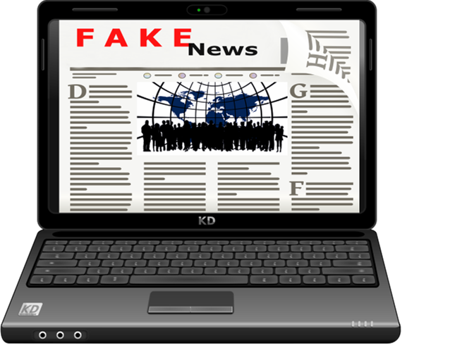
Definitions of „fake news”
The phrase "fake news", so used in recent years, has caused a lot of controversy, especially because it is very unclear.
Due to the lack of precision, the term "fake news" has often been used by politicians to discredit critical but well-documented news, with labels alleging lies
"Does fake news only include deliberate misinformation that is disguised as news? What about exaggerated or biased stories? What about misleading satirical or even fictional media articles that are meant to entertain but mislead consumers?” (Dalkir, Katz, 2020, xxiv)
Photo source: Articulate
Defintions

Slide 9
„Fake news”, word of the year 2017
Collins Dictionary named “fake news” the word of the year 2017 in response to the increase in its use in the Collins corpus of English by 365% compared to the previous year.
According to the Collins Dictionary, "fake news" can be defined as "false information, often sensational, broadcast under the guise of news.“
In 2019, the term "fake news" was introduced in the Oxford Dictionary and is defined as: “False reports of events, written and read on websites“.
*Source: https://www.collinsdictionary.com/dictionary/english/fake-news ** Source: https://www.oxfordlearnersdictionaries.com/definition/english/fake-news?q=fake+news
Defintions

Slide 10
Fabricated content is spread in all fields
Justin McBrayer (2021, p. 4) defines “fake news” as: “misleading information (mis-information). Intentionally false stories are certainly included in the category of misinformation, but there are lots of ways to deceive people that don’t requires saying what’s out-and-out false.„
In public discourse, the term "fake news" is associated with the political world but according to Greifeneder et alii (2021) wrote that false news is not limited to politics.
The fabricated content is spread in all fields, and the most exposed are: consumption of goods, health and finances
Defintions

Slide 11
Controlling questions
1. “Fake news” are used also by politicians? True or false?
2. What are the most exposed fields for „fake news?
Sports, economics and arts;
Consumption of goods, health and finances
History, biology and technology
3. „Fake news" can be defined as “False reports of events”? True or false?
*Red highlighted answers are correct

Slide 12
History of „fake news”

Slide 13
“Fake news” from Ancient Rome
“Fake news” became Collins Dictionary’s word of the year in 2017 and since then remained in the headlines, but existed long before the presidential campaign in the US elections
About 2000 years ago, the Roman Republic faced an civil war between Octavian and Mark Anthony to became the new ruler
To get public attention, Octavian launched a ‘fake news’ war against Mark Anthony, claiming his rival was having an affair with Cleopatra, the Egyptian Queen
History of Fake News

Slide 14
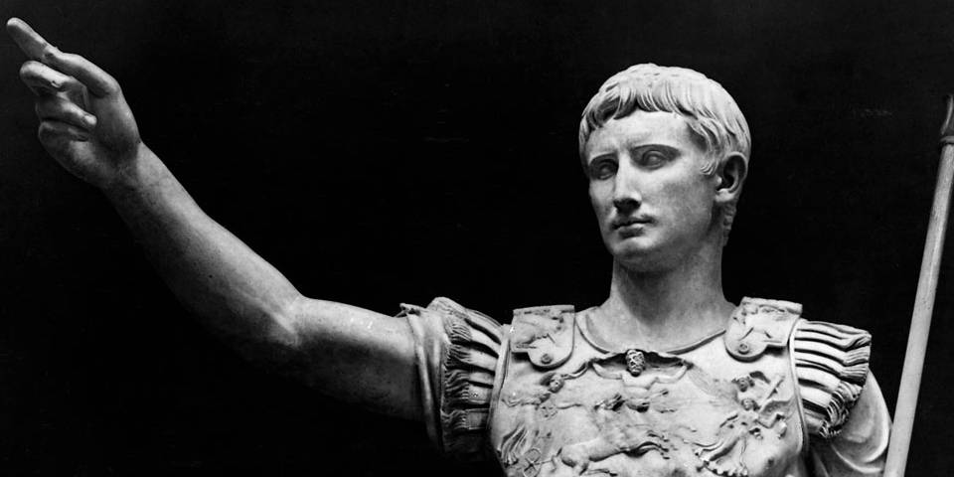
Octavian became the first Emperor of Rome
The message get to public through poetry and slogans printed on coins.
Octavian won and became the first Emperor of Rome, ruling for over 40 years, according to BBC.
Photo source: rome.us
History of Fake News

Slide 15
“Fake news”, used in times of crisis
There are a lot of examples of “fake news” in the history of humanity:
It was used by Nazi propaganda machines for anti-Semitism
In 1800’s in America, racism led to publishing false stories about african americans supposed deficiencies and crimes
In 1917 during First World War, The Times and the Daily Mail run a story claiming that the Germans were extracting fat from the bodies of dead soldiers on both sides of the war to make soap and margarine.
The story came from an official British government department. They knew the story was false, but it helped to create an image in the eyes of the public that Germans were a barbaric enemy.
History of Fake News

Slide 16
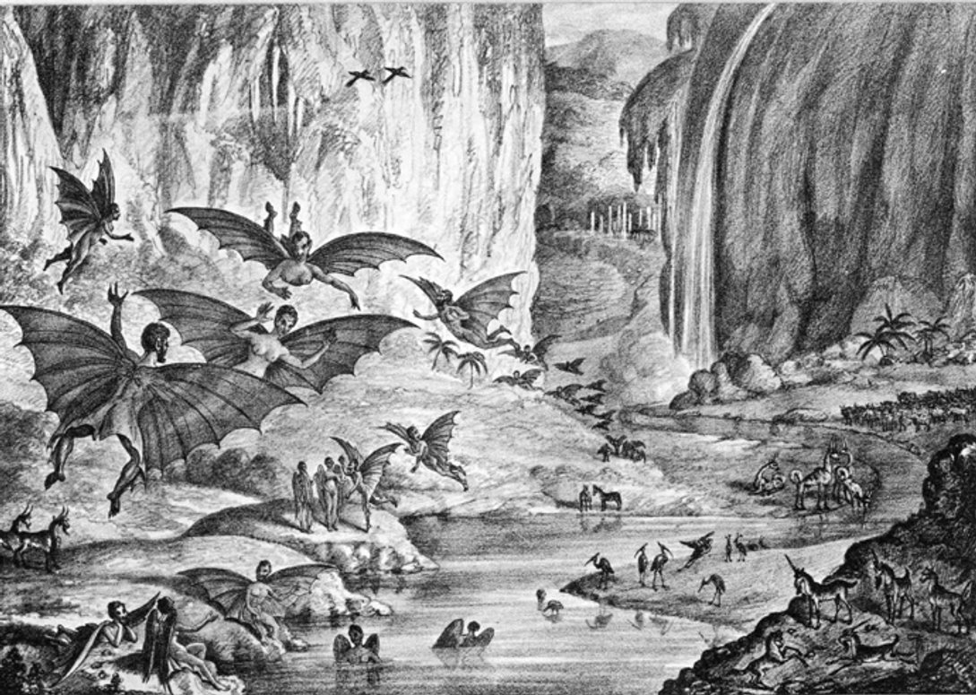
Fake news about civilization on the Moon
In august 25th 1835, The New York Sun, published a series of six articles about the supposed discovery of life on the Moon
The discoveries were attributed falsely to Sir John Herschel, one of the astronomers of the time.
Photo source: http://www.museumofhoaxes.com/images/moonprint2.jpg
History of Fake News

Slide 17
“Fake news” about Russian intervention in Syria
In 2016 a news anchor from Egyptian TV was criticized for presenting incorrect information about Russian intervention in Syria: “Yes, this is the Russian army, this is Putin. Yes, they are countering terrorism, truly countering it. Now you will see a terrifying video, terrifying.”
But, in reality, the footage was from a 5-year-old YouTube clip of a flight simulator video game
Video source: Youtube
History of Fake News

Slide 18
Controlling questions
1. What was the cause of spreading „fake news” stories in 1800’s in America?
War
Racism
Xenophobia
2. When was documented one of the first examples of “fake news”?
4000 years ago
6 years ago
2000 years ago
3. Why was “fake news” used by nazi propaganda machines?
Anti-Semitism
Chauvinism
Anti-Colonialism

Slide 19
Ground zero in fake news – the American elections in 2016

Slide 20
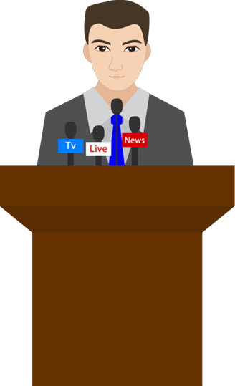
“Fake news“ exploded in popularity in 2016
The "fake news" phenomenon has exploded in popularity during the campaign for the 2016 US presidential elections.
Social media was a fertile ground for spreading the “fake news”, without any barriers to check the content published on the internet.
Facebook was without reaction during the 2016 US presidential elections. False quotes of the candidates, fake news, misinformations were circulating through the network without any barriers.
Photo source: Articulate
Ground zero in fake news

Slide 21
What happened during the American elections?
During the American elections in 2016, fake news stories generated more total engagement on Facebook than top election stories from 19 major news outlets combined, according to Buzzfeed.
During these critical months of the campaign, 20 top-performing false election stories from hoax sites generated 8,711,000 shares, reactions, and comments on Facebook.
The 20 best-performing election stories from 19 major news websites generated a total of 7,367,000 shares, reactions, and comments on Facebook
Ground zero in fake news

Slide 22
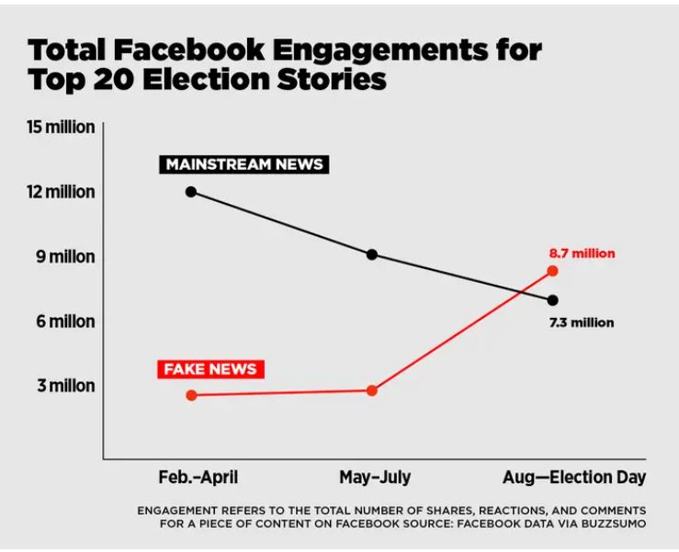
Facebook Engagements for Top 20 elections stories in 2016
Total Facebook Engagements for Top 20 elections stories in 2016 (Source: Buzzfeed)
Source: https://www.buzzfeednews.com/article/craigsilverman/viral-fake-election-news-outperformed-real-news-on-facebook
Ground zero in fake news

Slide 23
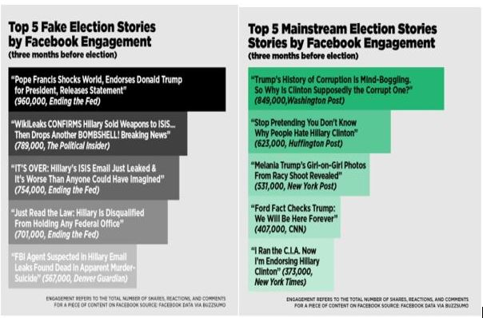
Top 5 “fake” and mainstream stories in elections
Top 5 fake elections stories and top 5 mainstream stories about 2016 American Elections, according to Buzzfeed.
Source: https://www.buzzfeednews.com/article/craigsilverman/viral-fake-election-news-outperformed-real-news-on-facebook
Ground zero in fake news

Slide 24
The aftermath
After 2016 US elections, “fake news” became such a popular term that Collins Dictionary’s choose it word of the year in 2017, after the usage of the term increased with 365% since 2016
Facebook and other social media started a fight to avoid the spread of misinformation after they received heavy criticism:
“Currently, the truth of a piece of content is less important than whether it is shared, liked and monetized. These “engagement” metrics distort the media landscape, allowing clickbait, hyperbole and misinformation to proliferate”, was one of comments in the Guardian about the failure of Facebook during the elections
Ground zero in fake news

Slide 25
The aftermath
Social media started a battle against “fake news” creating new products to stop proliferating false information:
“At Facebook, we're working to fight the spread of false news in three key areas:
disrupting economic incentives because most false news is financially motivated;
building new products to curb the spread of false news; and
helping people make more informed decisions when they encounter false news”, the response of Facebook regarding the work to stop fake news.
Ground zero in fake news

Slide 26
Controlling questions
1. Social media is a fertile ground for spreading the “fake news”? True or false?
2. During de 2016 elections, “Fake news” stories generated more engagement on Facebook than top election stories from major news outlets. True or false?
3. Social media was without reaction against „fake news” during the 2016 US presidential elections. True or false?

Slide 27
Dangers of fake news

Slide 28
Dangers of “fake news”
Some examples of “fake news” can be unharmful and fun, like the satire or parody, but others can be malicious and even dangerous for readers
“Fake news” is created to change people’s beliefs and perceptions and can change their behavior
Example: You read a “fake news” about weather. You don’t take the umbrella because you read that it will be a sunny day and ultimately you get wet. Imagine that at another scale: a “fake” financial or banking advice that can to a lot of harm
Dangers of ”fake news”

Slide 29
Dangers of “fake news”
If you believe “fake news”, someone else drives the beliefs and decisions, and in some countries there can be legal consequences to spreading false news
Studies have shown that a lot of Americans cannot tell the difference between what news is fake and real. This can create confusion regarding important social issues
Misinformation and disinformation can also pose cyber security concerns. “Fake news” can be entry points for hackers to steal information
Dangers of ”fake news”

Slide 30
Dangers of “fake news”
There are many “fake news” related to medical treatments and major diseases like cancer. Trusting false stories coud lead to decisions that are harmful for health
According to a Pew Research Center, “fake news” it’s not just making people believe, but it’s also making them less likely to consume or accept information.
“Fake news” can intensify conflict and suppress conversation about social issues. Some governments use “fake news” to keep citizens happy and distract them from important social issues.
Dangers of ”fake news”

Slide 31
Controlling questions
1. Which of the following is a non-harmful example of „fake news”?
Satire
Fabricated content
False connection
2. “Fake news” can be entry points for hackers. True or false?
3. Why some governments use to spread „fake news”?
To intentionally deceive people
To distract them from important social issues
To have a financial benefit

Slide 32
Highlights
Definition of „fake news”: "false information, often sensational, broadcast under the guise of news.“ (Collins Dictionary)
“Fake news” is not a new concept. It has been around for over 2000 years and has been used ever since
The "fake news" phenomenon has exploded in popularity during the campaign for the 2016 US presidential elections
After 2016 elections, social media started a battle against “fake news”, creating new products to stop proliferating false information
There are a lot of dangers hidden in “fake news”. Digital literacy and critical thinking are two abilities that users should possess to avoid being misinformed
Highlights

Slide 33
Bibliography, referred works
Dalkir, Kimiz, Katz, Rebecca. (2020). Navigating Fake News, Alternative Facts, and Misinformation in a Post-Truth World, IGI Global
McBrayer J. (2021). Beyond Fake News, Routledge, New York
Greifeneder R., Jaffé, M.E., Newman, E.J. , Schwarz N., (2021). The Psychology of fake news, Routledge
Barclay, Donald A. (2018). Fake News, Propaganda, and Plain Old Lies, The Rowman & Littlefield Publishing Group, London

Slide 34
Online resources
Austin Community College, Fake News and Alternative Facts: Finding Accurate News: Why is Fake News Harmful? https://researchguides.austincc.edu/c.php?g=612891&p=4258046
BBC, A brief history of fake news, https://www.bbc.co.uk/bitesize/articles/zwcgn9q
BBC: https://www.bbc.co.uk/bitesize/articles/zwcgn9q
Buzzfeed: https://www.buzzfeednews.com/article/craigsilverman/viral-fake-election-news-outperformed-real-news-on-facebook#.lkOvJO6p0
Center for Information Technology & Society, The Danger of Fake News in Inflaming or Suppressing Social Conflict. https://www.cits.ucsb.edu/fake-news/danger-social
Collins dictionary: https://www.collinsdictionary.com/dictionary/english/fake-news
Domonoske, C. (2016). Students Have 'Dismaying' Inability To Tell Fake News From Real, Study Finds. NPR. https://www.npr.org/sections/thetwo-way/2016/11/23/503129818/study-finds-students-have-dismaying-inability-to-tell-fake-news-from-real?t=1639226889532
Graham, D. A. (2019). Some Real News About Fake News. The Atlantic. https://www.theatlantic.com/ideas/archive/2019/06/fake-news-republicans-democrats/591211/
Meta for Media, Working to Stop Misinformation and False News. https://www.facebook.com/formedia/blog/working-to-stop-misinformation-and-false-news

Slide 35
Online resources
O'Grady, S. (2015). Game Over, Man: How an Egyptian TV Host Got Pwned by a 5-Year-Old Video Game Clip. Foreign Policy. https://foreignpolicy.com/2015/10/12/game-over-man-how-an-egyptian-tv-host-got-pwned-by-a-5-year-old-video-game-clip/
Oxford dictionary: https://www.oxfordlearnersdictionaries.com/definition/english/fake-news?q=fake+news
PeoplesBank. (2021). The Dangers of Fake News. https://www.peoplesbanknet.com/the-dangers-of-fake-news/
Silverman, C. (2016). This Analysis Shows How Viral Fake Election News Stories Outperformed Real News On Facebook, https://www.buzzfeednews.com/article/craigsilverman/viral-fake-election-news-outperformed-real-news-on-facebook#.lkOvJO6p0
Solon, O. (2016) Facebook’s failure: did fake news and polarized politics get Trump elected? The Guardian. https://www.theguardian.com/technology/2016/nov/10/facebook-fake-news-election-conspiracy-theories
The Guardian, 2015, First world war 'corpse factory' propaganda reveale. https://www.theguardian.com/world/2015/oct/26/first-world-war-propaganda-corpse-factory-1925
www.quotemaster.org

Slide 36
Sources of Photos
Illustration pictures:
Articulate Content Library 360
Unsplash:
All photos published on Unsplash can be used for free. You can use them for commercian and non-commercial purposes.
https://unsplash.com/license
Pixabay:
CCO 1.0 Universal (CC0 1.0) Public Domain Dedication
http://www.pixabay.com
Notes:
See other sources in the notes

Slide 37
Sources of Photos
Freepik: https://www.freepik.com/
Pexels: All photos on Pexels can be used for free. https://www.pexels.com
Microsoft Powerpoint Stock Photos

Slide 38
Other Sources of Photos/Printscreens
rome.us
www.quotemaster.org
https://www.buzzfeednews.com/article/craigsilverman/viral-fake-election-news-outperformed-real-news-on-facebook
https://foreignpolicy.com/2015/10/12/game-over-man-how-an-egyptian-tv-host-got-pwned-by-a-5-year-old-video-game-clip/
http://www.museumofhoaxes.com/images/moonprint2.jpg

Slide 39
Where you can find us
newsreel.pte.hu
newsreel@pte.hu
thenewsreelproject
@thenewsreelproject @newsreelproject
The project was funded by the European Commission. The views expressed in this publication do not necessarily reflect those of the European Commission.

