Slide 1
JOURNALISM FOR VOICE-ACTIVATED ASSISTANTS AND DEVICES
Funded by the Erasmus+ Programme of the European Union
New Teaching Fields for the Next Generation of Journalists 2020-1-HU01-KA203-078824

Slide 2
Lesson1 - Brief history of voice-activated devices and assistants

Slide 3
The Course
Journalism for voice-activated assistants and devices
Lesson 1 - Brief history of voice-activated devices and assistants
Lesson 2 - Voice-activated devices and assistants and their use in media and journalism
Lesson 3 - Languages and limitations to produce and search contents for voice-activated devices and assistants
Lesson 4 - State of the art of voice-activate devices and assistants

Slide 4
About the authors
Miguel Crespo is a journalist, editorial consultant, and researcher at MediaLab_ISCTE -University Institute of Lisbon, and OberCom – Portuguese Media Observatory. Lecturer at ISCTE and European University Lisbon, and trainer at ETIC Creative School and Cenjor – Portuguese Journalists Training Center. PhD student in Communication Sciences and Master’s in Communication, Culture, and Information Technologies.
Ana Pinto-Martinho is a journalist and researcher at MediaLab_ISCTE -University Institute of Lisbon of ISCTE-IUL and Obercom – Portuguese Media Observatory. Lecturer at ISCTE-IUL, where she is the executive coordinator of the post-graduation programme in Journalism. She is currently working on her PhD, has a Master’s degree in Communication, Culture and Information Technologies and a Bachelor's Degree in Communication Sciences.
Wanessa Andrade is a journalist for 14 years, 10 of them for the largest communication company in Latin America, TV Globo, where she was a reporter, anchor and editor. Nominated for the News and Documentary Emmy Awards. Trainer in communication, storytelling strategies for social media and video recording and editing techniques. Master's in Internet Studies (ISCTE-IUL).

Slide 5
What we are going to discuss
Brief history of voice-activate devices and assistants
Discussion focused on present and future uses:
How to translate theoretical insights into journalistic practice and vice versa

Slide 6
What are they

Slide 7
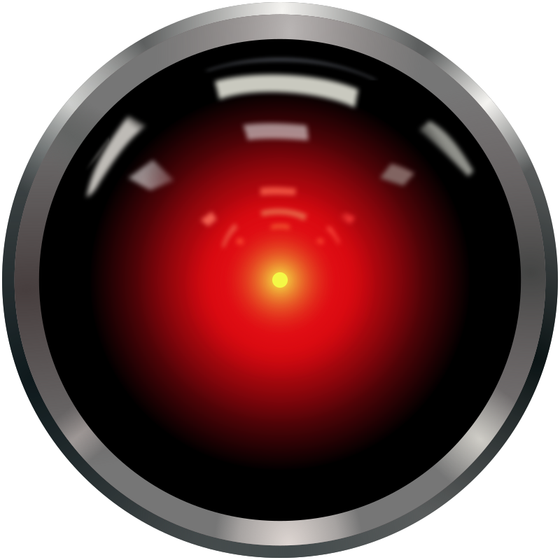
“People have wanted to talk to computers almost from the moment the first computer was invented.
Science fiction is full of computers that can hold a conversation, from HAL 9000 and the Starship Enterprise’s computer to Marvin the Paranoid Android and KITT the car.” (Matthew, 2018)
Notes:
Credits: Cryteria (CC BY 3.0)
Caption: HAL 9000 “eye”

Slide 8
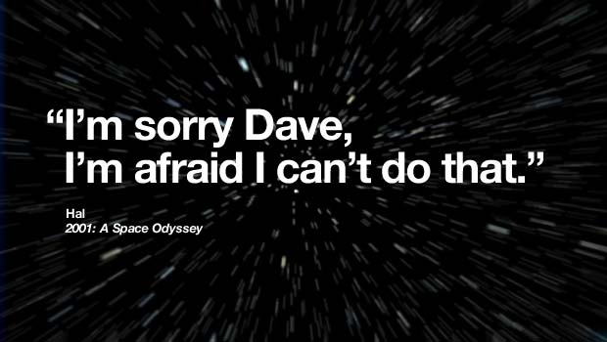
HAL 9000, from the movie “2001: A Space Odyssey” (1968, directed by Stanley Kubrick and based on Arthur C. Clarke’s novel) is probably the first famous voice assistant, even if it is not very helpful…
You can view this clip to have an idea: https://www.youtube.com/watch?v=Wy4EfdnMZ5g
Notes:
Credits: IBM
Caption: (spoiler alert) In the 1968 film 2001: A Space Odyssey, an American spaceship is on a mission to Jupiter. On the ship, a HAL 9000 computer runs most of the operations. Hal, as the computer is referred to, does not only understand and speak human language, but also can read lips and express emotions. When faced with being disconnected, Hal reacts by killing most of the crew.

Slide 9
The starship Enterprise’s computer from the original “Star Trek Series” (1966) and its voice interface is surprisingly similar to the ones we actually have today.
You can view this clip of Captain Kirk performing a voice search to have an idea: https://www.youtube.com/watch?v=1ZXugicgn6U

Slide 10
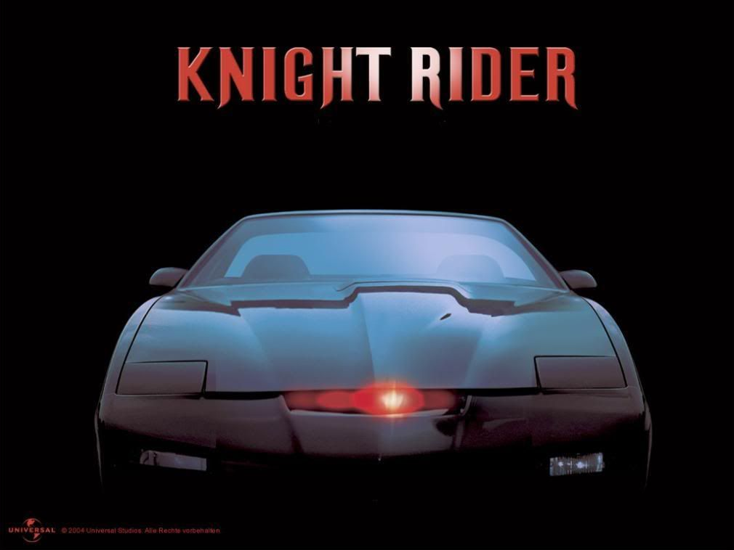
When Michael Knight (David Hasselhoff’s character) asked for the help of KITT, his smart car in the “Knight Rider” TV series (1982), the car responded and acted as requested. As we expect in most cars we can buy today!
You can view this clip, when KITT speaks for the fist time (from 2m45s) to have an idea: https://www.youtube.com/watch?v=dANY3uk7lxc
Notes:
Image – Credits: Universal/NBC Classics

Slide 11
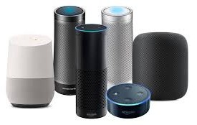
Today, voice assistants are not sci-fi but real software agents that can interpret human speech and respond via synthesized voices.
Apple’s Siri, Amazon’s Alexa, Microsoft’s Cortana, and Google’s Assistant are the most popular voice assistants and are embedded in smartphones or dedicated home speakers, like the ones in the image.
Notes:
Image Credits: created by the authors
Caption: Apple’s Homepod, Amazon’s Alexa, and Google’s Home ranges are the most popular voice-activated devices you can have at home

Slide 12
Users can ask their assistants questions (search), control home automation devices and media playback via voice, and manage other basic tasks such as email, to-do lists, and calendars with verbal commands.
Notes:
Image Credits: created by the authors
Caption: Apple’s Homepod, Amazon’s Alexa, and Google’s Home ranges are the most popular voice-activated devices you can have at home

Slide 13
“Smart voice assistants have become popular thanks largely to their default naturalistic female voices and helpful personae.” (Humphry & Chester, 2020)
The authors even argue we can trace changes in robot voices in popular culture and explain how this history influenced the voice design of smart voice assistants.
This happened because designers of devices like the Google Home and Amazon Echo inherited a cultural imaginary of alien and dangerous robots with artificial voices and personalities.
Notes:
Image Credits: created by the authors
Caption: Apple’s Homepod, Amazon’s Alexa, and Google’s Home ranges are the most popular voice-activated devices you can have at home

Slide 14
These devices rely on a software agent, sometimes called intelligent virtual assistant (IVA) or intelligent personal assistant (IPA), that can perform tasks or services for an individual based on commands or questions.
Maybe you already eared the term "chatbot“, used to refer to virtual assistants generally or specifically accessed by online chat, but here we are speaking about much more:
These virtual assistants are able to interpret human speech and respond via synthesized voices.
Notes:
Image Credits: created by the authors
Caption: Apple’s Homepod, Amazon’s Alexa, and Google’s Home ranges are the most popular voice-activated devices you can have at home

Slide 15
Controlling Questions

Slide 16
Controlling questions
The first time we saw a voice interface surprisingly similar to the ones we actually have today was in:
(select the correct answer):
Knight Rider
Star Trek
2001: a Space Odissey
Monthy Python’s Flying Circus
(correct answer in RED)

Slide 17
Controlling questions
Today, voice assistants are real software agents that can: (select the correct answer):
interpret human speech and respond via text
interpret human text and respond via synthesized voices
interpret human speech and respond via synthesized voices
interpret human text and respond via text
(correct answer in RED)

Slide 18
Some history

Slide 19
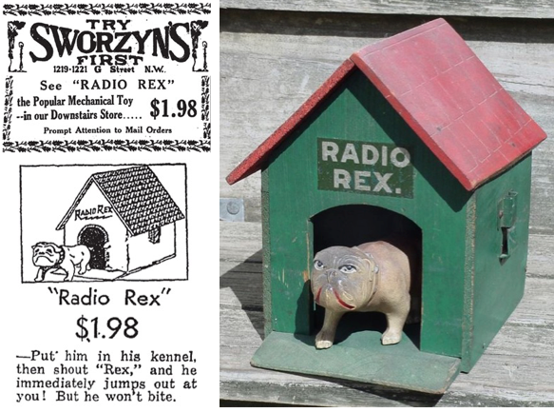
You might be surprised, but the first voice activated device was launched in… 1922!
Radio Rex was a wooden toy in the shape of a dog that would come out of its house when its name is called… even if it had no real voice recognition.
You can view this clip (the only available) to have an idea how it worked:
https://www.youtube.com/watch?v=AdUi_St-BdM
Notes:
Image – Credits: ctinventor.wordpress.com

Slide 20
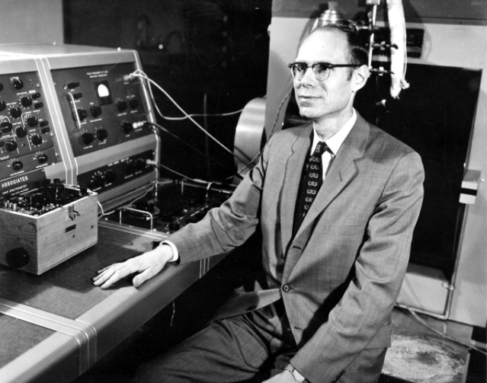
Audrey is considered de the first-ever voice recognition machine.
Audrey (which stood for “automatic digit recognizer”) was built in the 1950’s by Bell Labs. It recognized the numbers from 0 to 9 with 90% accuracy.
Audrey was pretty big, as every electronics at the time:
it’s relay rack alone was almost 2 meters tall
it needed substantial power to run
had streams of cables
But it worked! It recognized ten digits… but only in the voice of its creator
Notes:
Credits: free use

Slide 21
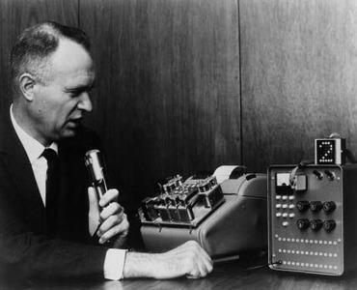
Another early tool which was enabled to perform digital speech recognition was the IBM Shoebox voice-activated calculator, presented to the general public during the 1962 Seattle World's Fair.
This early computer, developed almost 20 years before the introduction of the first IBM Personal Computer in 1981, was able to recognize 16 spoken words and the digits 0 to 9.
Notes:
Credits: IBM Archives (https://www.ibm.com/ibm/history/exhibits/specialprod1/specialprod1_7.html)
Caption: Dr. E. A. Quade, manager of the advanced technology group in IBM's Advanced Systems Development Laboratory in San Jose, Calif., demonstrates Shoebox, an experimental machine that performed arithmetic on voice command

Slide 22
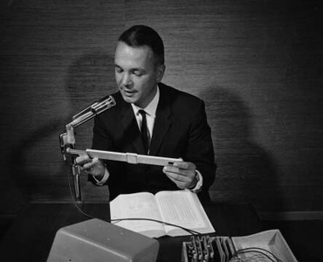
When a number and command words such as "plus," "minus" and "total" were spoken, Shoebox instructed an adding machine to calculate and print answers to simple arithmetic problems.
Shoebox was operated by speaking into a microphone, which converted voice sounds into electrical impulses.
You can view this promotion IBM clip to have an idea how it worked:
https://mediacenter.ibm.com/media/(1961)+Shoebox+-+IBM+Archives+(78-013)/0_4m2ynnkk
https://www.youtube.com/watch?v=gQqCCzrS5_I
Notes:
Image – Credits: IBM Archives (https://www.ibm.com/ibm/history/exhibits/specialprod1/specialprod1_7.html)
Caption - IBM engineer William C. Dersch, shown above in 1961, demonstrates Shoebox, an experimental machine that performed arithmetic on voice command.
NOTE: to embed use the youtube, but the IBM link has much better video quality

Slide 23
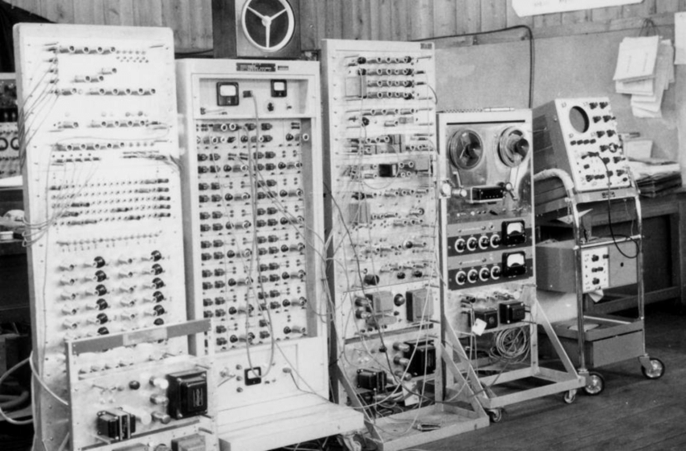
Still in the 1960's, Japanese scientists presented their own devices that could recognize:
Vowels (Radio Research Lab, Tokyo)
Phonemes (Kyoto University): it could understand one hundred Japanese monosyllables
Spoken digits (NEC Laboratories): it recognized results of 99.7% out of 1000 utterances pronounced by 20 male speakers
Notes:
Source: Radio Research Lab
Caption: The vowel recognizer built by Suzuki and Nakata at the Radio Research Lab, Tokyo

Slide 24
The first natural language processing computer program similar to a chatbot was ELIZA, developed by MIT professor Joseph Weizenbaum in the 1960s. It was created to "demonstrate that the communication between man and machine was superficial".
ELIZA used pattern matching and substitution methodology into scripted responses to simulate conversation, which gave an illusion of understanding on the part of the program.

Slide 25
The next milestone in the development of voice recognition technology was achieved in the 1970s at the Carnegie Mellon University in Pittsburgh, Pennsylvania. It was the result of the thesis in Philosophy from Bruce T. Lowerre.
The research had substantial support of the United States Department of Defense and its DARPA agency, which funded five years of a Speech Understanding Research program, aiming to reach a minimum vocabulary of 1,000 words.
Companies and academia including IBM, Carnegie Mellon University (CMU) and Stanford Research Institute took part in the program.

Slide 26
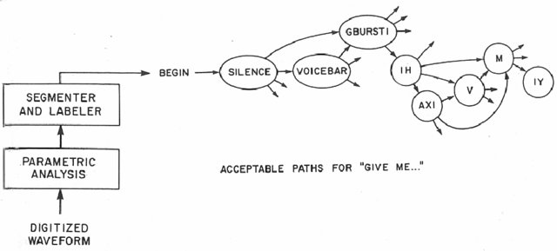
The result was Harpy: it mastered about 1,000 words, the vocabulary of a three-year-old, and it could understand sentences.
It could process speech that followed pre-programmed vocabulary, pronunciation, and grammar structures to determine which sequences of words made sense together, and thus reducing speech recognition errors.
If you want to read the official report from 1976, you can read the thesis summary here: https://stacks.stanford.edu/file/druid:rq916rn6924/rq916rn6924.pdf
Notes:
Image – Credits: Lowerre, B.T. thesis (1976)
Caption: A block diagram of the CMU Harpy system. It is also shown a small fragment of the state transition network for sentence beginning with “Give me…”

Slide 27
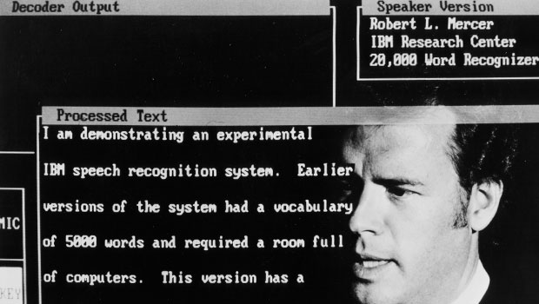
By 1986, the Speech Recognition Group at IBM Research in Yorktown Heights has developed a real-time, isolated-utterance speech recognizer for natural language based on the IBM Personal Computer AT and IBM Signal Processors.
The system Tangora enhanced the vocabulary from 5,000 words to 20,000 words and, by the addition of a speech workstation, supported usability studies on document creation by voice.
The system supports spelling and interactive personalization to augment the vocabularies.
If you want to read the paper (Averbuch et al, 1987) describing the implementation, user interface, and comparative performance of the recognizer, you can find it here: https://stacks.stanford.edu/file/druid:rq916rn6924/rq916rn6924.pdf
Notes:
Image – Credits: IBM
Caption: With Tangora (1986) the IBM speech recognition system went from a vocabulary of 5000 words stored on a room full of computers to a 20,000 word vocabulary stored in a single IBM personal computer

Slide 28
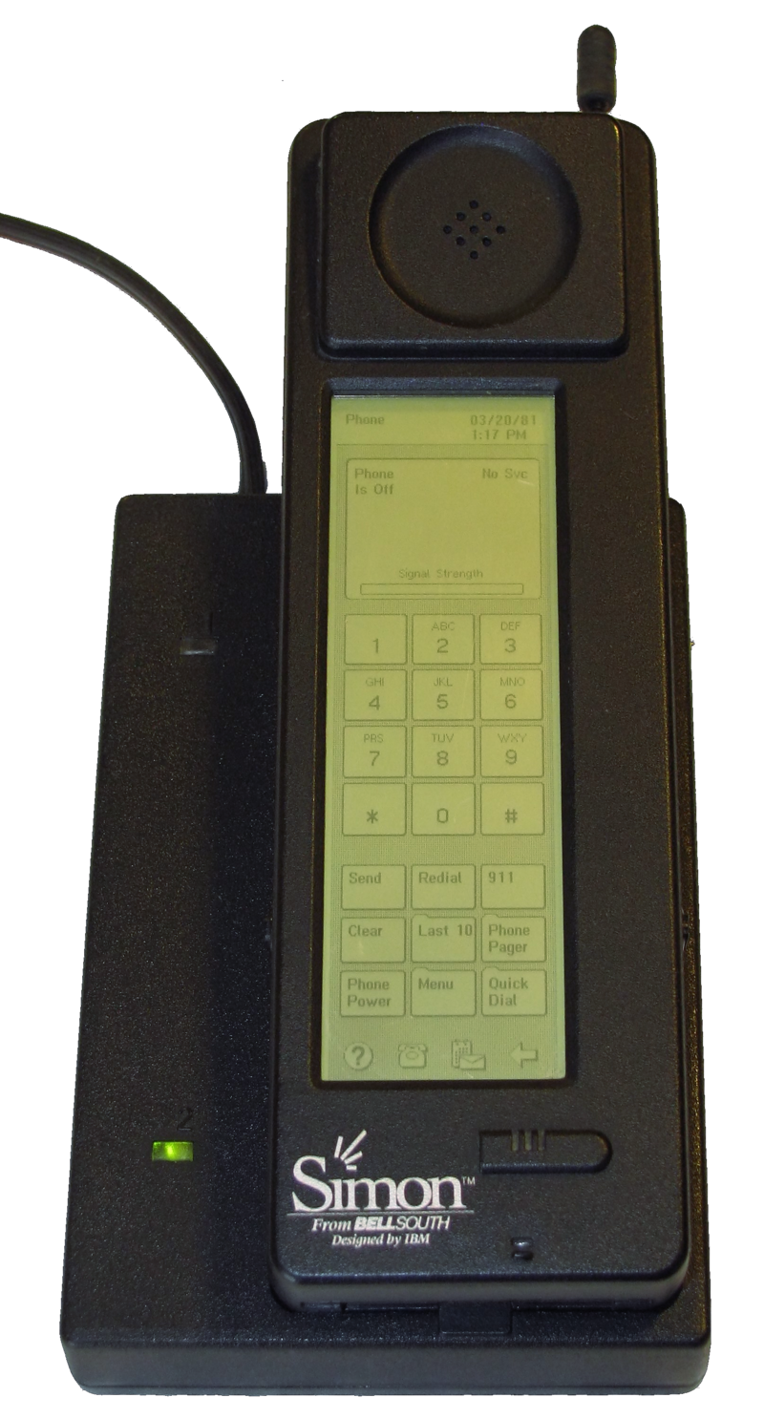
In the 1990s, digital speech recognition technology became a feature of the personal computer with IBM, Philips and Lernout & Hauspie fighting for customers. The market launch of the first smartphone (IBM Simon in 1994) with touchscreen laid the foundation for smart virtual assistants as we know them today.
In 1997, Dragon's Naturally Speaking software could recognize and transcribe natural human speech without pauses between each word into a document at a rate of 100 words per minute. You can see the news of the launch here (https://www.youtube.com/watch?v=eV5qEPIG5is&t=26s) and how it worked then here (https://secureservercdn.net/160.153.138.249/23i.2de.myftpupload.com/wp-content/uploads/2020/11/dragon-dictate.mov)
A version of Dragon is still available for download HERE and it is still used today (free trial for IOS and Android).
Notes:
Image – Credits: Public domain
Caption: The 1994 IBM Simon Personal Communicator and charging base

Slide 29
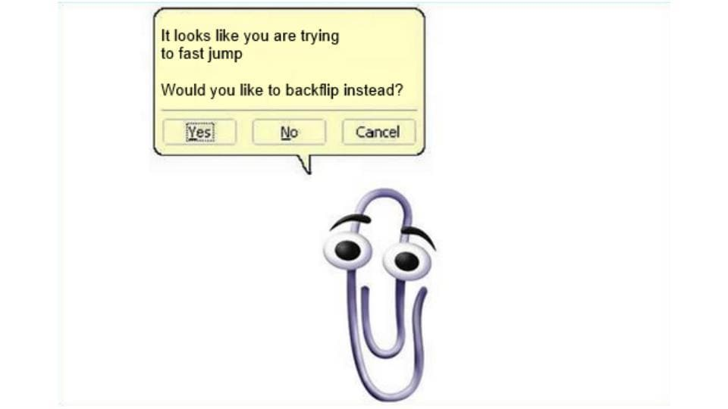
In 1996, Microsoft introduced Clippy (many remembers the annoying paperclip) which showed how natural language in text could be tracked and interpreted on the basis to provide guidance and suggestions.
Being one of the earlier examples of a voice assistant, through Microsoft’s Speech Recognition Engine, Clippy allowed speech inputs and could be used to help find answers to problems.
Although discontinued, one of the most important lessons from Clippy was virtual assistants should only come forward when called for rather than annoy you constantly.
Notes:
Image – Credits: Microsoft
Caption: Clippy and their “cousins” (including the dog Rocky, the cat Links, and Merlin, the magician) failed, mostly because they where always sugesting help, even if you don’t need it

Slide 30
The first modern digital virtual assistant installed on a smartphone was Siri, which was introduced as a feature of the iPhone 4S on 4 October 2011.
Apple developed the assistant following the 2010 acquisition of Siri, a spin-off of SRI International, which is a research institute financed by DARPA and the US Department of Defense (again).
The aim of Siri was to aid in tasks such as sending a text message, making phone calls, checking the weather or setting up an alarm. Over time, it has developed to provide restaurant recommendations, search the internet, and provide driving directions.
In November 2014, Amazon announced Alexa voice assistant alongside the Echo device. In April 2017 Amazon released a service for building conversational interfaces for any type of virtual assistant or interface.

Slide 31
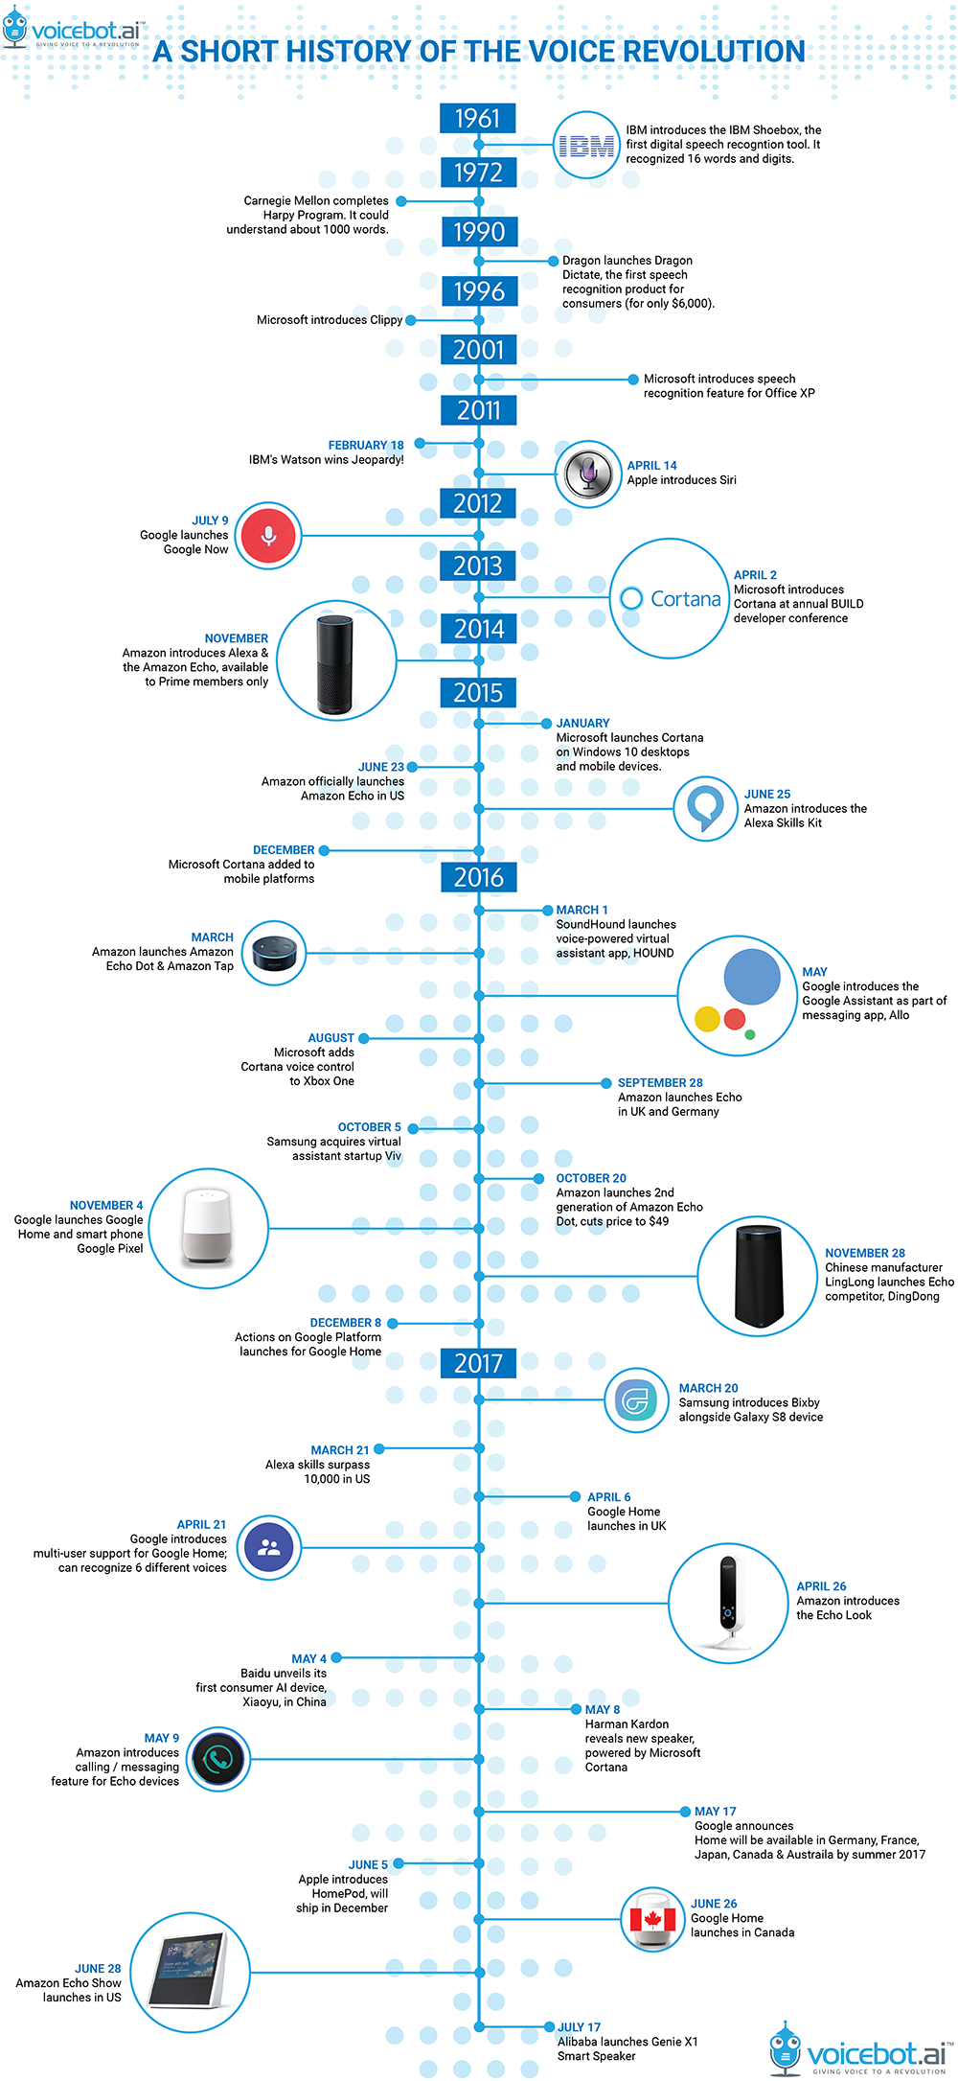
To finish, you can go through a timeline produced by Voicebot.ai here: https://voicebot.ai/2017/07/14/timeline-voice-assistants-short-history-voice-revolution/)
or download it her: http://46ba123xc93a357lc11tqhds-wpengine.netdna-ssl.com/wp-content/uploads/2017/07/voicebot-history-voice-assistants.pdf
Notes:
Source: Voicebot.ai

Slide 32
Food for thought
So, before going on to the current state of the art, this is the first time to question (yourself) on present and future uses for voice-activated devices, especially on how to translate theoretical insights into journalistic practice and vice versa.
And the first challenge is:
Think about three interactions you do every day (searching something, consulting any newsmedia, go through social media, etc.) and how you imagine to do it using ONLY voice interactions.
Write it somewhere.
We will go back to these during this course.

Slide 33
Controlling Questions

Slide 34
Controlling questions
The first real tool to perform digital speech recognition was: (select the correct answer):
A wooden dog
An IBM Personal Computer
An automatic digit recognizer
A calculator
Apple’s Siri
(correct answer in RED)

Slide 35
Controlling questions
What was the name of the first Microsoft’s Speech Recognition Engine? (select the right answer)
Chirpy
Myppy
Clippy
(correct answer is in RED)

Slide 36
Controlling questions
Which was the first modern digital virtual assistant installed on a smartphone? (select the correct answer)
Alexis
Siri
Cortana
Bixbi
(correct answer is in RED)

Slide 37
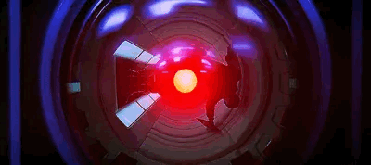
Voice-activated devices and assistants and their use in media and journalism Be aware Journalism for voice-activated assistants and devices
Notes:
Source: In media res (https://maekar76.tumblr.com/post/655293530543095808/hal-9000-2001-a-space-odyssey)

Slide 38
Bibliography, referred works
Averbuch et al., (1987) Experiments with the Tangora 20,000 word speech recognizer, ICASSP '87. IEEE International Conference on Acoustics, Speech, and Signal Processing, 1987, pp. 701-704, doi: 10.1109/ICASSP.1987.1169870
CDEI (2019), Smart Speakers and Voice Assistants, Available at https://assets.publishing.service.gov.uk/government/uploads/system/uploads/attachment_data/file/831180/Snapshot_Paper_-_Smart_Speakers_and_Voice_Assistants.pdf
Chung, H., Iorga, M., Voas, J., & Lee, S. (2017), Alexa, can I trust you?, Computer, 50(9), 100-104
Humphry, J., & Chesher, C. (2020). Preparing for smart voice assistants: Cultural histories and media innovations. New Media & Society, 23(7), 1971–1988. doi:10.1177/1461444820923679
Lowerre, B.T. (1976) The HARPY Speech Recognition System, PhD thesis, Carnegie-Mellon University, Pitsburg, USA. Avaliable (summary) at https://stacks.stanford.edu/file/druid:rq916rn6924/rq916rn6924.pdf
Matthew B. Hoy (2018) Alexa, Siri, Cortana, and More: An Introduction to Voice Assistants, Medical Reference Services Quarterly, 37:1, 81-88, DOI: 10.1080/02763869.2018.1404391
Pieraccini, R. (2012) The Voice in the Machine: Building Computers That Understand Speech, MIT Press
Sergeeva, T. (2019) The gender history of voice assistants and their influence on users. Nauka.me, Issue 2, DOI: 10.18254/S241328880006338-5

Slide 39
Sources of Photos
Illustration pictures:
Articulate Content Library 360
Unsplash:
All photos published on Unsplash can be used for free. You can use them for commercian and non-commercial purposes.
https://unsplash.com/license
Pixabay:
CCO 1.0 Universal (CC0 1.0) Public Domain Dedication
http://www.pixabay.com
Notes:
See other sources in the notes

Slide 40
Sources of Photos
Freepik: https://www.freepik.com/
Pexels: All photos on Pexels can be used for free. https://www.pexels.com
Microsoft Powerpoint Stock Photos

Slide 41
Where you can find us
newsreel.pte.hu
newsreel@pte.hu
thenewsreelproject
@thenewsreelproject @newsreelproject
The project was funded by the European Commission. The views expressed in this publication do not necessarily reflect those of the European Commission.

