Slide 1
COVERING MIGRATION
Funded by the Erasmus+ Programme of the European Union
New Teaching Fields for the Next Generation of Journalists 2020-1-HU01-KA203-078824

Slide 2
LESSON2- CONTEXT FACTORS & GEOGRAPHIES OF MIGRATION & FORCED DISPLACEMENT

Slide 3
The Course
Lesson 1 - Terminologies, legal frameworks, actors
Lesson 2 - Context factors & geographies of migration & forced displacement
Lesson 3 - Media coverage of migration & forced displacement
Lesson 4 - The ethics of covering migration & forced displacement

Slide 4
About the author
Fields of Research: media accountability and transparency, public service media, media policy
Dominik Speck is a researcher at the Institute of Journalism and the Erich Brost Institute for International Journalism at TU Dortmund University. He also has several years of experience as a freelance journalist specialized on covering media issues, working mostly for the German trade journal epd medien, and worked as a Visiting Researcher at the European Broadcasting Union (EBU). His teaching includes courses on international journalism with a practical stance.
Fields of Research: journalism education, journalism as a profession, reporting on migration and forced Displacement from a global perspective, global media accountability
Monika Lengauer is a researcher at the Institute of Journalism and the Erich Brost Institute for International Journalism at TU Dortmund University. She has several decades of experience in working in communication, journalism education and media development projects. Together with Susanne Fengler and Anna-Carina Zappe, she is one of the co-editors of the 2021 Unesco Handbook for Journalism Educators Reporting on Migrants and Refugees.
Fields of Research: Comparative journalism studies, Reporting about migration and forced displacement in an international context, media accountability and transparency
Prof. Dr. Susanne Fengler is Professor for International Journalism at the Technical University Dortmund and Scientific Director of the Erich Brost Institute for International Journalism at TU Dortmund University, Germany. She has managed numerous international projects in the fields of journalism research and journalism education in collaboration with the VolkswagenStiftung, the Robert-Bosch-Stiftung, the GermanForeign Office, the EU, and many other sponsors. Her research focuses include media accountability, media and migration and the reporting of foreign affairs. Together with Monika Lengauer and Anna-Carina Zappe, she co-edited “Reporting on Migrants and Refugees: Handbook for Journalism Educators” published by UNESCO.

Slide 5
What we are going to discuss
Context factors that influence the global flows of migration
The difference between push and pull factors of migration
Motives that make people leave their home
The relationship between migration and development
Countries of origin, transit and destination of migrants and refugees

Slide 6
PUSH AND PULL FACTORS

Slide 7
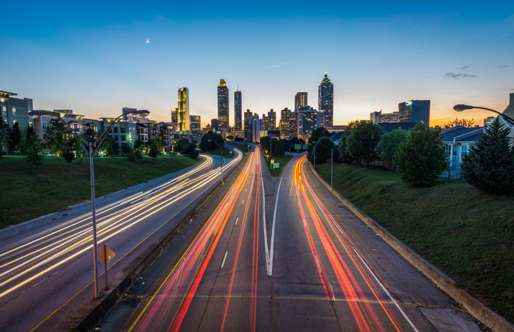
PUSH VS. PULL FACTORS
What are push factors?
Push factors are those conditions, developments, and circumstances which drive people away from their home. Thus, push factors are those drivers of migration connected to their country or region of origin.
What are pull factors?
Pull factors are those conditions, developments, and circumstances which incentivize people to choose specific areas of destination. Thus, pull factors are those drivers of migration connected to the destination.
How do push and pull factors interrelate?
Together, push and pull factors form the context factors of migration, i.e., the conditions, developments, circumstances, reasons and motives for which people decide, or are being forced to, go on the move.
Push and pull factors

Slide 8
WHY DO PEOPLE LEAVE?
People leave their homes for many reasons. In general, we may choose from a variety of contexts which influence global migration flows, including political, economic, sociocultural and environmental factors.
Political factors
Push factors | Pull factors
Conflict, war & violence | Safety and Security
Human rights abuses and/or denial of civil rights | Respect for human & civil rights
Political instability | Political stability
Corruption | Safeguards for good governance
Inadequate public infrastructure or lack of access to public infrastructure (i.e., education, health care, other public services) | Better health care and/or education opportunities
Political support for emigration (i.e., economic importance of labour emigration and diaspora remittances) | (Favourable) migration policy, governance & infrastructure
Source: Author adapted from Urbánski (2022)
Push and pull factors

Slide 9
WHY DO PEOPLE LEAVE?
People leave their homes for many reasons. In general, we may choose from a variety of contexts which influence global migration flows, including political, economic, sociocultural and environmental factors.
Economic factors
Push factors | Pull factors
Poverty / low wages | Prospects for higher wealth & wages
Economic instability | Economic stability / economic growth
Socio-economic inequality | Socio-economic rights and equality
Unemployment | Job opportunities & demand for labour
Source: Author adapted from Urbánski (2022)
Push and pull factors

Slide 10
WHY DO PEOPLE LEAVE?
People leave their homes for many reasons. In general, we may choose from a variety of contexts which influence global migration flows, including political, economic, sociocultural and environmental factors.
Sociocultural factors
Push factors | Pull factors
Religious discrimination | Freedom of religion
Consequences of population growth | Consequences of overaged populations
Family size & structure | Family reunification; migrant communities & cultural ties
Gender-related oppression | Gender equality & LGBTQI* rights
Negative consequences of globalization | Globalization & post(colonialism)
Communication (interpersonal, social networks, mass media) | Communication (interpersonal, social networks, mass media)
Source: Author adapted from Urbánski (2022)
Push and pull factors
Push factors | Pull factors
Climate change | Better geographic conditions and/or resources to mitiage the consequences of climate change
Natural disasters | Less extreme climate conditions / lower exposure to natural hazards

Slide 11
WHY DO PEOPLE LEAVE?
People leave their homes for many reasons. In general, we may choose from a variety of contexts which influence global migration flows, including political, economic, sociocultural and environmental factors.
Environmental factors
Push factors | Pull factors
Climate change | Better geographic conditions and/or resources to mitigate the consequences of climate change
Natural disasters | Less extreme climate conditions / lower exposure to natural hazards
Source: Author adapted from Urbánski (2022)
Push and pull factors

Slide 12
CONTROLLING QUESTIONS
Which of the following drivers of migration is not a push factor?
Principles of religious tolerance
Famine
Oppression of LGBTQI* people
High unemployment
Family reunification
Push and pull factors

Slide 13
CONTROLLING QUESTIONS
Which of the following drivers of migration is not a pull factor?
Freedom of religion
Lack of access to education
High employment rates
Respect of gender-related rights
Better shelter
Push and pull factors

Slide 14
DRIVERS OF MIGRATION: A CLOSER LOOK

Slide 15
MIXED MOTIVES
It is hardly ever a single factor that makes people leave their homes. Rather, a combination of different push and pull factors fits most biographies of migrants and refugees. Therefore, it is often difficult to isolate the role and importance of independent context factors. Drivers of migration may also be located at different levels:
Micro level: Individual (personal) reasons to leave, i.e., marriage, family reunification, seek for employment or an increase of living standards
Meso level: Sociocultural factors, e.g. sense of attachment to a specific community, cultural ties
Macro level: Larger political and economic context of a decision to leave, e.g. climate of oppression and inequality
The multiple context factors that surround migration and forced displacement are also present in the debate on mixed migration.
The International Organization for Migration, IOM, pays tribute to this complex blend of reasons in its definition of drivers of migration:
“Complex set of interlinking factors that influence an individual, family or population group’s decisions relating to migration, including displacement. [...] The concept of “drivers of migration” is dynamic, reflecting an interaction of personal, social, structural, environmental and circumstantial factors working in tandem with local, national, regional and global level incentives and constraints. Drivers influence the decisions to migrate, whether the migration is internal or international, regular or irregular, and/or temporary or permanent; and they operate along a spectrum between voluntary and involuntary movement.” (IOM, 2019, p. 58)
Drivers of migration: A closer look

Slide 16
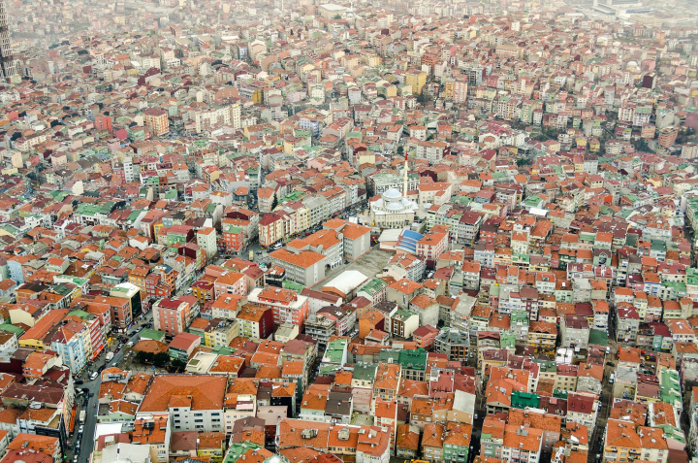
MIGRATION AND DEMOGRAPHY
Demography has been described as the “unstoppable force” related to migration (Dao et al., 2018), with population growth being discussed as a key driver for people leaving their homes.
Population growth and migration
Yet, it has been argued that population growth may not be a push factor in itself, but rather the conditions created when high population density comes along with dire economic situations and political instability, which in turn aggravate the effects of high population density. These conditions include, for example, high unemployment rates, or the high share of young people confronted with only limited access to education. Countries with low fertility rates have sometimes experienced an increase in emigration rates, as argued by De Haas (2010).
Demography as a pull factor
However, demography is not only a push factor, but also a pull factor: Societies with shrinking population or a lack of skilled workers in certain fields deliberately invite migrants to mitigate the effects of population ageing. According to UNDESA (2017, p. 1), “migration has been the primary source of population growth in the developed regions of the world” since the 1990s, and even projected to be its only driver in these regions in the future.
Drivers of migration: A closer look

Slide 17
REMITTANCES
Remittances refer to „when migrants send home part of their earnings in the form of either cash or goods to support their families (...) They have been growing rapidly in the past few years and now represent the largest source of foreign income for many developing economies“ (Ratha, n.d.).
Remittances from migrants abroad are thus a major economic factor for many countries of origin of large emigrant communities. According to IOM, the estimated figure of international remittances stood at USD 702 billion globally in 2020. By contrast, these payments accounted for an estimated USD 128 billion in 2000, demonstrating their increasing importance (IOM, 2022, p. 10). Remittances are thus both a major political and economic push factor for migration: Families seek to improve their economic situation by sending some of their members abroad, national governments encourage labour emigration in the hope of remittances leading to a reduction of poverty and, consequently, an increase of state budgets.
It is important to note that remittance do not only benefit the poorest households: For many middle-class , „they may provide capital for small business and entrepreneurial activities“ (Ratha, n.d.).
Drivers of migration: A closer look

Slide 18
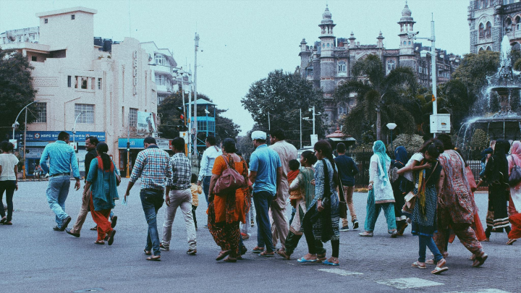
MIGRATION AND DEVELOPMENT
It has often been argued that increasing development cooperation and foreign aid is a way to reduce push factors and, in turn, reduce migration. As policymakers in many Western countries see themselves pressurized to fight the causes of migration, foreign investment in major countries of origin of migrants is praised as a powerful tool.
Research though paints a more ambiguous picture. On the contrary, it has been argued that increased economic development is more likely to increase, rather than reduce, migration. Some studies demonstrated that the number of migrants initially increases alongside economic growth, decreasing only once the country has reached a relatively high Gross Domestic Product (GDP), thus showing a positive correlation between increasing development and increasing migration in the first place.
This effect is known as the „migration hump“, also reflecting the situation that it is typically not the poorest deciding to leave their country, but rather those having acquired the means to migrate. Also, the poorest countries are often not the most common countries of origin of people migrating to developed countries.
Yet, other studies have warned against interpreting a simplified causal relationship between development and increased migration, pointing towards other factors at play that may explain why migration increases or decreases. For a recent study, see Bencek & Schneiderheinze (2020).

Slide 19
Excercise
Please read this report from the Dutch news website De Correspondent about an academic paper contradicting the theory of the „migration hump“ and answer the following tasks:
- Briefly describe the main arguments of the theory of the „migration hump (max. 200 words)
In how far does the article challenge the theory of the „migration hump“? (max. 300 words)
Drivers of migration: A closer look

Slide 20
CONTROLLING QUESTIONS
Which of the following statements are correct?
Demography may be both a push and a pull factor of migration
The “migration hump” describes a correlation between increased development and decreased emigration
Population growth always comes along with greater emigration
High population density coupled with dire economic and political conditions often come along with greater emigration
Remittances represent the largest source of income for many developed countries
Drivers of migration: A closer look

Slide 21
Geographies of migration

Slide 22
COUNTRIES OF ORIGIN, TRANSIT, DESTINATION
According to the Glossary „Asylum and Migration“ of the European Migration Network, the country of origin is defined as „the country of nationality or, for stateless persons, of former habitual residence“ (EMN, 2018, p. 78). However, the term is sometimes also used for the country of residence of a person who goes on the move, regardless of whether it is their country of nationality.
A country of transit is defined as a country through „which a migrant passes in order to enter a country of destination“ (p. 80), with the latter being referred to as the (final) destination of migration flows.
The distinction between countries of transit and countries of destination is not always clear-cut: A migrant might stay in a country of transit for longer periods of time, attending to get an entry visa for or employment within their desired destination, raising questions of whether their country of transit has already become a country of destination itself.
Geographies of migration

Slide 23
MIGRATION FLOWS
The term migration flows is defined by the UN as „the number of migrants entering or leaving a given country during a given period of time, usually one calendar year“. Data on worldwide migration movements are available at Migration Data Portal.
Even though migration is a global phenomenon, most movements involve a limited set of countries.
Again, we may distinguish between migration and forced displacement. According to data from UNHCR (2021) , there were 82.4 million forcibly displaced persons worldwide in 2020, the majority of which were internally displaced people and thus remaining in their countries of origin. Around two thirds of the 26.4 million refugees came from only five countries of origin: Syria (6.7 million refugees), Venezuela (4.0 million), Afghanistan (2.6 million), South Sudan (2.2 million) and Myanmar (1.1 million).
The five largest host countries of refugees were Turkey (3.7 million refugees), Colombia (1.7 million), Pakistan (1.4 million), Uganda (1.4 million), and Germany (1.2 million).
Geographies of migration

Slide 24
MIGRATION FLOWS
Speaking of international migrants, two thirds of all international migrants lived in just 20 countries in 2020, with the USA (51 million), Germany (16 million) and Saudi Arabia (13 million), Russia (12 million) and the United Kingdom (9 million) (IOM, 2022, p. 24).
The example of Russia though illustrates that a country may be both a country of destination and a country of origin of international migrants: It is not only the fourth-largest country of destination, but also the third-largest country of origin, with an emigrant population of about 11 million people in 2020. The largest country of origin is India (18 million people), followed by Mexico (11 million). The fourth most significant international emigrant community comes from China (10 million), followed by the over 8 million Syrians living abroad, most of them refugees (IOM, 2022, p. 25).
Summing up, a country may have a large inflow of migrants and a large outflow at the same time. Other countries, such as Morocco, fulfil the criteria for all three classification of states: There is a great Morrocan emigrant population living in European states such as France. Morocco, on the other hand, is also a major transit land of migrants and refugees from Sub-Saharan Africa on their way to Europe. Finally, Morocco „has since the beginning of the 21st century become a default destination for many sub-Saharan migrants“ itself (El Ghazouani, 2019).
Geographies of migration

Slide 25
PUT IN ORDER
Below you see a list of the top countries of destination of international migrants. Please put these countries in order, with the country with the largest communities of international immigrants at the first place, followed by the country with the second-largest community, and so on.
USA
Germany
Saudi Arabia
Russia
United Kingdom
Geographies of migration

Slide 26
PUT IN ORDER
Below you see a list of the top countries of origin international migrants. Please put these countries in order, with the country with the largest communities of international emigrants at the first place, followed by the country with the second-largest community, and so on.
India
Mexico
Russia
China
Syria
Geographies of migration

Slide 27
CONTROLLING QUESTIONS
Which of the following regions have more migration within their borders than to other parts of the world?
Africa
Asia
Europe
North America
Latin America and the Caribbean
Which of the following characteristics apply to Morocco?
Country of origin
Country of transit
Country of destination
Which of the following world regions receive comparatively few immigrants from other world regions?
Africa
Asia
Europe
North America
Latin America and the Caribbean
Geographies of migration

Slide 28
Bibliography, referred works
Bencek, D., & Schneiderheinze, C. (2020). Higher economic growth in poor countries, lower migration flows to the OECD Revisiting the migration hump with panel data, Kiel Working Paper. Kiel Institute for the World Economy, https://www.ifw-kiel.de/fileadmin/Dateiverwaltung/IfW-Publications/Claas_Schneiderheinze/KWP_2145-revised-Higher_economic_growth_in_poor_countries_lower_migration_flows_to_the_OECD.pdf
Dao T. H., Docquier, F., Maurel, M., & Schaus, P. (2018). Global Migration in the 20th and 21st Centuries: the Unstoppable Force of Demography, FERDI Working paper P223, March 2018. https://ferdi.fr/publications/global-migration-in-the-20th-and-21st-centuries-the-unstoppable-force-of-demography
De Haas, H. (2010). Migration transitions: A theoretical and empirical inquiry into the developmental drivers of international migration, International Migration Institute Working Papers No. 24. https://www.migrationinstitute.org/publications/wp-24-10
El Gahzouani, D. (2019). A Growing Destination for Sub-Saharan Africans, Morocco Wrestles with Immigrant Integration. Migration Policy Institute, 2 July. https://www.migrationpolicy.org/article/growing-destination-sub-saharan-africans-morocco#:~:text=An%20estimated%20700%2C000%20sub-Saharan,and%20access%20to%20social%20services
European Migration Network (EMN) (2018). Asylum and migration. Glossary 6.0: A tool for better comparability produced by the European Migration Network. https://www.bamf.de/SharedDocs/Anlagen/EN/EMN/Glossary/emn-glossary.pdf?__blob=publicationFile&v=6
Fengler, S., & Lengauer, M. (2021). Module 1. Matters of Migrants and Refugees – Challenges of the 21st Century. In Fengler, S., Lengauer, M., & Zappe, A.-C. (eds.). Reporting on Migrants and Refugees. Handbook for Journalism Educators. Paris: UNESCO, 11-28.
International Organization for Migration (IOM) (2019). International Migration Law. Glossary on Migration. https://publications.iom.int/system/files/pdf/iml_34_glossary.pdf
International Organization for Migration (IOM) (2022). World Migration Report 2022. https://publications.iom.int/books/world-migration-report-2022

Slide 29
Bibliography, referred works
Lengauer, M., & Fengler, S. (2021). Module 3. Context Factors for Migration and Forced Displacement. In Fengler, S., Lengauer, M., & Zappe, A.-C. (eds.). Reporting on Migrants and Refugees. Handbook for Journalism Educators. Paris: UNESCO, 53-96.
Migration Data Portal (n.d.). International migration flows. https://www.migrationdataportal.org/themes/international-migration-flows#:~:text=Migration%20flows%20“refer%20to%20the,compile%20statistics%20on%20migration%20flows
Ratha, D. (n.d.) What Are Remittances? International Monetary Fund Finance & Development. https://www.imf.org/external/Pubs/FT/fandd/basics/76-remittances.htm#:~:text=When%20migrants%20send%20home%20part,income%20for%20many%20developing%20economies
United Nations Department of Economic and Social Affairs (UNDESA) (2017). Migration and population change – drivers and impacts. December 2017. https://www.un.org/en/development/desa/population/migration/publications/populationfacts/docs/MigrationPopFacts20178.pdf
UNHCR (2021). Global Trends. Forced Displacement in 2020. Copenhagen: UNCHR Global Data Service. https://www.unhcr.org/flagship-reports/globaltrends/
Urbánski, M. (2022). Comparing Push and Pull Factors Affecting Migration. Economies 10: 21. https://doi.org/10.3390/economies10010021
Vermeulen, M. (2020). A key assumption about migration turns out to be wrong – taking a few of my articles down with it. The Correspondent, 24 July. https://thecorrespondent.com/606/a-key-assumption-about-migration-turns-out-to-be-wrong-taking-a-few-of-my-articles-down-with-it/80227856412-a3e30880#:~:text=The%20reason%3A%20it%20costs%20money,to%20leave%20will%20diminish%20steadily

Slide 30
Sources of Photos
Illustration pictures:
Articulate Content Library 360
Unsplash:
All photos published on Unsplash can be used for free. You can use them for commercian and non-commercial purposes.
https://unsplash.com/license
Pixabay:
CCO 1.0 Universal (CC0 1.0) Public Domain Dedication
http://www.pixabay.com

Slide 31
Sources of Photos
Freepik: https://www.freepik.com/
Pexels: All photos on Pexels can be used for free. https://www.pexels.com
Microsoft Powerpoint Stock Photos

Slide 32
Where you can find us
newsreel.pte.hu
newsreel@pte.hu
thenewsreelproject
@thenewsreelproject @newsreelproject
The project was funded by the European Commission. The views expressed in this publication do not necessarily reflect those of the European Commission.

