Slide 1
COVERING MIGRATION
Funded by the Erasmus+ Programme of the European Union
New Teaching Fields for the Next Generation of Journalists 2020-1-HU01-KA203-078824

Slide 2
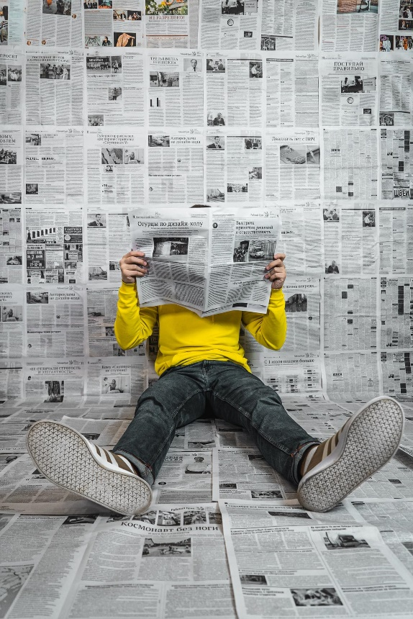
LESSON3 - MEDIA COVERAGE OF MIGRATION & FORCED DISPLACEMENT

Slide 3
The Course
Lesson 1 - Terminologies, legal frameworks, actors
Lesson 2 - Context factors & geographies of migration & forced displacement
Lesson 3 - Media coverage of migration & forced displacement
Lesson 4 - The ethics of covering migration & forced displacement

Slide 4
About the authors
Dominik Speck
Fields of Research: media accountability and transparency, public service media, media policy
Dominik Speck is a researcher at the Institute of Journalism and the Erich Brost Institute for International Journalism at TU Dortmund University. He also has several years of experience as a freelance journalist specialized on covering media issues, working mostly for the German trade journal epd medien, and worked as a Visiting Researcher at the European Broadcasting Union (EBU). His teaching includes courses on international journalism with a practical stance.
Anna-Carina Zappe
Fields of Research: Reporting about migration and forced displacement in an international context, media ethics
Anna-Carina Zappe is a senior researcher at the Institute of Journalism and the Erich Brost Institute for International Journalism (EBI) at TU Dortmund University, Germany, as well as a practicing TV journalist and a Ph.D. cadidate at TU Dortmund University, Germany. As a researcher, she is particularly involved in understanding the roles of journalists – as they report under exceptional circumstances, cover disasters and experience their own traumas. She is committed to increase the quality reporting on migrants and refugees with a focus on sub-Saharan Africa. She is a lecturer in global journalism, ethics and reporting techniques. As a trainer for mid-career journalists, she supervised cross-continental collaborative research and reporting projects. Together with Susanne Fengler and Monika Lengauer, she co-edited “Reporting on Migrants and Refugees: Handbook for Journalism Educators” published by UNESCO.
Susanne Fengler
Fields of Research: Comparative journalism studies, Reporting about migration and forced displacement in an international context, media accountability and transparency
Prof. Dr. Susanne Fengler is Professor for International Journalism at the Technical University Dortmund and Scientific Director of the Erich Brost Institute for International Journalism at TU Dortmund University, Germany. She has managed numerous international projects in the fields of journalism research and journalism education in collaboration with the VolkswagenStiftung, the Robert-Bosch-Stiftung, the GermanForeign Office, the EU, and many other sponsors. Her research focuses include media accountability, media and migration and the reporting of foreign affairs. Together with Monika Lengauer and Anna-Carina Zappe, she co-edited “Reporting on Migrants and Refugees: Handbook for Journalism Educators” published by UNESCO.

Slide 5
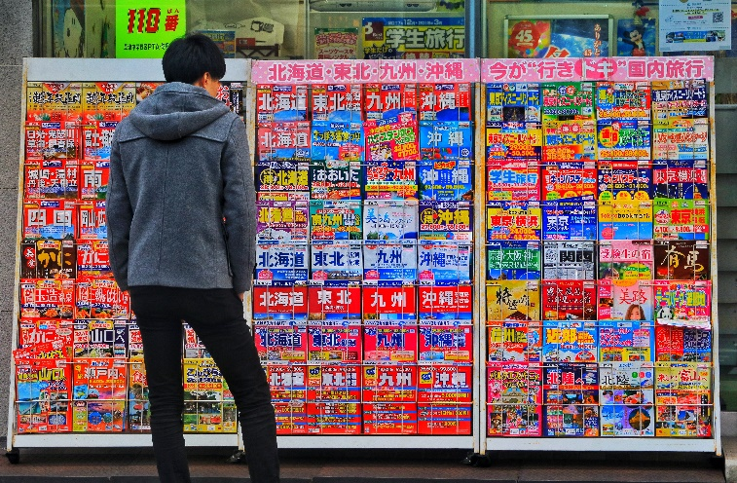
What we are going to discuss
Insights from research analysing the contents of news coverage about migration and forced displacement
The shortcomings and biases that researchers have identified with regard to this coverage
Potential effects of this coverage on public opinion and citizens' attitudes
A discussion of the Alan Kurdi case as a specific turning point of news coverage on forced displacement

Slide 6
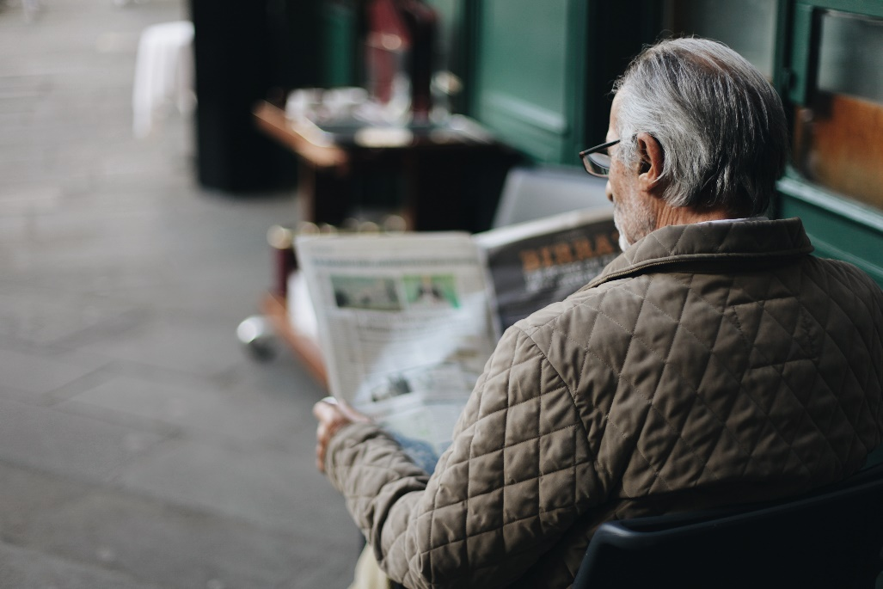
CONTENT OF MEDIA COVERAGE

Slide 7
STUDYING MIGRATION COVERAGE
Why assessing media coverage on migration and forced displacement?
“(i) the media provide a source of information about groups or issues related to migration and diversity; (ii) the media convey or construct particular representations of minorities and immigrants, including negative depictions; and (iii) the media act as a space for the participation of migrants and minorities in a public sphere where they can advance their interests and identities.”
Bleich et al., 2015, p. 859
“To understand public opinion about immigration in Europe, one has to understand the media’s role in it.”
Eberl et al., 2018, p. 207
Content of media coverage

Slide 8
A NEED FOR ENHANCED COVERAGE OF MIGRATION AND FORCED DISPLACEMENT?
According to a Eurobarometer survey from 2017 in all then EU Member States, Europeans are not very satisfied with the extent to which they feel informed about immigration and integration: Less than four in ten perceive themselves as well informed.
„Overall, to what extent do you think that you are well informed about immigration and integration related matters?“ (% - EU level)
Source: European Commission (2018, p. 4.)
Adapted from Fengler, Lengauer, & Zappe (2021)
Content of media coverage

Slide 9
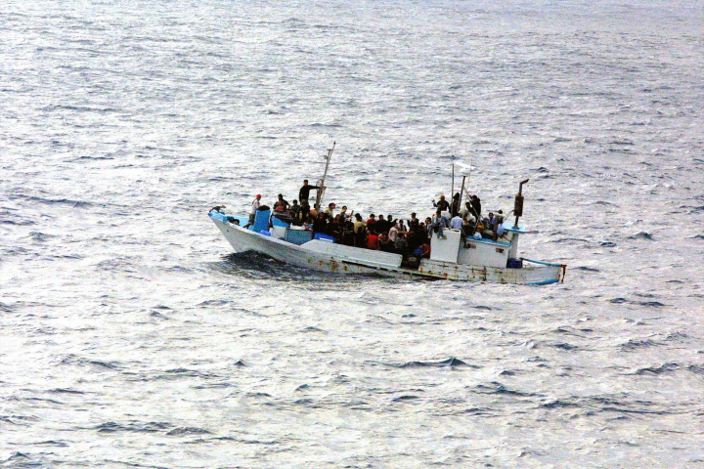
COMMON SHORTCOMINGS
Research has identified a range of shortcomings in the way the news media – on average – deal with covering migrants and refugees. These are some main criticisms:
Negativity
Studies have found that negative frames and narratives of conflict characterize coverage of migrants and refugees in European media. Migrants and refugees are frequently portrayed as a threat to security, spreading terrorism or infectious diseases (Esses et al., 2013). Further, migration is associated with threats to economic prosperity and cultural identity (Caviedes, 2015). According to a study comparing political news coverage in 16 Western democracies, the issue of immigration and integration is the third most negative topic. However, negativity varies between the different groups of migrants and refugees depicted in the news media (Esser et al., 2016). For example, news media often describe intra-EU immigrants more positive than non-EU immigrants.
Representation of migrants and refugees
The use of water-related metaphors (El Refaie, 2001) such as “refugee wave” or “flood of immigrants” may lead to a “dehumanization” of migrants and refugees, associating them with language used to describe natural disasters. Further, journalists tend to describe migrants and refugees as powerless victims (Horsti, 2008), rather than as actors in their own right (Fotopoulos & Kaimaklioti, 2016). Such “victimization” effects are particularly salient during the initial phase of news cycles (Greussing & Boomgaarden, 2017). On the other hand, studies conclude that migrants and refugees are commonly described as criminals, leading to a “victim or perpetrator”-dichotomy (Kroon et al., 2016). Media coverage talks about migrants and refugees rather than with them (Horsti, 2016; Berry et al., 2015). Research has also shown that news media report most frequently about asylum seekers, leading to an over-representation of this specific group (Blinder, 2015), thus neglecting other groups such as labour migrants or international students (Strömbäck et al., 2017). At the same time, content analyses imply that journalists often do not handle the terminologies of migration and forced displacement with care (Fengler & Kreutler, 2020). Refugees with their respective rights under the Geneva Convention, and asylum seekers are confounded with other groups.
Content of media coverage

Slide 10
COMMON SHORTCOMINGS
Lack of contextualization
Studies point towards a lack of contextualization of migration and forced displacement (Chouliaraki & Zaborowski, 2017), such as neglecting the causes and consequences of migration and forced displacement in the countries of origin, or only little reporting about integration efforts. As a general tendency, it seems that political debates and political actors are over-represented within media coverage of migration and forced displacement (Rodríguez-Perez et al., 2022). This may come at the expense of relevant economic, cultural, or historical backgrounds. Further, there seem to be a lack of knowledge about the complex issue of migration among journalists in European and MENA countries about migrants’ countries of origin (ICMPD, 2017).
Focus on events and crises
Media coverage of migration and forced displacement tends to be dominated by day-to-day politics and particular moments of crisis (Fengler et al., 2022) rather than by a constant monitoring and relevant background information audiences would need to assess matters of migrants and refugees. News are driven by particular events rather than by long-term comparisons. In the case of the European “refugee” crisis, a great part of media attention is dedicated to shipwrecks in the Mediterannean Sea.
How migrants and refugees perceive media coverage
Similar to media coverage itself, international media research often lacks the perspective of those affected by reporting migration and forced displacement. Zappe et al. (2020) conducted focus groups with refugees from sub-Saharan Africa and asked them about their perception of German media coverage on migration. The respondents assessed the reporting as too one-sided and as reduced to the to the sub-themes of poverty and war (Zappe et al., 2020, p. 132). The immigrants in Belgium surveyed by Smets et al. (2019) criticized that asylum seekers and refugees were mostly portrayed as victims and thus appear incapable and inferior. At the same time, they emphasized the importance of telling the “ugly truth” of forced displacement to arouse empathy and possibly bring about change (Smets et al., 2019, p. 189).
However, it is fair to say that the tonality and framing of news media coverage is highly contextual and may vary not only over time and from country to country (EJO, 2015), but also between individual news media outlets and media genres (Cheregi, 2015), such as tabloids, quality newspapers, or television. While many studies focus on migration coverage in a single media system, comparative research assessing more than only a few media systems has remained rather scarce. The next section will introduce selected comparative studies.

Slide 11
CONTROLLING QUESTIONS
According to a poll conducted in 2017, more than four in ten EU citizens perceived themselves as well informed about immigration and integration.
True
False
Content of media coverage

Slide 12
CONTROLLING QUESTIONS
Which of the following statements are correct?
Studies have shown that...
... labour migrants receive the greatest share of media attention, at the expense of asylum seekers
... migrants and refugees are often described as powerless victims
...news media coverage is very much focused on the causes and consequences of migration
... migration and migrants are often framed as a threat
Content of media coverage

Slide 13
SELECTED COMPARATIVE STUDIES

Slide 14
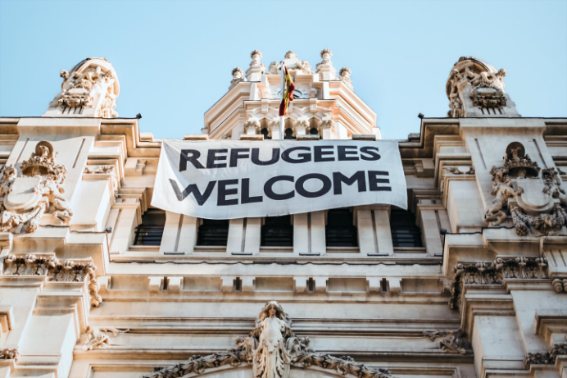
EXEMPLARY STUDY I
Georgiou, M., & Zaborowski, R. (2017). Media coverage of the “refugee crisis”: A cross-European perspective
Methodology
The analysis was based on a content analysis of quality press coverage of the so-called “refugee crisis” of 2015 in the Czech Republic, France, Germany, Greece, Hungary, Ireland, Serbia and the UK, as well as two main Arabic-language newspapers, Al-Hayat and Al-Araby Al-Jadeed. It assessed articles issued in the days immediately after three sets of key events: Hungary beginning to build a barrier along its border with Serbia, the publication of the images of the death body of Alan Kurdi, a small refugee boy who drowned in the Mediterranean Sea, as well as the November 2015 Paris terror attacks. The researchers analysed 20 articles per newspaper and period; summing up to a total of 1,200 articles.
A changing narrative
Georgiou and Zaborowski identified temporal trends in the ways in which the analysed newspapers depicted migrants and refugees: During summer and early autumn of 2015, a large proportion of the coverage reacted “sympathetic and empathetic” (p. 3) towards refugees and migrants, this gradually changed to suspicion or even hostility. The authors concluded that the press moved vom “careful tolerance” in July 2015 to “ecstatic humanitarianism” in September and then to “fear and securitisation” in November, thus highlighting the cyclical character of news media framing and narratives.
´Differences between the countries under study
Concerning the temporal shift from rather emotional narratives to a rather distant framing of migrants and refugees, the study concluded that this shift was most outspoken in Western European countries, whereas the Eastern European newspapers and the Arabic-language press stayed more balanced across the whole period under study.
Little space for migrants' and refugees' voices
The analysed newsppers only rarely gave voice to refugees and migrants: “Most often, they were spoken about and represented in images as silent actors and victims” (p. 3). Female migrants and refugees appeared even less frequently as speakers. In all countries, representatives of national governments, governments of other countries and European politicians appeared significantly more often compared to migrants and refugees.
Selected comparative studies

Slide 15
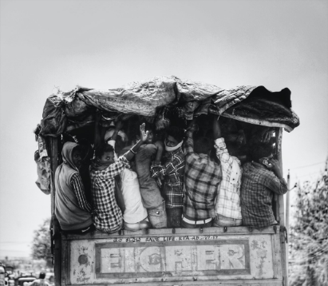
EXEMPLARY STUDY II
Fengler, S., et al. (2022). Covering Migration — in Africa and Europe: Results from a Comparative Analysis of 11 Countries
Methodology
A consortium of European and African universities analysed articles related to migration and forced displacement published in the online editions of two leading daily newspapers each from Germany, the UK, France, Italy, Greece, and Spain, as well as Kenya, Uganda, Tanzania, Ethiopia, and Ghana. The study assessed 1,512 articles within one year (1 June 2015 to 31 May 2016) dealing with migration from Africa to Europe.
Differences between African and European media
About 88 per cent of the articles found during the study period came from European media, with African media amounting to only 12 per cent. Even when taking account that African newspapers have less space for news compared to European newspapers, this is a striking imbalance. In Europe, coverage of migration was heavily self-centred and revolved around European security issues. European media largely ignored the sub-Saharan African countries of origin and focused on European actors.
Similarities between African and European media
Coverage in both Europe and Africa was dominated by day-to-day politics, and severely lacked deeper insights. Less than 9 per cent of the total coverage was devoted to relevant background information, which would help audiences to understand the actual causes and impact of migration and forced displacement. Media audiences in both Europe and Africa received little background information to assess matters of migrants and refugees – or to understand the relevance of the topic. Similar to the focus of the European media, African newspaper devoted more attention to European migration policies than to national migration policies.
Selected numbers
Only 1.9 per cent of the articles from European media dealt with causes of migration in general as a main topic, compared to 4.6 per cent of articles of African media. By contrast, 11.3 per cent of European articles focused on accidents, disasters and rescue, compared to 9.7 per cent of articles in African media.
Selected comparative studies

Slide 16
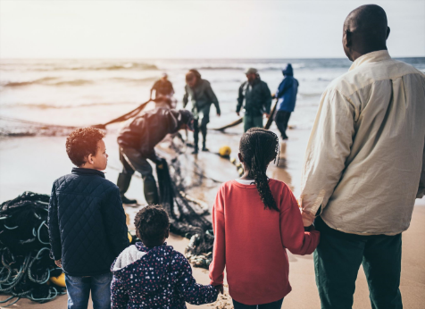
EXEMPLARY STUDY III
Fengler, S., & Kreutler, M. (2020). Migration coverage in Europe’s media. A comparative analysis of coverage in 17 countries
Methodology
The study compared migration coverage in 17 countries in Western and Eastern Europe, the United States, and Russia. The scholars selected two media outlets per country. If feasible, these should represent contrasting political opinions. The study analysed reporting in six exemplary weeks between August 2015 and March 2018, retrieving a total of 2,417 articles. The sample countries comprised Albania, Belarus, Czech Republic, France, Germany, Greece, Hungary, Italy, Poland, Portugal, Romania, Spain, Switzerland, the UK, and Ukraine.
Differences between the countries covered
Coverage in Germany and Hungary – the two countries with the highest numbers of first-time asylum applicants in 2015 – stood out in terms of volume. In Hungary, 1,500 articles were identified, in Germany, there were still 1,000 articles. The average number of articles per country, by contrast, was no more than 200 articles. In other European countries, the topic received much less attention. In the Italian media, and partly in the French media, immigrants from Africa dominated the media coverage; other countries in Europe focussed on migrants and refugees from the Near and Middle East; potentially reflecting the main flows of migration to these countries. While Eastern European outlets generally took a more critical approach towards migrants and refugees, there were often clear differences between each country’s pair of analysed media outlets, reflecting the respective political leaning.
Similarities between the countries covered
Many European media treated matters of migrants and refugees as a “foreign topic”, taking place far away from users’ own country. A focus on migration as a domestic topic was only apparent in Italy, Germany, and Greece. Migrants were under-represented in most reports, depicted as large groups rather than individuals. Within these groups, male refugees and migrants were over-represented. A low share of migrants and refugees was quoted, only 4 per cent of articles focused on personal stories of migrants or refugees. It is though important to note that differences have not only been found in between the countries, but also between the two media outlets analysed per country. Media across countries typically did not make a clear distinction between refugees with protected status and migrants.
Selected numbers
Only 6 per cent of the articles analysed comprised an individual migrant or refugee as a main actor. By contrast, 18 per cent featured large, anonymous groups of migrants and refugees whereas in 37 per cent of articles, government actors were prominently featured.
Selected comparative studies

Slide 17
EXEMPLARY STUDY IV
Eberl, J.-M., et al. (2019). European Media Migration Report: How Media Cover Migration and Intra-EU Mobility in Terms of Salience, Sentiment and Framing
Methodology
The authors examined two separate text corpora of migration-related media coverage in Spain, the UK, Germany, Sweden, Poland, and Romania. Applying an automated, computer-assisted analysis, they focused on news reports of at least two news outlets from these countries from 2003-2017, and an additional corpus from 2013-2017, adding 20 more outlets and Hungary as an additional country. A total of 844,230 articles was included.
Focus
The study aimed to juxtapose general media coverage of migration with media coverage about intra-European migration based on the EU fundamental principle of free movement, taking into account the salience, sentiment, and framing of the analysed news reports.
Intra-European migration depicted more positively
Contrary to migration reporting in general, articles about intra-European migration exhibited a positive relative sentiment. Further, the news media related intra-European migration more frequently to economic and welfare issues. On the other hand, the security frame (i.e., articles focusing on security and crime-related aspects of migrants and migration) was not that dominant with regard to intra-European migration.

Slide 18
EXEMPLARY STUDY IV
Intra-European migration depicted more positively
Contrary to migration reporting in general, articles about intra-European migration exhibited a positive relative sentiment. Further, the news media related intra-European migration more frequently to economic and welfare issues. On the other hand, the security frame (i.e., articles focusing on security and crime-related aspects of migrants and migration) was not that dominant with regard to intra-European migration.
Differences between sending and receiving countries
Migration received most media attention in Germany, Sweden, and the UK as common receiving countries, and less attention in Poland and Romania, representing two main sending countries of intra-EU migration. Interestingly, media attention to migration shrunk in Spain since 2010, when the country turned from a receiving into a sending country, as many Spanish people left the country following an economic crisis. The authors conclude that “Media salience of migration coverage is higher for receiving countries than for sending countries” (p. 64). To some extent, this reflects the case of African sending countries, where newspapers report less about migration than their counterparts in European receiving countries.
Selected numbers
The media covered migration in general and from outside of Europe much more frequently than intra-European migration: Only 4.8 per cent of all migration-related articles in the bigger text corpus related to intra-European migration at least partly. Romanian media dedicated most attention to intra-European migration, with 11.2 per cent of articles.

Slide 19
DRAG THE WORDS
When the numbers of refugees arriving in Europe rose considerably in 2015, the media in several countries initially reported... | sympathetic and emphatetic
Studies indicate that media in many European countries tend to cover migration from a predominantly... news perspective | foreign
Articles about intra-European migration tend to represent more... sentiment compared to overall migration coverage. | positive
Migrants are often depicted as... groups. | anonymous
Compared to news outlets from receiving countries, media coverage about migration tends to be less... in both European and African sending countries. | salient
Selected comparative studies

Slide 20
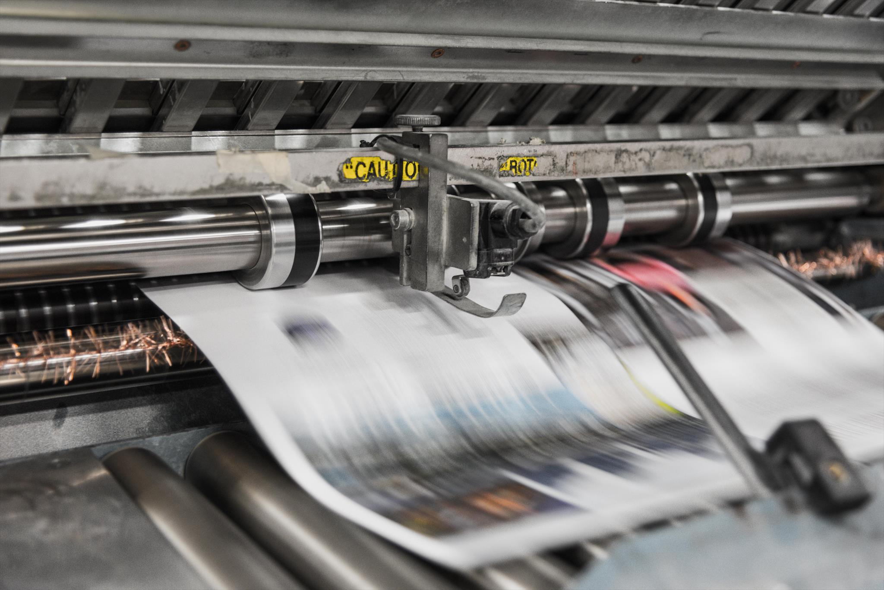
EFFECTS OF MEDIA COVERAGE

Slide 21
PUBLIC OPINION ON MIGRATION
A study from the International Organization for Migration (IOM), in which 183,000 adults across
more than 140 countries have been interviewed between 2012 and 2014, revealed that 34% of
respondents across the world would like to see immigration to their country decreased, 21% increased, 22% kept at its present level and 22% did not give an opinion.
According to the study, people in Europe seemed to hold most negative views towards immigration, with the majority (52%) saying immigration levels should be decreased. In Africa, 40% wanted to decrease immigration into their countries.
Based on question „In your view, should immigration in this country be kept at its present level, increased or decreased?“
Notes: *Total group results are weighted by population size. Figures might not add up to 100% due to rounding.
Source: Esipova et al (2015, p. 8), adapted from Zappe (2021)

Slide 22
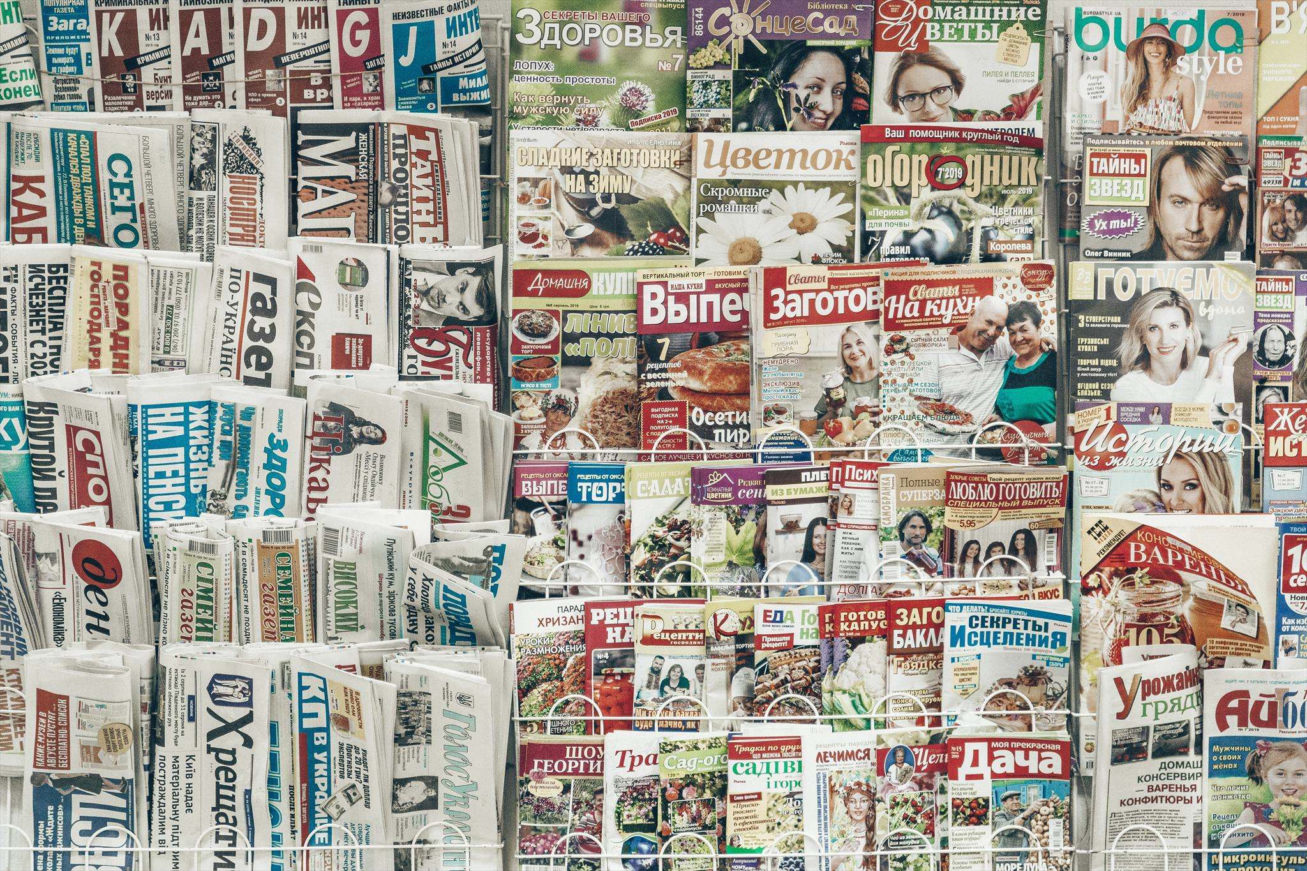
MEDIA EFFECTS THEORIES
The news media can influence public attitudes towards migration and forced displacement. While one should refrain from the naïve assumption that the media are, under all circumstances, the only and most influential force shaping people's attitudes, there is plenty of research on how the media influence public opinion. Here are some key theories of media impact:
Agenda-setting
Mass media shape public perception by coverage, irrespective of frequency, of a certain issue, and by positioning the issue as high or low on the news agenda, thus prioritizing topics. When the media cover an issue frequently and prominently, this may lead to large segments of the public perceiving these issues as important as well, and more important than others (e.g., Pürer, 2003; Coleman et al., 2008).
Priming
Priming is not about a cognitive impact on media consumers, but about an affective impact. The media agenda can change attitudes, assumptions, mindsets and, ultimately, choices, e. g., a voter’s election decisions by drawing attention to some issues while ignoring others (Iyengar et al., 1984). Priming theory emphasizes that people unwittingly connect nodes (concepts) to one another through associative thinking. Media coverage may activate such nodes in memory (Moy et al., 2016).
Effects of media coverage
Adapted from Zappe (2021)

Slide 23
MEDIA EFFECTS THEORIES
Framing
Entman (1993, p. 52) states that “To frame is to select some aspects of a perceived reality and make them more salient in a communicating text, in such a way as to promote a particular problem definition, causal interpretation, moral evaluation, and/or treatment recommendation for the item described.” Framing thus sets the tone, or builds the narrative, in which an article reports about – i.e., frames – a certain issue or event. More than agenda-setting or priming, framing is thus about the particular contents and wording of news media coverage (Moy et al., 2016).
Exemplification
According to Zillmann (1999), news media exemplification refers to a reporting style that is „judging the whole by some of its parts“, e.g., describing a certain issue or event by focusing on an individuals´perceptions or decisions. These stories have a different effect on media users compared to abstract descriptions (Fast et al., 2014): „[ V]ivid examples, compared to pallid ones tend to foster superior accessibility” (Zillmann & Brosius, 2000, p. 48). As a consequence, exemplary descriptions of individuals as case studies may influence the judgment of media users (Tversky & Kahneman, 1973).
Effects of media coverage
Adapted from Zappe (2021)

Slide 24
SELECTED RESEARCH RESULTS
Relation of Salience, Exposure and Public Opinion
A study on media coverage in Germany found that the quantity of media coverage about migration issues was positively associated with concerns about immigration along the German population (Benesch et al., 2018). The analysis suggested that an increase in news items covering the issue affects immigration worries expressed by citizens. Similarly, a study from the UK concluded that press emphasis on economy and education-related issues of migration appeared to increase concern about immigration (McLaren et al., 2018). Herda (2010) found that while TV news exposure leads to an overestimation of the number of immigrants, citizens with greater exposure to newspaper coverage estimated immigrant figures more realistically. Similarly, research points out that TV news exposure does not lead to greater knowledge about immigration issues (Aalberg & Strabac, 2010), whereas citizens using printed news had a more positive opinion on the economic of immigration compared to TV viewers (Héricourt & Spielvogel, 2014).
Negativity
Media coverage framed in a way that accentuates economic competition with immigrants leads to support for restrictive immigration policies (Costello & Hodson, 2011). Interestingly, a study from the Netherlands on attitudes towards migrants found that a focus on multicultural issues had a positive effect on the attitudes towards migrants, while victimization frames surprisingly caused negative effects rather than stipulating empathy (Bos et al., 2016). A similar result was found by Medianu (2014), indicating that both describing refugees as terrorists and as victims led to an automated dehumanization of refugees on the part of the audience, explained by priming. Research comparing Denmark and the Netherlands concluded that a positive tone of news coverage reduced negative attitudes towards immigration. Interestingly, though, a negative tone did not lead to an increase in negativity of views (van Klingeren et al., 2015).
Influence on voting decisions
A study by Burscher et al. (2015) comparing the situation in 11 countries demonstrated that exposure to immigration- and crime-related news was associated positively to the likelihood that citizens voted for an anti-immigration party.
Effects of media coverage

Slide 25
CONTROLLING QUESTIONS
Agenda setting describes how politicians influence journalists to reflect their agenda in reporting.
True
False
Exemplification has different effects on media users compared to more abstract styles of reporting.
True
False
Research indicates that a positive tone of news items reporting about immigration leads to more negative views of citizens on this issue.
True
False
Effects of media coverage

Slide 26
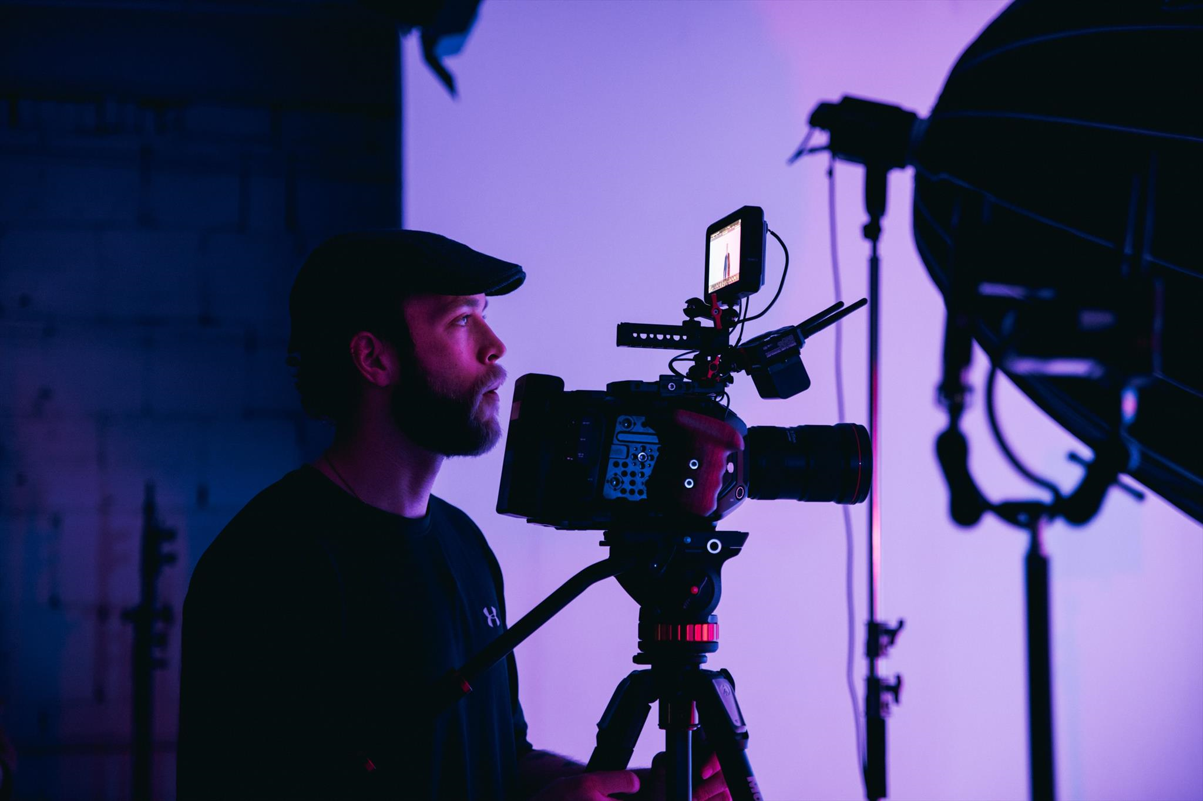
EFFECTS OF MEDIA COVERAGE: A CLOSER LOOK

Slide 27
THE CNN EFFECT
The CNN effect describes the impact international media coverage has on policy-makers across the world. The model implies that global news networks, of which CNN has been one of the earliest examples, as well as the 24/7 news cycle have a considerable effect on the decision-making process of political leaders, who may feel under public pressure to intervene into humanitarian situations and political crises they may not have a stake in otherwise (Robinson, 2002). This notion of direct impact has though not gone unchallenged; authors suggested a differentiated interpretation of the impact of global media on international politics (Gilboa, 2005; Gilboa et al., 2016).
In the context of the current migration movements, partly inflicted by crises and wars, political effects similar to the CNN effect can be observed:
Syrian gas attacks
Both Donald Trump and Barack Obama were confronted with horrible images from Syrian gas attacks that were reported worldwide during their presidencies (Doucet, 2018). In April 2017, images of dead and dying children from a chemical gas attack on Khan Sheikhoun in Syria went viral. According to a Washington Post article, President Donald Trump announced that the pictures had a big impact on him (Bahador, 2017). He reacted with statements like “something should happen” (Bash et al., 2017). It appeared to generate a shift in Trump’s Syria policy (Bahador, 2017). “Observations from the Trump and Obama administrations underline that the media were a key part of the constant pressure on policy-makers from politicians, pundits, and the array of powerful actors involved in the Syrian crisis” (Doucet, 2018, p. 154).
Libya conditions
A report in 2017 by CNN revealed that refugees in Libya were kept in shockingly inhumane conditions. The report showed how migrants were being sold by smugglers and that a slave market existed in Libya (CNN, n. d.). The report caused worldwide reactions and for the first time also brought African politicians to action in that matter; for instance, Rwanda was subsequently“offering refuge to enslaved African migrants trapped in Libya” (Said-Moorhouse, 2017). Further, political leaders discussed the topic at the African Union-European Union summit (Smith-Spark, 2017). Interestingly, the IOM had pointed out the existence of migrants being auctioned as slaves in Libya before the CNN report. Still, only the alarming CNN report finally produced a major political reaction from Western and African politicians (Völlinger, 2017).
Adapted from Zappe (2021)

Slide 28
THE CASE OF ALAN KURDI
The news media can impact people through the way they cover the matters concerning migrants and refugees. A striking illustration is the example of the image of Alan Shenu (often reported as “Alan Kurdi”), the three-year-old Syrian boy, who was found drowned on a beach in Turkey after trying to reach Europe with his family. The picture went viral and became a symbol of the “refugee crisis” in the Western world and the widespread international apathy until that point. Over-sized pictures of the boy’s dead body were published on newspaper front pages and were shown on TV news across the globe. However, the case also illustrates how short-lived news cycles, and, in turn, media effects may be. The case of Aylan Kurdi may thus be a drastic case of exemplification.
Source: Screenshots The Washington Post, BBC, The Guardian, Le Monde, Observador
Effects of media coverage: A closer look

Slide 29
THE CASE OF ALAN KURDI
Reinforcing support for liberal refugee policies
A study by Sohlberg et al. (2019) notes how the image of Alan Shenu had contextual effects on audience political preferences. Initially, the photo of the dead boy reinforced support for liberal refugee policies across ideological lines. Over time, however, the image was also used by staunch opponents of such policies for their own purposes and thus instrumentalised.
A picture raising interest
In another study by Slovic et al. from 2017, it was proven that the iconic photo of a single child - Alan Shenu - had more impact than many statistical reports of hundreds of thousands of deaths. People who seemed unaffected by the rising death toll in Syria - after seeing the photo of Alan Shenu - suddenly showed much more interest in the fates of the refugees. However, the researchers also found that this newly sparked empathy subsided again relatively quickly.
Influence on positive media coverage
While the picture thus seemed to have affected media users and public opinion, it also influenced the way news media reported – i.e., framed – migration issues: A study by the European Journalism Observatory showed that in Portugal, UK, Germany and Italy positive humanitarian stories about migrants and refugees increased three-fold immediately after the photographs were published (EJO, 2015).
Effects of media coverage: A closer look

Slide 30
FOOD FOR THOUGHT
Watch this film of VPRO documentary, a Youtube channel of Dutch public broadcaster VPRO https://www.youtube.com/watch?v=VcliHwsf8jI
Please take some notes and answer the following questions:
How did, according to the documentary, the picture of the boy went viral to become a worldwide media phenomenon? How did the news media react to the image? (max. 250 words)
In how far could the case of the Alan Kurdi picture be described as having caused a „CNN effect“? (max. 200 words)
Then vice-president of visual media company Getty Images, Hugh Pinney, said related to the picture: “And the reason we’re talking about it after it’s been published is because it breaks a social taboo that has been in place in the press for decades: a picture of a dead child is one of the golden rules of what you never published” (quoted in Laurent, 2015). Why do you think this taboo was broken in this case? Refer to the points raised in the documentary, as well as to the contents of this e-learning session (e.g., related to the news style of exemplification) (max. 300 words)
Effects of media coverage: A closer look

Slide 31
CONTROLLING QUESTIONS
Which of the following statements are not correct?
The CNN effect relates to a theory according to which major news media change their editorial line according to the preferences of politicians.
In several European countries, media coverage changed following the picture of Alan Kurdi going viral.
The picture of Alan Kurdi did reinforce public support for liberal immigration policies in the short run according to a study.
Studies conclude that the picture of Alan Kurdi did not spark any significant empathy for refugees on the part of the audience.
Effects of media coverage: A closer look

Slide 32
OUTLOOK
“Scholars of migration journalism have argued that migration is hard to cover because it’s a story that oozes, rather than breaks – so the breaking news of a smuggling ship sinking is easier to do than the massive sociopolitical, demographic and economic challenges of the entire phenomenon.”
(Dell’Orto, n. d.)
“In 2015 and 2016, when everybody was paying attention to this subject, we had a lot of good reporting on this subject. (…) But there are no conditions at most of the newsrooms to have a journalist that is paying attention to this with the frequency that we should have. Because it is a phenomenon that will not stop.”
Catarina Santos, Editor, Observador (Portuguese newspaper), quoted in Fengler et al., 2021, pp. 61-62
Many studies point towards shortcomings of media coverage on migration and forced displacement, such as a focus on elite actors and large groups rather than on individual migrants and refugees, a greater emphasis on asylum seekers compared to other migrants, a potential negativity bias and a style of reporting that neglects the causes and consequences of people leaving their homes to resettle abroad.
Journalists thus have great responsibility when covering the stories of migrants and refugees. At the same time, newsrooms might be confronted with a range of professional challenges when covering issues of migration and forced displacement, such as a lack of resources for in-depth and long-time reporting.
The following e-learning session will lay focus on ethical and professional challenges, as well as good practices of reporting migration and forced displacement.

Slide 33
Bibliography, referred works
Aalberg, T., & Strabac, Z. (2010). Media use and misperceptions. Nordicom Review, 31(1), 35–52. https://doi.org/10.1515/nor-2017-0119
Bash, D., Herb, J., Starr, B., & Diamond, J. (2017, April 2017). Trump on Syria’s Assad: “Something should happen”. CNN. https://edition.cnn.com/2017/04/06/politics/donald-trump-syria-options/index.html
Benesch, C., Loretz, S., Stadelmann, D., & Thomas, T. (2018). Media coverage and immigration worries: Econometric evidence. DICE Discussion Paper, No. 288. Düsseldorf Institute for Competition Economics (DICE). https://www.econstor.eu/bitstream/10419/177889/1/1019740337.pdf
Berry, M., Garcia-Blanko, I., & Moore, K. (2015). Press coverage of the refugee and migrant crisis in the EU: A content analysis of five European countries. Report prepared for the United Nations High Commission for Refugees (December 2015). Cardiff School of Journalism, Media and Cultural Studies. https://www.unhcr.org/protection/operations/56bb369c9/press-coverage-refugee-migrant-crisis-eu-content-analysis-five-european.html
Bleich, E., Bloemraad, I., & de Graauw, E. (2015). Migrants, minorities and the media: Information, representations and participation in the public sphere. Journal of Ethnic and Migration Studies, 41(6), 857-873. https://doi.org/10.1080/1369183X.2014.1002197
Blinder, S. (2015), Imagined Immigration. Polit Stud, 63(1), 80-100. https://doi.org/10.1111/1467-9248.12053

Slide 34
Bibliography, referred works
Bahador, B. (2017, April 10). Did pictures in the news media just change U.S. policy in Syria? The Washington Post. https://www.washingtonpost.com/news/monkey-cage/wp/2017/04/10/did-media-images-just-change-u-s-policy-in-syria-three-lessons-from-kosovo/
Bos, L., Lecheler, S., Mewafi, M., & Vliegenthart, R. (2016). It's the frame that matters: Immigrant integration and media framing effects in the Netherlands. International Journal of Intercultural Relations, 55, 97-108. https://doi.org/10.1016/j.ijintrel.2016.10.002
Burscher, B., van Spanje, J., & de Vreese, C. H. (2015). Owning the issues of crime and immigration: the relation between immigration and crime news and anti-immigrant voting in 11 countries. Electoral Studies, 38, 59-69. https://doi.org/10.1016/j.electstud.2015.03.001
Caviedes, A. (2015). An emerging ‘European’ news portrayal of immigration? Journal of Ethnic and Migration Studies, 41(6), 897-917. https://doi.org/10.1080/1369183X.2014.1002199
Cheregi, B.-F. (2015). The media construction of identity in anti-immigration discourses. Revista Romana de Jurnalism si Comunicare - Romanian Journal of Journalism and Communication, issue 1, 5-25.
Chouliaraki, L., & Zaborowski, R. (2017). Voice and community in the 2015 refugee crisis: A content analysis of news coverage in eight European countries. International Communication Gazette, 79(6-7), 613–635.
CNN (n.d.) People for sale: Exposing migrant slave auctions in Libya. https://edition.cnn.com/specials/africa/libya-slave-auctions

Slide 35
Bibliography, referred works
Coleman, R., McCombs, M., Shaw, D., & Weaver, D. (2008). Agenda Setting. In Wahl-Jorgensen, K., & Hanitzsch, T. (Eds.), The Handbook of Journalism Studies. Routledge.
Costello, K., & Hodson, G. (2011). Social dominance-based threat reactions to immigrants in need of assistance. European Journal of Social Psychology, 41(2), 220–231. https://doi.org/10.1002/ejsp.769
Dell’ Orto, G. (n. d.). The visible & invisible borders of migration: Journalism challenged. Media Governance & Industries Lab blog at the University of Vienna. https://univiennamedialab.wordpress.com/2017/01/11/the-visible-invisible-borders-of-migration-journalism-challenged/
Doucet, L. (2018). Syria & the CNN effect: What role does the media play in policy-making? Daedalus, 147(1), 141-157. https://doi.org/10.1162/DAED_a_00480
Eberl, J.-M., Meltzer, C. E., Heidenreich, T., Herrero, B., Theorin, N., Lind, F., Berganza, R., Boomgaarden, H. G., Schemer, C., & Strömbäck, J. (2018). The European media discourse on immigration and its effects: a literature review. Annals of the International Communication Association, 42(3), 207-223. https://doi.org/10.1080/23808985.2018.1497452
Eberl, J.-M., Galyga, S., Lind, F., Heidenreich, T., Edie, R., Boomgaarden, H. G., Herrero, B, Gómez Montero, E. L., & Berganza, R. (2019). European media migration report: How media cover migration and intra-EU mobility in terms of salience, sentiment and framing. Report. https://www.reminder-project.eu/wp-content/uploads/2019/08/REMINDER-D8.3.pdf

Slide 36
Bibliography, referred works
EJO (2015). Research: How Europe’s Newspapers Reported The Migration Crisis. https://en.ejo.ch/research/research-how-europes-newspapers-reported-the-migration-crisis
El Refaie, E. (2001). Metaphors we discriminate by: Naturalized themes in Austrian newspaper articles about asylum seekers. Journal of Sociolinguistics, 5, 352-371. https://doi.org/10.1111/1467-9481.00154
Esser, F., Engesser, S., & Matthes, J. (2016). Negativity. In de Vreese, C., Esser, F., & Hopmann, D. N. (Eds.), Comparing Political Journalism. Routledge.
Esses, V.M., Medianu, S., & Lawson, A.S. (2013). Uncertainty, Threat, and the Role of the Media in Promoting the Dehumanization of Immigrants and Refugees. Journal of Social Issues ,69(3), 518-536. https://doi.org/10.1111/josi.12027
Entman, R. M. (1993). Framing: Toward clarification of a fractured paradigm. Journal of Communication, 43(4), 51-58. https://doi.org/10.1111/j.1460-2466.1993.tb01304.x
Esipova, N., Ray, J., Pugliese, A., & Tsabutashvili, D. (2015). How the world views migration. IOM. https://www.ecampus.iom.int/pluginfile.php/12080/block_html/content/How%20the%20world%20migration%20.pdf
European Commission (2018). Special Eurobarometer 469: Integration of immigrants in the European Union. Summary. https://ec.europa.eu/migrant-integration/library-document/what-do-people-europe-think-about-migrants-special-eurobarometer-survey_de

Slide 37
Bibliography, referred works
Fast, V., Müller, P., & Scherr, S. (2014). Der kombinierte Einsatz von Daten und Fallbeispielen in den Medien: Wirkung und Glaubwürdigkeit. In Loosen, W. & Dohle, M. (Eds.), Journalismus und (sein) Publikum: Schnittstellen zwischen Journalismusforschung und Rezeptions- und Wirkungsforschung , 317-334. Springer VS.
Fengler, S., & Kreutler, M. (2020). Migration coverage in Europe’s media: A comparative analysis of coverage in 17 countries. OBS Working Paper 39. https://www.otto-brenner-stiftung.de/fileadmin/user_data/stiftung/02_Wissenschaftsportal/03_Publikationen/AP39_Migration_EN.pdf
Fengler, S. (2021). The Media and the Migration Story – An Analysis across Countries. In Fengler, S., Lengauer, M., & Zappe, A.-C. (Eds.), Reporting on Migrants and Refugees: Handbook for Journalism Educators. https://mediaandmigration.com/wp-content/uploads/2021/07/Module4_Reporting-on-Migrants-and-Refugees.pdf
Fengler, S., Speck, D., Kreutler, M., Lengauer, M., & Zappe, A.-C. (2021). Covering Migration. In: The Newsreel Project Consortium (Ed.): Newsreel2. New Teaching Fields for the Next Generation of Journalists. Research report, 54-73. Dortmund: Erich Brost Institute for International Journalism.
Fengler, S., Bastian, M., Brinkmann, J., Zappe, A. C., Tatah, V., Andindilile, M., Assefa, E., Chibita, M., Mbaine, A., Obonyo, L., Quashigah, T., Skleparis, D., Splendore, S., Tadesse, M. & Lengauer, M. (2022). Covering Migration– in Africa and Europe: Results from a comparative analysis of 11 countries. Journalism Practice, 16(1), 140-16. https://doi.org/10.1080/17512786.2020.1792333

Slide 38
Bibliography, referred works
Fotopoulos, S., & Kaimaklioti, M. (2016). Media Discourse on the Refugee Crisis: On what have the Greek, German and British Press Focused? European View, 15(2), 265–279. https://doi.org/10.1007/s12290-016-0407-5
Georgiou, M., & Zaborowski, R. (2017). Council of Europe report: Media coverage of the “refugee crisis”: A cross-European perspective. https://rm.coe.int/1680706b00
Greussing, E., & Boomgaarden, H. (2017). Shifting the refugee narrative? An automated frame analysis of Europe’s 2015 refugee crisis. Journal of Ethnic and Migration Studies, 43(11), 1749-1774. https://doi.org/10.1080/1369183X.2017.1282813
Gilboa, E. (2005). The CNN effect: The search for a communication theory of international relations. Political Communication, 22(1), 27-44. https://doi.org/10.1080/10584600590908429
Gilboa, E., Jumbert, M. G., Miklian, J., & Robinson, P. (2016). Moving media and conflict studies beyond the CNN effect. Review of International Studies, 42(4), 654-672. https://doi.org/10.1017/S026021051600005X
Horsti, K. (2016). Visibility without voice: Media witnessing irregular migrants in BBC online news journalism. African Journalism Studies, 37(1), 1-20. https://doi.org/10.1080/23743670.2015.1084585
Herda, D. (2010). How many immigrants? Foreign-born population innumeracy in Europe. Public Opinion Quarterly, 74(4), 674–695. https://www.jstor.org/stable/40927164

Slide 39
Bibliography, referred works
Héricourt, J., & Spielvogel, G. (2014). Beliefs, media exposure and policy preferences on immigration: Evidence from Europe. Applied Economics, 46(2), 225–239. https://doi.org/10.1080/00036846.2013.844330
ICMPD (2016). How does the media on both sides of the Mediterranean report on migration? Preliminary findings, draft conclusions and draft recommendations. https://cdn.ethicaljournalismnetwork.org/wp-content/uploads/2017/03/Draft_Migration_and_Media_Report.pdf
Iyengar, S., Kinder, D. R., Peters, M. D., & Krosnick, J. A. (1984). The evening news and presidential evaluations. Journal of Personality and Social Psychology, 46(4), 778-787. https://doi.org/10.1037/0022-3514.46.4.778
Jacobs, L., Meeusen, C., & d’Haenens, L. (2016). News coverage and attitudes on immigration: Public and commercial television news compared. European Journal of Communication, 31(6), 642-660. https://doi.org/10.1177/0267323116669456
Kroon, A. C., Kluknavská, A., Vliegenthart, R., & Boomgaarden, H. G. (2016). Victims or perpetrators? Explaining media framing of Roma across Europe. European Journal of Communication, 31(4), 375-392. https://doi.org/10.1177/0267323116647235
Laurent, O. (2015, September 4). What the image of Aylan Kurdi says about the power of photography. Time Magazine. https://time.com/4022765/aylan-kurdi-photo/#:~:text=The%20image%20of%20the%20death,senseless%20deaths%20in%20the%20Mediterranean.

Slide 40
Bibliography, referred works
McLaren, L., Boomgaarden, H., & Vliegenthart, R. (2018). News Coverage and Public Concern About Immigration in Britain. International Journal of Public Opinion Research, 30(2), 173-193. https://doi.org/10.1093/ijpor/edw033
Medianu, S. (2014). The role of the media in the automatic dehumanization of refugees. (Publication No. 2287) [Thesis, The University of Western Ontario, Canada]. Western Libraries.
Moy, P., Tewksbuey, D., & Rinke, E. M. (2016). Agenda-Setting, Priming, and Framing. In Jensen, K. B., Rothenbuhler, E. W., Pooley, J. D., & Craig, R. T. (Eds.), The International Encyclopedia of Communication Theory and Philosophy. https://doi.org/10.1002/9781118766804.wbiect266
Pürer, H. (2003). Publizistik- und Kommunikationswissenschaft: Ein Handbuch. UVK.
Robinson, P. (2002). The CNN effect: The myth of news, foreign policy and intervention. Routledge.
Rodríguez-Pérez, C., Jivkova-Semova, D., Pérez-Vara, E., Asadi, N., & Kreutler, M. (2022). Unravelling migration media coverage. How migrants and immigration were portrayed in Spain during the refugee crisis (2015-2018). Historia y comunicación social, 27(1), 161-173.
Said-Moorhouse, L. (2017, November 24). Rwanda offers refuge to “migrants held captive in Libya”. CNN. https://edition.cnn.com/2017/11/24/africa/rwanda-reaction-libya/index.html

Slide 41
Bibliography, referred works
Slovic, P., Västfjäll, D., Erlandsson, A., & Gregory, R. (2017). Iconic photographs and the ebb and flow of empathic response to humanitarian disasters. Proceedings of the National Academy of Sciences of the United States of America, 114(4), 640-644. https://doi.org/10.1073/pnas.1613977114
Smith-Spark, L. (2017, November 29). Slavery, security on agenda as Merkel and Macron meet African leaders. CNN. https://edition.cnn.com/2017/11/29/africa/au-eu-summit-ivory-coast/index.html
Smets, K., Mazzocchetti, J., Gerstmans, L., & Mostmans, L. (2019). Beyond victimhood: Reflecting on migrant-victim representations with Afghan, Iraqi, and Syrian asylum seekers and refugees in Belgium. In d’Haenens, L., Joris, W., & Heinderyckx, F. (Eds.), Images of Immigrants and Refugees , 177–198. Leuven University Press. https://doi.org/10.11116/9789461662811
Sohlberg, J., Esaiasson, P., & Martinsson, J. (2018). The changing political impact of compassion-evoking pictures: The case of the drowned toddler Alan Kurdi. Journal of Ethnic and Migration Studies, 45(13), 2275-2288. https://doi.org/10.1080/1369183X.2018.1538773
Strömbäck, J., Andersson, F., & Nedlund, E. (2017). Immigration in the media – how did Swedish newspapers report 2010-2015? Stockholm: Delegationen för migrationsstudier.
Tversky, A., & Kahneman, D. (1973). Availability: A heuristic for judging frequency and probability. Cognitive Psychology, 5(2), 207-232. https://doi.org/10.1016/0010-0285(73)90033-9

Slide 42
Bibliography, referred works
Van Klingeren, M., Boomgaarden, H. G., Vliegenthart, R., & de Vreese, C. H. (2015). Real World is Not Enough: The Media as an Additional Source of Negative Attitudes Toward Immigration, Comparing Denmark and the Netherlands. European Sociological Review, 31(3), Pages 268–283, https://doi.org/10.1093/esr/jcu089
Völlinger, V. (2017, November 23). Ein Möglichkeitsfenster gegen Sklaverei. Zeit Online. https://www.zeit.de/politik/ausland/2017-11/fluechtlinge-libyen-cnn-sklavenhandel-eu-frederica-mogherini-afrikanische-union-un-sicherheitsrat
Zappe, A.-C., Bastian, M., Leißner, L., Henke, J., & Fengler, S. (2020). Perspektivwechsel. Migrationsberichterstattung in ausgewählten afrikanischen Ländern und Deutschland aus Migrant*innensicht. In Gehrau, V., Waldherr, A. & Scholl, A. (Eds.), Integration durch Kommunikation. Jahrbuch der Publizistik- und Kommunikationswissenschaft 2019, 131-140. https://doi.org/10.21241/ssoar.68126
Zappe, A.-C. (2021). Module 5: Migration Coverage – Media Effects and Professional Challenges. In Fengler, S., Lengauer, M., & Zappe, A.-C. (Eds.), Reporting on Migrants and Refugees. Handbook for Journalism Educators. https://mediaandmigration.com/wp-content/uploads/2021/07/Reporting-on-Migrants-and-Refugees.pdf

Slide 43
Sources of Photos
Illustration pictures:
Articulate Content Library 360
Unsplash:
All photos published on Unsplash can be used for free. You can use them for commercian and non-commercial purposes.
https://unsplash.com/license
Pixabay:
CCO 1.0 Universal (CC0 1.0) Public Domain Dedication
http://www.pixabay.com

Slide 44
Sources of Photos
Freepik: https://www.freepik.com/
Pexels: All photos on Pexels can be used for free. https://www.pexels.com
Microsoft Powerpoint Stock Photos

Slide 45
Where you can find us
newsreel.pte.hu
newsreel@pte.hu
thenewsreelproject
@thenewsreelproject @newsreelproject
The project was funded by the European Commission. The views expressed in this publication do not necessarily reflect those of the European Commission.

