Slide 1
COVERING MIGRATION
Funded by the Erasmus+ Programme of the European Union
New Teaching Fields for the Next Generation of Journalists 2020-1-HU01-KA203-078824

Slide 2
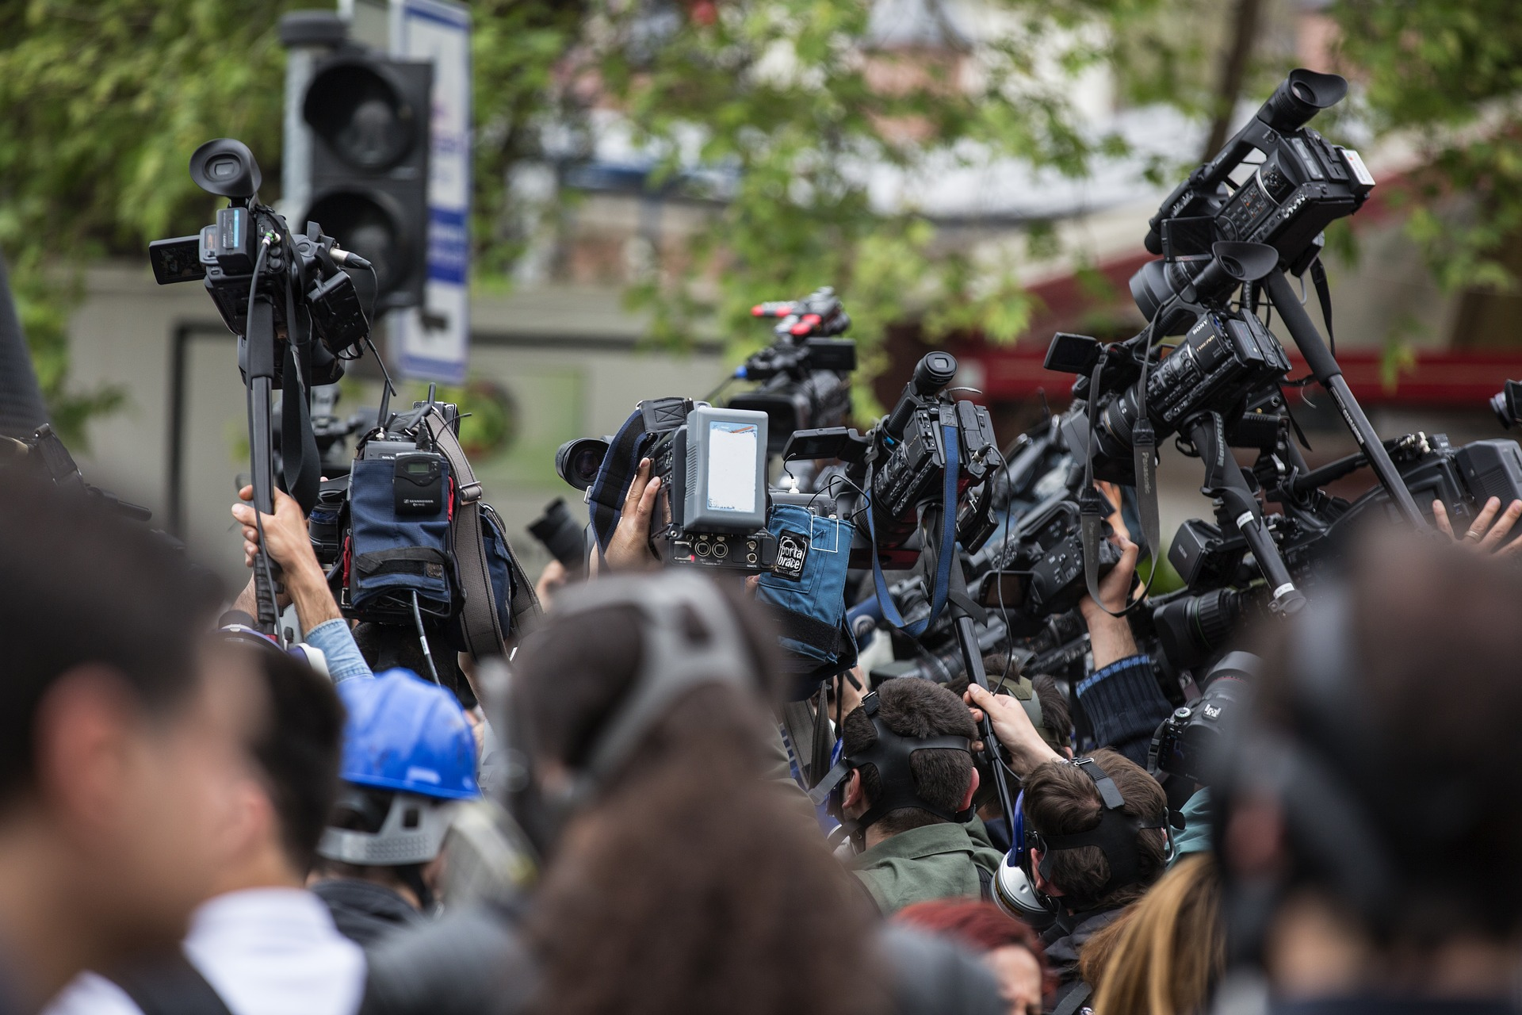
LESSON4 - THE ETHICS OF REPORTING ON MIGRATION & FORCED DISPLACEMENT

Slide 3
The Course
Lesson 1 - Terminologies, legal frameworks, actors
Lesson 2 - Context factors & geographies of migration & forced displacement
Lesson 3 - Media coverage of migration & forced displacement
Lesson 4 - The ethics of covering migration & forced displacement

Slide 4
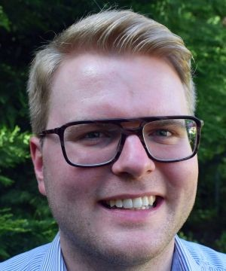
About the authors
Anna-Carina Zappe
Fields of Research: Reporting about migration and forced displacement in an international context, media ethics
Anna-Carina Zappe is a senior researcher at the Institute of Journalism and the Erich Brost Institute for International Journalism (EBI) at TU Dortmund University, Germany, as well as a practicing TV journalist and a Ph.D. cadidate at TU Dortmund University, Germany. As a researcher, she is particularly involved in understanding the roles of journalists – as they report under exceptional circumstances, cover disasters and experience their own traumas. She is committed to increase the quality reporting on migrants and refugees with a focus on sub-Saharan Africa. She is a lecturer in global journalism, ethics and reporting techniques. As a trainer for mid-career journalists, she supervised cross-continental collaborative research and reporting projects. Together with Susanne Fengler and Monika Lengauer, she co-edited “Reporting on Migrants and Refugees: Handbook for Journalism Educators” published by UNESCO.
Dominik Speck
Fields of Research: media accountability and transparency, public service media, media policy
Dominik Speck is a researcher at the Institute of Journalism and the Erich Brost Institute for International Journalism at TU Dortmund University. He also has several years of experience as a freelance journalist specialized on covering media issues, working mostly for the German trade journal epd medien, and worked as a Visiting Researcher at the European Broadcasting Union (EBU). His teaching includes courses on international journalism with a practical stance.

Slide 5
What we are going to discuss
Learn about important elements of reporting migration and forced displacement in an ethically sensitive way
Discuss factors that influence the way in which migration and forced displacement is being reported (e.g., news values, relevance of source selection, protagonists)
Obtaining knowledge about ethical guidelines that are specifically important for reporting on migration and forced displacement
Reflecting on the selection of credible sources and the importance of producing ethically responsible news reports even under time pressure and difficult conditions
The importance of being aware of the impact of traumatizing experiences when interviewing migrants and refugees

Slide 6
CHOOSING SOURCES & TERMINOLOGIES

Slide 7
ACCESS TO SOURCES
This course will provide you wihow to do research for a story covering the topic of migration and forced displacement rooted in ethical considerations.
You are about to start with your source research. The first question is what access points to your sources you choose: Do you start with online research or do you make targeted calls to key players? Do you sit down in an archive, or do you go to specific locations to meet people relevant to your story on the ground?
Research can be done in a variety of ways: both actively and passively. Often, journalists are more passive recipients of information - they use press releases or information from other news outlets. Research shows that in many newsrooms the use of internet sources dominates. Search engines, especially Google, determine the look for sources. They thus have a considerable influence on how journalistic stories come about and the topics they cover.
Research on the internet can lead to websites where information is incomplete, outdated or incorrect. That is why caution is needed when using online information. Especially when algorithms are increasingly enabling the rapid dissemination of information, and sharing and liking on news sites and social networks means information circulates even faster.
Therefore, you need to check:
- whether a website is trustworthy and transparent,
- where the information comes from,
- if the source is indicated, how old the information is,
- whether the information provided sounds plausible.
You may also want to use the full range of access to sources - phone calls, social th a step-by-step guide on media, face-to-face and digital meetings, other media, (big) data, investigative research, yor own ears and eyes on the spot, and so on.
Choosing Sources & Terminologies

Slide 8
DATA SOURCE RECOMMENDATIONS
One recommended data source that you may come across during your research is the Migration Data Portal of IOM (International Organization for Migration). You will find texts, data and statistics on migration prepared by the IOM in four languages: English, Spanish, French and German. It is a one-stop shop for data from mandated and officially recognized international sources on migration (Lengauer, 2021, p. 32).
Other suitable sources of numbers, statistics, and information:
UNSD: The United Nations Statistics Division (UNSD) collects and disseminates official national data on international migration movements and figures.
UNPD: The United Nations Development Programme (UNPD) produces estimates of migrant numbers for all countries using the data provided by UNSD. The annual statistics are very useful for comparison on timelines as well as across continents and countries.
ILO: The International Labor Organization (ILO) collects and collates international labor migration statistics.
UNHCR: The United Nations Refugee Agency (UNHCR) collects and compiles data on refugees, asylum seekers, internally displaced persons, stateless persons, and groups of people relevant for covering migration and forced displacement.
IOM: The International Organization for Migration (IOM) collects, analyses, and publishes data on a wide range of migration issues.
WDI: The World Bank's World Development Indicators (WDI) database is a compilation of internationally comparable statistics on global development and poverty reduction, available in several languages, including Arabic, Russian, and Portuguese.
Choosing Sources & Terminologies
Notes:
Links

Slide 9
WORD CHOICE
Following the first check of sources, you realize that not every press release on migration and forced displacement can be believed and not all news on the internet on the topic is true. Professional research thus also means to constantly question myths and stereotypes. Using the right words in publications is one step in avoiding the spread of myths and stereotypes. Only, what are the right words?
You come across helpful tips and summarize them as follows:
Crisis: The European Federation of Journalists (EFJ, 2016), for example, recommends in a blog post not to write "migrant or refugee crisis." That makes people – rather than circumstances and conditions – the problem. It would be better to write “crisis of migration policy."
Values: The EFJ post also recommends that instead of "EU/national values" or "moral values" it is better to speak of the "universal values which Europe hold dear“
Legal framework: A five-point guide developed by the Ethical Journalism Network (n.d.) advises knowing the relevant legal framework to avoid incorrect wording.
Emotionalization: The guide suggests to avoid oversimplifying the presentation and to avoid describing migration and forced displacement with a narrow perspective only focusing on hardship and humanitarian aspects that do not take into account the bigger picture. Compassionate language is desired, but journalists should not emotionalize.
Choosing Sources & Terminologies

Slide 10
WORD CHOICE
Swarms, Floods, and Waves: In order not to encourage extreme political attitudes, words that can lead to hatred towards migrants and refugees should also be avoided. According to the guide, these include words such as "swarm," "flood" and "waves" that insinuate a mass and/or uncontrollable movement or group. It also warns against the indiscriminate use of terms such as "racism" and "xenophobia."
Illegal: An expert interview on immigration reporting by the Dart Center for Journalism and Trauma (Carcamo et al., 2014) recommends against using terms such as "illegal" or "undocumented." Rather, a person's situation or status should be described and contextualized as accurately as possible. After all, no person is illegal – they are just currently living illegally in a country.
Victims: The same applies to "victimization": migrants or refugees should only be described as victims if that is how they describe themselves. An internal editorial guideline of the Africa News Channel advises that descriptions using victimizing language, i.e. using terms such as "destitute," "devastated," "defenseless," "pathetic," and "tragic," should also be avoided. Such a formulation would portray migrants and refugees as powerless and passive.
For more input on terminologies in the field of migration and forced displacement, you may also take a look again at the first course of this teaching material.
Choosing Sources & Terminologies

Slide 11
CONTROLLING QUESTIONS
Just as you finish your research on which terminologies to use, a colleague sends you a text about a current event that he would like to contribute to your dossier. Using your knowledge of ethically responsible word choice, which parts would you suggest him to improve?
Headline: Dramatic death on the Mediterranean
Should be improved
Should not be improved
At least seven people have drowned in a boat accident off the coast of the Italian island of Lampedusa. The number of people fleeing across the Mediterranean has increased significantly this year. Experts suspect that Europe is heading for a new peak in the refugee crisis.
Should be improved
Should not be improved
Choosing Sources & Terminologies

Slide 12
CONTROLLING QUESTIONS
In the morning, the Italian coast guard received a distress call from a boat, according to a press release. However, as several news agencies reported, the boat capsized just before a rescue ship came to the rescue. Seven of the occupants could only be recovered dead from the sea by the coast guard. Five migrants had to be resuscitated. Particularly dramatic: Among them was a helpless pregnant woman. The search for missing persons is still ongoing.
Should be improved
Should not be improved
Where the boat came from and from which countries the refugees originate, is not yet known. For weeks, more and more boats have been reaching the Italian Mediterranean island of Lampedusa, halfway between North Africa and Sicily. Experts see a renewed wave of refugees approaching Europe. Authorities in Europe consider it problematic that many of the people are illegal.
Should be improved
Should not be improved
Choosing Sources & Terminologies

Slide 13
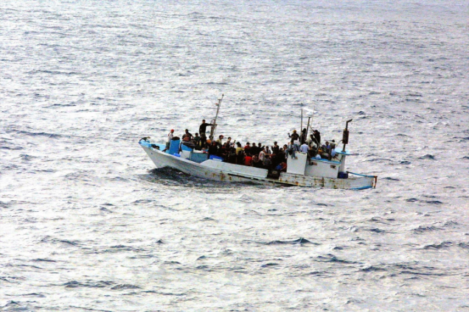
FOOD FOR THOUGHT
Please reflect again on the text your colleague has sent you (see the full text below) and your answers on what should be improved. Why do you think it should be improved? Explain your decisions (max. 300 words).
Dramatic death on the Mediterranean
At least seven people have drowned in a boat accident off the coast of the Italian island of Lampedusa. The number of people fleeing across the Mediterranean has increased significantly this year. Experts suspect that Europe is heading for a new peak in the refugee crisis.
In the morning, the Italian coast guard received a distress call from a boat, according to a press release. However, as several news agencies reported, the boat capsized just before a rescue ship came to the rescue. Seven of the occupants could only be recovered dead from the sea by the coast guard. Five migrants had to be resuscitated. Particularly dramatic: Among them was a helpless pregnant woman. The search for missing persons is still ongoing.
It is not yet known where the boat came from and from which countries the refugees originate. For weeks, more and more boats have been reaching the Italian Mediterranean island of Lampedusa, halfway between North Africa and Sicily. Experts see a renewed wave of refugees approaching Europe. Authorities in Europe consider it problematic that many of the people are illegal.
Contents of media coverage

Slide 14
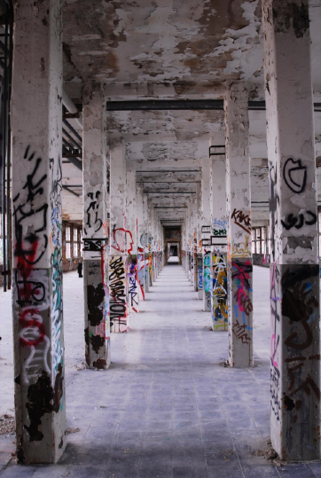
CHOOSING VARIOUS PERSPECTIVES

Slide 15
CONSTRUCTIVE JOURNALISM
In addition to the words you suggested for improvement in your colleague's text, you reflect about the perspective on the topic that your colleague chose. Often, the news media focus only on specific, dramatic events and tragedies. Thus, migration and forced displacement tend to be reported from a conflict-oriented perspective, and migrants and refugees tend to be stereotyped as a "problem“.
An alternative approach can also give a story a broader perspective - away from the conflict- or problem-oriented focus often used. One option you might think of is constructive journalism, often called solution-oriented journalism as well. This points to solutions rather than just reporting on problems and drama. Facts should be presented with explanatory context in this style of storytelling and reporting.
Definition Constructive Journalism:
“Constructive journalism is an emerging form of reporting that takes distance from the negativity bias in the news. Based on the ideas of positive psychology, constructive news stories focus on solutions and include positive emotions. The goal of this technique is to enhance audiences' interest in the news and, that way, to energize and inspire them to prosocial behavior. Constructive reporting matches the social responsibility function of journalism and can be located in its normative tradition” (Nölleke, 2019). When it comes to the topic of migration and forced displacement, a constructive angle may include, for example, looking at the resilience of people who are survivors of human trafficking, or looking at possible long-term answers to migration policy questions.
Choosing Various Perspectives

Slide 16
CONSTRUCTIVE JOURNALISM
Effects of Constructive Journalism
Such constructive reporting can, as argued by Hooffacker (2020), have the effect that
readers, viewers, listeners and users feel better after the reception by consciously perceiving positive perspectives or solutions and not only being burdened with problems
media companies achieve a better retention of the audience, i.e. reading times and reach increase.
the solutions and perspectives presented bring about progress in society. By presenting role models and solutions, others may feel encouraged to become socially engaged.
In the specific case of migration and refugee reporting, this also means that recipients can develop more understanding for migrants and people with refugee experience through constructive journalism.
Choosing Various Perspectives

Slide 17
WORD CLOUDS
The "glasses" through which one views the topic of migration and forced displacement may also influence how it is presented. The following word cloud is a collection of terms from a European perspective on the topic of migration. This word cloud is identifiable by the destination countries' perspective on the issue, with keywords such as "labor," "policy," "economic influence," "asylum," "legal situation," "minority," etc.
.
Choosing Various Perspectives

Slide 18
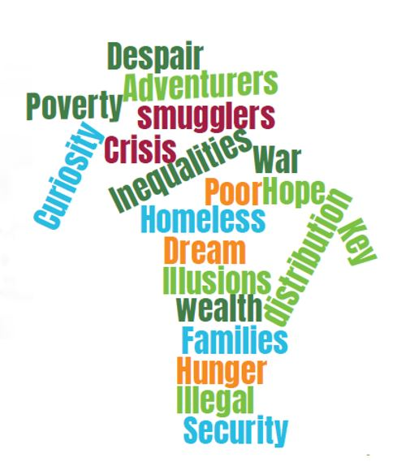
WORD CLOUDS
Looking at the second wordcloud, which was created during a workshop with journalists in the West African country Ivory Coast, makes the difference to the European perspective clear. Because in the second word cloud, which was created in a country of origin of migrants, completely different terms appear - "hunger", "hope", "war", "poverty", etc.
Source: Mack, J. (2018). Wordcloud. Ivory Coast. Internal Document.
Choosing Various Perspectives

Slide 19
MULTIPLE PERSPECTIVES: A JOURNALIST'S VIEW
To show the story from different places. To write about what’s happening in a Bavarian village that welcomes refugees, but also to go to Lesbos and see what’s going on on that island. And then also to go to Turkey, and write a reportage about Syrians in Istanbul for example. When it comes to the fact that people who come to Europe are not only refugees from war-torn countries, then you could go to Senegal. A country that is rather democratic in an African context, and relatively wealthy. And at the same time, a lot of people are leaving from there. Why? How does the Senegalese discussion on migration actually look like. Do they, for example local academics, see this exodus of young people as something helping or rather hurting their country?
Tomáš Lindner, Editor, Respekt (Czech News Magazine), quoted in Fengler et al. (2021)
Choosing Various Perspectives

Slide 20
TO-DO-LIST: MULTIDIMENSIONALITY IN REPORTING
To approach issues from migration and forced displacement from multiple angles, journalists need to prepare thoroughly. Here is a to-do-list you may use to ensure a multidimensional perspective:
Review of media coverage: Review previous coverage by different media to get a general overview
Context factors: Research and be aware of political, cultural and social contexts of specific migration and refugee movements
Data sources: Research and evaluate relevant data from international, national and local organizations
Organizations: Know activities of institutions and non-governmental organizations (NGOs) concerned with the topic, and critically reflect on their work
Social media: Follow social media postings from different sources on the topic
Politics: Know statements of politicians on the topic as well as the implications of their respective policies
Expert knowledge: Talk to migration and forced displacement experts
Variety of sources: Use NGOs as well as established sources such as governments, political parties, judicial authorities, police authorities, local governments, business organizations, trade unions, churches, international actors and many more as sources
Always: Conduct comprehensive source research
Choosing Various Perspectives

Slide 21
APPLICATION: MULTI-PERSPECTIVE VIEW
You would like to take a multi-perspective, global view of topics for your story, rather than just reporting from local or national perspectives. Jot down ideas on how you might report on the following topics in a multi-perspective way. You can find some ideas by clicking on the fictional headlines below.
Study: What attitudes do the citizens of Brno have toward refugees?
Instead of only using a local perspective on Brno, an outlook on other regions of the Czech Republic or even international comparisons could broaden the view. In this way, local attitudes can be contextualized with national and international statistics, and it becomes clear whether attitudes are actually comparatively positive or negative, for example.
More people than ever fleeing to Italy
Here, it makes sense not only to look at the effects of rising refugee numbers in Italy, but also to shed light on the causes in the countries of origin. In addition, the statistics could be classified: What data sources exist for the figure that more people than ever are fleeing to Italy, and how reliable are they?
Still this week the decision is to fall whether a blind asylum seeker from Syria may remain in Germany
It makes sense, for example, to also look at Syria in this context: How many people are being returned to Syria from which countries? What awaits the people there?
Choosing Various Perspectives

Slide 22
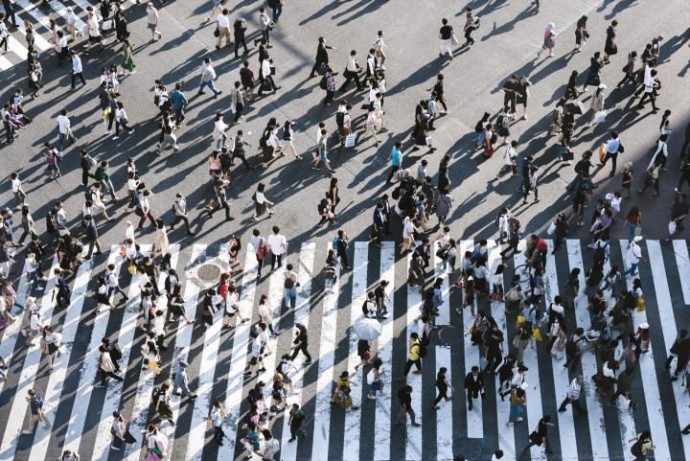
CHOOSING PROTAGONISTS
Ethically sound reporting also requires you to be responsible in your choice of protagonists and sources.
As you have learned in the course “Media Coverage on Migration and Forced Displacement", politicians are often the protagonists of the reporting. If the article is about political actions and decisions, this is unquestionably obvious. Nevertheless, even here the citizens, migrants and refugees affected by the decisions and the spokespersons of NGOs can have their say.
You take it upon yourself to approach the issues with a truly open mind and let people have their say. That way, you'll hear many more perspectives on an issue. You also want to spend enough time with people to understand the complexity of their situation, their personal stories, the socio-political situation of the countries they are moving through, and the contexts.
Choosing Various Perspectives

Slide 23
GUIDELINES
There are important codes for reporting on migrants and refugees that you can use as a guide:
- Charter of Idomeni
- Charter of Rome
- Guidelines of the international Ethical Journalism Network on migration reporting
- E-Media Toolkit of the European Union Agency for Fundamental Rights
Please take some time to read and reflect on these guidelines.
Choosing Various Perspectives

Slide 24
DRAG THE WORDS
One way to tackle negativity bias in reporting is called... | constructive journalism
As a journalist, it is important to know political and economic... of migration and forced displacement | context factors
A multidimensional approach to reporting migration and forced displacement may imply taking on the perspective of... | countries of origin
It is important to know about the activities of... concerned with the topic and critically reflect on them. | NGOs
A multi-perpective view also implies talking to... themselves. | migrants and refugees
Choosing Various Perspectives

Slide 25
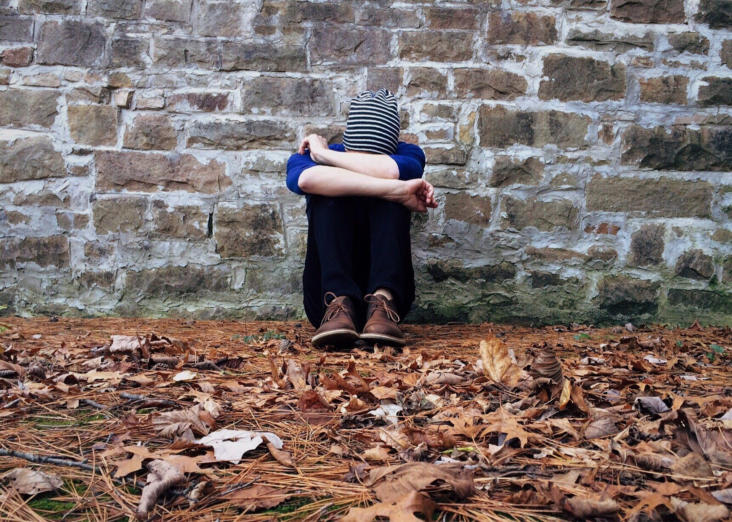
DEALING WITH TRAUMA

Slide 26
STUDY RESULTS
People who have experienced forced displacement and migration may be traumatized, which can make interviews and reporting difficult. To get an overview of the issue, you browse through some study results to get a better sense of the links between trauma and migration/forced displacement. For example, Carswell et al. (2011) and Steel et al. (2009) which concluded that increased symptoms of post-traumatic stress disorder (PTSD) were associated with higher levels of trauma among refugees and asylum seekers.
As you do so, consider: in what ways might traumatic experiences and trauma differ among different groups of migrants and refugees?
PTSD among refugees in Western countries
A study looking at mental disorders in about 7,000 refugees in seven Western countries found PTSD (9%) and major depression (5%) in refugees. The researchers concluded that refugees are about ten times more likely to suffer from PTSD than the general population in these countries.
PTSD among migrants in China
A study of trauma experiences and mental illness among 170 North Korean migrants in China shows that all interviewees were exposed to traumatic events, with food and water shortages (93%) and illnesses without access to medical care (89%) being the most commonly cited trauma experiences. Researchers suspected PTSD in 56% of respondents. Scores above the threshold for anxiety and depression were found in 90% and 81% of cases, respectively.
Dealing with Trauma

Slide 27
STUDY RESULTS
PTSD among migrants in the U.S.
In this study, migrants from Central America, specifically Honduras, El Salvador, and Guatemala, were interviewed at the U.S. border in Texas. Based on symptom checklists that migrants self-completed, diagnostic criteria were met for PTSD (32%), depression (24%), and for a mixture of PTSD and depression (17%).
PTSD among diverse groups in Switzerland
A comparative study of the mental health of various groups of immigrants and natives in Switzerland shows that respondents met the criteria for PTSD to varying degrees: Asylum seekers (54%) and refugees (41%) were most frequently affected; illegal migrants were significantly less likely (6%). Labor migrants were also affected to a lesser extent; the comparable figure for native-born Swiss was only 8%. These figures may lead to the conclusion that the residence status and/or the reason for leaving the home country may already be an indicator for PTSD.
Dealing with Trauma

Slide 28
TIIM MODEL
You are back from an interview with a refugee. In some moments you were not sure if you did the right thing.
You come across so called TIIM – Trauma Informed Interviews with Migrants - model that provides you with eight categories of what to take care of when talking to people who might have suffered trauma.
It is based on recommendations by Dart Center (2011), Hanaford et al. (2016), Hight & Smyth (2009), and Nobel (2018). The model has been published in the UNESCO Handbook "Reporting on Migrants and Refugees“ (Zappe, 2021, pp. 267-269).
Preparation – Thoroughly prepare interviews
Besides particular skills (e. g. interview techniques) and understanding of immigration law, statistics about migrants and refugees as well as migration
backgrounds, journalists should be aware about trauma aspects. If journalists know about the potential presence of trauma and have informed themselves about it, they have taken an
important step in preparation.
Identification – Be honest and transparent right from the beginning
Before asking the first questions, journalists should introduce themselves and their role: “My name is John Doe and I would like to report about migration for the Daily Magazine.” Journalist may receive an abrupt insensitive reaction. But they should not respond in a like manner and keep in mind that the reaction may be due to a traumatization. If a potential interviewee does not agree to the interview,
journalists could leave a contact card and suggest to talk later.
Dealing with Trauma
Notes:
Noch mehr aus UNESCO-Handbuch?

Slide 29
TIIM MODEL
Explanation – Keep in mind that your interviewees are rarely media experts
Journalist should know that migrants or refugees might come from a media culture different to theirs. They should try to explain the media process in their region and how their story, photo and/or footage is likely to be used. Journalists should also explain that the material could be edited before or after publication, may be used several times or may not be used at all. Above all, journalists should
refrain from giving abused people the additional burden of an (exclusive) contract. Media contracts are relatively unknown to most and negotiating such a contract – as a traumatized person
– can be a burden.
Respect – Always treat the interviewees with dignity
Journalists should respect the rights of migrants and refugees not to be interviewed, filmed and/or photographed – this means that people should always be asked in advance. Thus, traumatized migrants or refugees may be unable to be interviewed, filmed or photographed – and unable to give informed consent to an interview. Journalists should take that into consideration. People suffering from traumatic situations´might not want to talk about their experiences but do so about other issues. Journalists should not press people into an interview, by saying they would help others.
Setting – Feel responsible for a safe space for the interview
Traumatized people do need to talk about their trauma(s) without unwanted listeners or disturbance. Moreover, journalists should endeavour to give some control to the interviewees. Create an atmosphere in which migrants or refugees understand that they do not have to answer all questions or tell (traumatic) details and that the interview can be ended at any time in case they do not want to talk anymore.
Dealing with Trauma
Notes:
Noch mehr aus UNESCO-Handbuch?

Slide 30
TIIM MODEL
Words - Pay attention to your choice of words
Journalists should not feign compassion but use considerate terms. The supportive phrase “I’m sorry for what happened to you” rather than thebluntly “How do you feel?” Journalists should also avoid saying “I understand how you feel.” No matter how well-prepared journalists are, they do not “understand” what a traumatized migrant or refugee has experienced. Moreover, journalists should prefer the term “survivor” instead of “victim.” Migrants or refugees are not “victims” unless they describe themselves with the word “victim”. In addition, journalists should avoid the language of blame: They should be careful of asking “why” questions, “devil’s advocate” questions or questions that suggests that the interviewee could have (re-)act in another way, because refugees or migrants might feel selfblame, guilt and shame.
Time – Take enough time for the interview
For migrants or refugees, their (potentially traumatic) experience is very intense and personal. Thus, journalists should spend enough time with them. Then migrants or refugees can develop a sense of trust in journalists. That means journalists also need time to listen – actively and non-judgmentally. Over time, the interviewee might be more likely to reveal aspects, about which journalists would not have asked.
Reaction – Be prepared to respond to emotional incidents
During an interview, journalists may inadvertently mention a detail that triggers a flashback or other stressful memories. The interviewee could become desperate, collapse emotionally or distance themself. If they show a traumatic reaction, journalists should give the migrant or refugee time to recover. An advice is: “Try to stay calm and keep your actions predictable” (Hannaford et al., 2016). Journalists should offer help, reassure the migrants or refugees that it is a safe situation in a safe location and remind them who they are. After a while, when the interviewee has gathered, journalists can ask: “Are you ready to move on with the interview?” It is also possible to cancel the interview after a collapse.
Source: Zappe, 2021
Dealing with Trauma
Notes:
Noch mehr aus UNESCO-Handbuch?

Slide 31
CONTROLLING QUESTIONS
Which of the following aspects is not a category of the TIIM model?
Preparation
Respect
Words
Pictures
Which of the following aspects is a category of the TIIM model?
Interaction
Identification
Identity
Ideology
Journalists should avoid saying „I understand how you feel“.
True
False
When interviewing migrants and refugees, journalists should not show any compassion at all.
True
False
Dealing with Trauma

Slide 32
CONCLUSIONS
This course has confronted you with research techniques and sources, criteria for choosing perspectives and protagonists, forms of presentation, criteria for choosing words and images, as well as knowledge of ethical guidelines and considering the role of trauma.
Important insights are:
- Narratives have contexts: Think carefully about your terminology.
- Facts and emotions are part of the story: Use both in a balanced way.
- With migration and forced displacement being a truly global issue, there is more than the national perspective: keep this in mind - even for local stories.
- Migrants are (more than) actors in articles and reports, they are people - with individual stories and feelings. They are not passive masses, but active individuals. Present them as such.
- As a journalist and in public relations, you can help shape public opinion on migration and forced displacement: Think about the potential impact of your reporting.
Conclusions

Slide 33
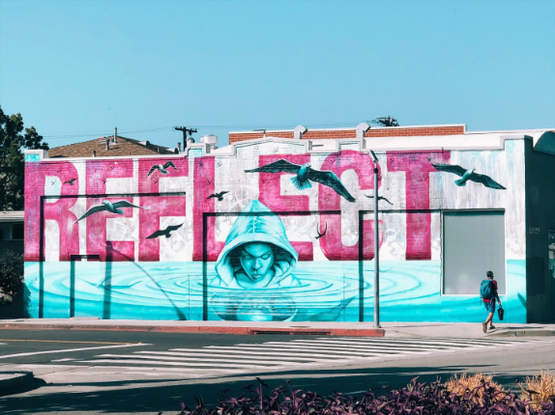
FOOD FOR THOUGHT
Please browse the headlines of one particular news media outlet for a week, looking for reports on issues related to migration and forced displacement (e.g., events related to migration and forced displacement; coverage of policies related to migration and forced displacement, etc.). Take one particular issue and reflect on the following questions:
Which sources were used for reporting? (max. 150 words)
Which protagonists did you recognize? (max. 150 words)
Which perspectives did the news outlet take in its reporting? (max. 250 words)
Think of ways to broaden the perspective of covering the issue. Suggest potential additional sources, protagonists, and perspectives that could have been used, and explain your choices. (max. 300 words)
Conclusions

Slide 34
Bibliography, referred works
Carcamo, C., Matza, M., Pierre-Pierre, G., Sacchetti, M., & Ritchin, A. (2014, January 6). Covering Immigrants & Immigration: Tips from Experts. https://dartcenter.org/content/covering-immigrants-immigration-tips-from-experts
Carswell, K., Blackburn, P., & Barker, C. (2011). The relationship between trauma, post-migration problems and the psychological well-being of refugees and asylum seekers. The International Journal of Social Psychiatry, 57(2), 107–119. https://doi.org/10.1177/0020764009105699
Dart Center for Journalism & Trauma (2011). Working With Victims and Survivors. https://dartcenter.org/content/working-with-victims-and-survivors#.VUYw-kJhP39
European Federation of Journalists (EJF) (2016). 8 tips for migration coverage. https://europeanjournalists.org/blog/2016/11/28/8-practical-tips-for-migration-coverage/
Ethical Journalism Network (n.d.) Five-point guide for migration reporting. https://ethicaljournalismnetwork.org/ethical-guidelines-on-migration-reporting
Fazel, M., Wheeler, J., & Danesh, J. (2005). Prevalence of serious mental disorder in 7000 refugees resettled in western countries: A systematic review. Lancet, 365(9467), 1309–1314. https://doi.org/10.1016/S0140-6736(05)61027-6
Fengler, S., Speck, D., Kreutler, M., Lengauer, M., & Zappe, A.-C. (2021). Covering Migration. In The Newsreel Project Consortium (Ed.), Newsreel2. New Teaching Fields for the Next Generation of Journalists. Research report (pp. 54–73). https://doi.org/10.17877/DE290R-22455
Hanaford, A., Hurd, J., Parkinson, J., Robjant, K., Salloum, R., & Gearing, J. (2016, February 26). Reporting on Refugees: Tips on Covering the Crisis. https://dartcenter.org/resources/reporting-refugees-tips-covering-crisis
Heeren, M., Wittmann, L., Ehlert, U., Schnyder, U., Maier, T., & Müller, J. (2014). Psychopathology and resident status - comparing asylum seekers, refugees, illegal migrants, labor migrants, and residents. Comprehensive Psychiatry, 55(4), 818–825. https://doi.org/10.1016/j.comppsych.2014.02.003

Slide 35
Bibliography, referred works
Hight, J., & Smyth, F. (2009, February 17). Tragedies & Journalists. https://dartcenter.org/content/tragedies-journalists-6?section=all
Hooffacker, G. (2020). Journalistische Praxis: Konstruktiver Journalismus. Springer Fachmedien. https://doi.org/10.1007/978-3-658-31771-3
Lee, Y., Lee, M. K., Chun, K. H., Lee, Y. K., & Yoon, S. J. (2001). Trauma experience of North Korean refugees in China. American Journal of Preventive Medicine, 20(3), 225–229. https://doi.org/10.1016/s0749-3797(00)00282-8
Lengauer, M. (2021). Module 2: Key Sources, Key Facts, Key Terms and Numbers. In S. Fengler, M. Lengauer, & A.C-Zappe (Eds.), Reporting on Migrants and Refugees. Handbook for Journalism Educators (pp. 29-53). UNESCO. https://unesdoc.unesco.org/ark:/48223/pf0000377890
McAuliffe, M., Pedrotti, M., & Weerasinghe, S. (2017). Migration research and analysis: Growth, reach and recent contributions. In IOM (Ed.), World Migration Report 2018.
Nobel, C. (2018, August 9). 10 rules for reporting on war trauma survivors. https://journalistsresource.org/politics-and-government/10-rules-interviewing-trauma-survivors/
Nölleke, D. (2019). Constructive Journalism. In T. P. Vos, F. Hanusch, & A. Sehl (Eds.), The international encyclopedia of journalism studies. John Wiley & Sons Ltd. https://doi.org/10.1002/9781118841570.iejs0121
Steel, Z., Chey, T., Silove, D., Marnane, C., Bryant, R. A., & van Ommeren, M. (2009). Association of torture and other potentially traumatic events with mental health outcomes among populations exposed to mass conflict and displacement: A systematic review and meta-analysis. JAMA, 302(5), 537–549. https://doi.org/10.1001/jama.2009.1132
Zappe, A.-C. (2021). Module 11: Reporting on Migrants and Refugees: Dealing with Trauma. In S. Fengler, M. Lengauer, & A.C-Zappe (Eds.) , Reporting on Migrants and Refugees. Handbook for Journalism Educators (pp. 243-262). UNESCO. https://unesdoc.unesco.org/ark:/48223/pf0000377890

Slide 36
Sources of Photos
Illustration pictures:
Articulate Content Library 360
Unsplash:
All photos published on Unsplash can be used for free. You can use them for commercian and non-commercial purposes.
https://unsplash.com/license
Pixabay:
CCO 1.0 Universal (CC0 1.0) Public Domain Dedication
http://www.pixabay.com

Slide 37
Sources of Photos
Freepik: https://www.freepik.com/
Pexels: All photos on Pexels can be used for free. https://www.pexels.com
Microsoft Powerpoint Stock Photos

Slide 38
Where you can find us
newsreel.pte.hu
newsreel@pte.hu
thenewsreelproject
@thenewsreelproject @newsreelproject
The project was funded by the European Commission. The views expressed in this publication do not necessarily reflect those of the European Commission.

