Slide 1
GRAPHIC JOURNALISM
Funded by the Erasmus+ Programme of the European Union
New Teaching Fields for the Next Generation of Journalists 2020-1-HU01-KA203-078824

Slide 2
Lesson 1 - Introduction to Comics Studies

Slide 3
The Course
Introduction to Comics Studies
Comics as Media Culture
Tools for Analysing Graphic Narratives
Media Genres of Comics Journalism

Slide 4
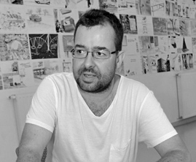
About the author
Gyula Maksa, PhD, dr. habil. is an associate professor at the University of Pécs (Hungary), Department of Communication and Media Studies, where he directs the Comics Studies Research Center (Képregénytudományi Kutatóközpont). He has organized several conferences, exhibitions and published two books in Hungarian on comics as a medium: Változatok képregényre (Variation for Comics, Budapest-Pécs, Hungary, 2010), Képregények kultúraközi áramlatokban (Comics in Transcultural Flows, Cluj, Romania, 2017). His main research areas are the geopolitics of comics, transcultural situations and communicative uses of comics.

Slide 5
What we are going to discuss
In the following we briefly define comics studies and describe some of its institutions.
We then provide theoretical comments on the emergence, dynamic identity, transculturality and digitisation of comics.

Slide 6
1. About Comics Studies and its Institutions

Slide 7
1.1. Comics Studies
Comics studies is an academic field that deals with comics. Within the field of cultural and media studies, comics studies and/or manga studies seem to be emerging. The study of comics as a medium focuses on three major aspects: examining production, industry, distribution, and authorship.
Analyses look at media texts in terms of the content conveyed, the creation of comics, and the use of comics language. Studies also focus on the audiences, uses, and reception of comics.
Transversal approaches examine all three aspects, such as the genre, popular geopolitics, or subculture.
1. About Comics Studies and its Institutions

Slide 8
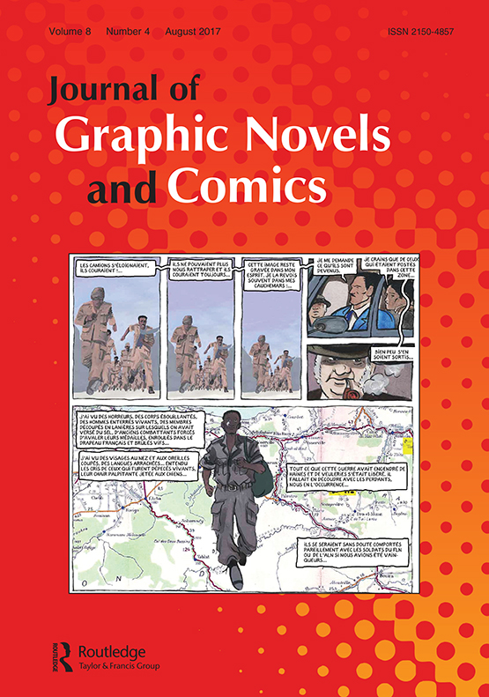
1.2. International Comics Studies Reviews and Journals
International Journal of Comic Art (1999) http://www.ijoca.net/
Image [&] Narrative (2000) http://www.imageandnarrative.be/
ImageText (2004) https://imagetextjournal.com/
European Comic Art (2008) https://www.berghahnjournals.com/view/journals/eca/eca-overview.xml
Comicalités. Etudes de culture graphique (2010) https://journals.openedition.org/comicalites/
Studies in Comics (2010) https://www.intellectbooks.com/studies-in-comics
Journal of Graphic Novels and Comics (2010) https://www.tandfonline.com/toc/rcom20/current
Sequantial Art Narrative in Education (2010) https://digitalcommons.unl.edu/sane/
The Comics Grid (2013) https://www.comicsgrid.com/
1. About Comics Studies and its Institutions

Slide 9
1.3. Comics Centres and Museums
Since the 1980s, independent centres for comic art in Belgium and France have functioned as both collections and museums. In the last two decades, comics research has been organized in several European countries. Germany has a society (ComFor), the Czech Republic and Hungary have university research centres for comics studies (Centrum pro studia komiksu,and Képregénytudományi Kutatóközpont, respectively), and comics research is particularly active in the Nordic countries.
1. About Comics Studies and its Institutions

Slide 10
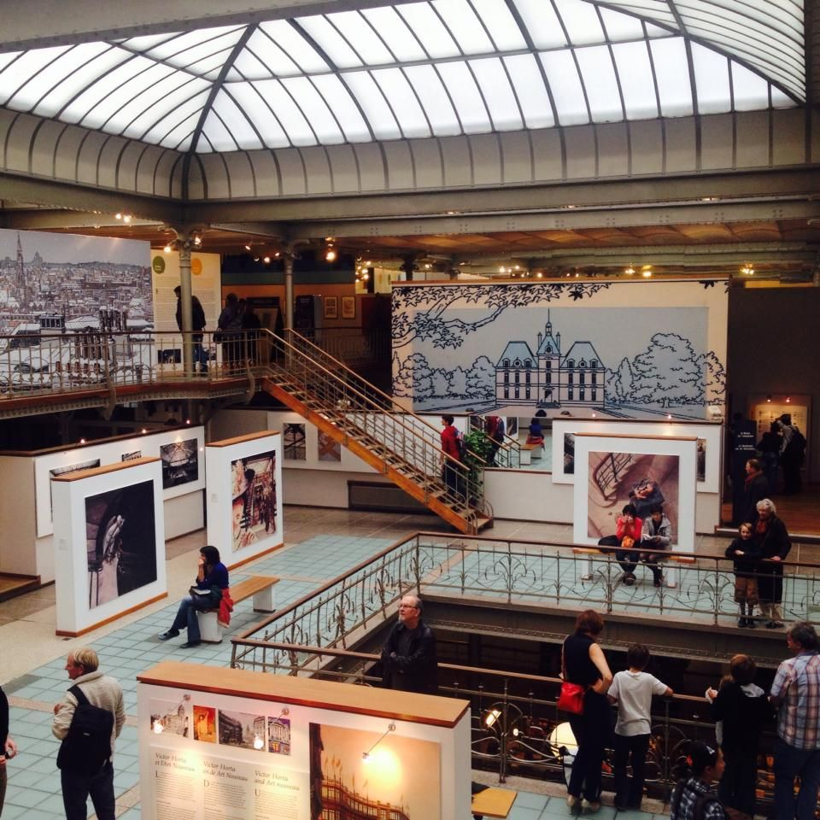
1.3. Comics Centres and Museums
Centre Belge de la Bande Dessinée/ Belgisch Stripcentrum/ Belgischen Comic-Zentrum, Brussels, Belgium https://www.cbbd.be/fr/accueil
Cité internationale de la bande dessinée et de l'image/ Musée de la Bande Dessinée, Angoulême, France http://www.citebd.org/
Comic-Archiv des Instituts für Jugendbuchforschung, Frankfurt am Main, Germany
http://sammlungen.uni-frankfurt.de/sammlung/11/comic-archiv-a-institut-f-r-jugendbuchforschung/
Kyoto International Manga Museum (京都国際マンガミュージアム, Kyōto Kokusai Manga Myūjiamu), Kyoto, Japan
https://www.kyotomm.jp/
Centre Belge de la Bande Dessinée
1. About Comics Studies and its Institutions

Slide 11
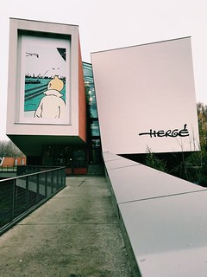
1.3. Comics Centres and Museums
Billy Ireland Cartoon Library & Museum, Columbus, Ohio, USA https://cartoons.osu.edu/about-us/
Michigan State University Comic Art Collection, Lansing, USA, https://comics.lib.msu.edu/
NOVA. Czytelnia Komiksów i Gazet, Poznan, Poland, http://lib.amu.edu.pl/pracownia_komiksu/
Cartoonmuseum Basel, Switzerland https://www.cartoonmuseum.ch/
Musée Hergé Louvain-la-Neuve, Belgium https://www.museeherge.com/fr
Storyworld, Groningen, Netherland, https://www.storyworld.nl/
Comicbibliothek Renate, Berlin, Germany, http://www.renatecomics.de/bibliothek.html
1. About Comics Studies and its Institutions

Slide 12
Controlling questions
Are the following statements true or false?
Since the 1980s, independent centres for comic art in Belgium and France have functioned as museums. (true)
ComFor is a German society for comics research. (true)
Only in the major international comics industry centres is there comics research activity. (false)
The Czech Republic and Hungary have university research centres for comics studies. (true)
There are only 5 comics studies journals and reviews in the world. (false)

Slide 13
2. Theoretical and Historical Considerations

Slide 14
2.1.„A medium is always born twice …”
André Gaudreault & Philippe Marion: A medium is always born twice …:
„For our purposes, we will use the definition of media proposed by Eliséo Véron. For Véron, a medium is: an ensemble composed of a technology plus the social practices around the production of that technology and the appropriation of the messages generated, when there is public access to these (whatever the conditions of this access may be, which usually has a price attached to it).”
On the concept of dynamic identity: „Identity is understood here in the sense suggested by Paul Ricoeur: it must be seen as being inscribed in a resolutely historical perspective, that of a permanent state of transformation, of an ipseity which makes it possible to overcome the same and the different.”
2. Theoretical and Historical Considerations

Slide 15
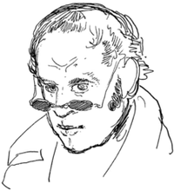
2.1.„A medium is always born twice …”
André Gaudreault & Philippe Marion: A medium is always born twice …:
1. The appearance of a technological process (crypto-medium): „Rodolphe Töpffer, who considered himself the heir to the tradition of caricature and popular imagery, increasingly appears (see Kunzle, Groensteen and Peeters) to be the true ‘inventor’ of the comic strip, or graphic novel. It was thus with Töpffer that the medium saw its first birth. Töpffer drew his first engraved story, Monsieur Vieux Bois, in 1827. With the encouragement of Goethe himself he published, and thus made public (recall here Véron’s criterion concerning public access to a medium) the first graphic novel: Monsieur Jabot (1833).”
2. The emergence of an apparatus, through the establishment of procedures (early culture, proto-medium): „Not only is the phase of the comic strip’s appearance crystallised in Töpffer; here we also find the first stirrings of its more dynamic period of emergence (our second phase). Töpffer, just like the early cinématographistes, worked with well-known genres (the story told with images, the caricature, popular imagery), but he did so with a feverish and halting awareness thus his means of expression was new and full of rich potential.”
3. The constitution of a media institution: „In its interaction with this press the comic strip and graphic novel became accepted and popular culture industries. It was in complicity with this press that it established itself and found its identity. Only then, during the first half of the twentieth century, did it experience its second birth and constitution (our third phase) as a singular medium.”
Rodolphe Töpffer
2. Theoretical and Historical Considerations

Slide 16
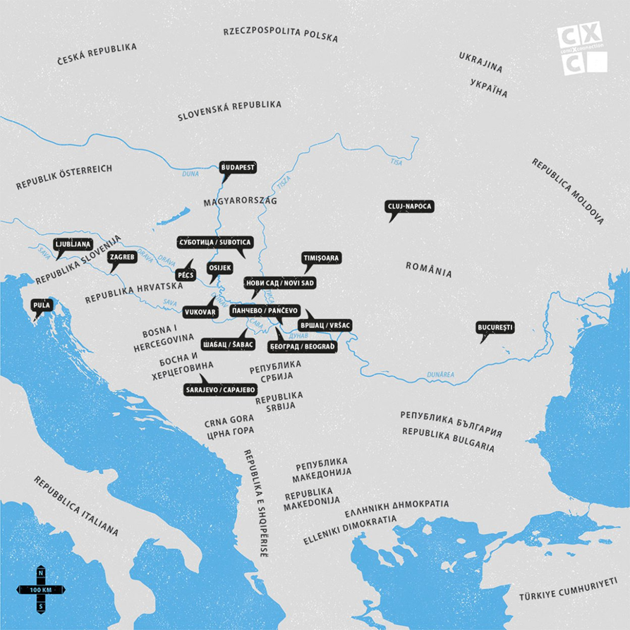
2.2. Transculturality
Concepts from contemporary culture and media studies such as transculturality and hybridisation, seem particularly useful when examining the media-cultural phenomena of contemporary comics. The notion of transculturality does not presuppose cultures that are intrinsically homogeneous and well distinguishable from each other. Rather, it draws our attention to the process of cultural evolution and dynamic identities, and thus seems more suitable for understanding cultural globalisation flows that are not understood exclusively as homogenisation and cultural imperialism.
The prefix 'trans' refers to being in motion, to transformation, to process, to change, to back and forth, and offers the possibility of a fixity of positions that is at most temporary. In the last few years we have also seen reflective transnational and transcultural comic art projects.
One example is comiXconnection.
2. Theoretical and Historical Considerations

Slide 17
Controlling questions
Are the following statements true or false?
The medium is an ensemble of technology and social practices. (true)
Töpffer published his book at Goethe's encouragement. (true)
The first birth of the medium is the constitution of the institution. (false)
The second birth of the media is the invention of technology. (false)
ComiXconnection is a transcultural comic art project. (true)

Slide 18
3. The Comics Media in the Digital Age

Slide 19
3.1.Dynamic Identity
The historical evolution of the dynamic identity of comics media generated the emergence of different historical and cultural versions. The dynamic identity of the comics media manifest in cultural versions is also evident in the digital age. With the changes of the medium and the change of mediative arrangements and dispositions, certain elements of the mediativity [mediativity: a set of characteristics specific to the given medium] of comics become less constant: sound is now expressed not exclusively by onomatopoeia, motion is not represented only with still images. The tabularity, the arrangement of panels on the comics page, is also dynamically changing.
3. The Comics Media in the Digital Age

Slide 20
3.2.Webcomics, Webtoon, Bande dessinée numérique
It is remarkable that the techno-cultural diversity of the comics media is not lost in the field of digital comics either. Traditional comics exists in geographical and cultural versions that often vastly differ in terms of genres, markets, audiences and graphic styles, and digital comics is similar to it in this sense. The history, distribution, mediatic arrangement and environment of North American webcomics, Korean webtoon, and Francophone bande dessinée numérique, as well as their uses show significant differences from each other, but they themselves are also characterised by a huge internal variety.
3. The Comics Media in the Digital Age

Slide 21
Controlling questions
Are the following statements true or false?
Digital comics only use still images. (false)
Webtoon is French in origin. (false)
Mediativity means the ability to act in media. (false)
Digital comics exists in cultural variations. (true)
Comics is a media with a dynamic identity. (true)

Slide 22
Bibliography, referred works
Gaudreault, A. and Marion, P. (2005): A Medium is Always Born Twice... Early Popular Visual Culture, Vol. 3., No. 1., 3–15.
Hepp, A. (2006): Transkulturelle Kommunikation, Konstanz: UVK.
Lukács, L. K. and Maksa, Gy. (2022): Comics Media in the Digital Age: The Case of the “Machines à Bulles” Exhibition, ME.DOK: MÉDIA-TÖRTÉNET-KOMMUNIKÁCIÓ Vol. 17, No. 2, 5-14.
Marion, P. (1997): ‘Narratologie médiatique et médiagénie des récits’, Recherches en Communication, No. 7, 61–87.
Paolucci, P. and Baudry, J. (2016): ‘La bande dessinée numérique vue d’ailleurs’ in Robert (ed.) Bande dessinée et numérique, Paris: CNRS, 59-77.
Robert, P. (ed.) (2016): Bande dessinée et numérique, Paris: CNRS.
Stefanelli, M. (2012): ‘Un siècle de recherches sur la bande dessinée’. in Maigret, Stefanelli (eds.) La bande dessinée: une médiaculture, Paris: Armand Colin – INA, 17–49.
Strömberg, F. (2016): ‘Comics studies in the Nordic countries – field or discipline?’, Journal of Graphic Novels and Comics Vol. 7, No. 2, 134–155.

Slide 23
Sources of Photos
Illustration pictures:
Articulate Content Library 360
Unsplash:
All photos published on Unsplash can be used for free. You can use them for commercian and non-commercial purposes.
https://unsplash.com/license
Pixabay:
CCO 1.0 Universal (CC0 1.0) Public Domain Dedication
http://www.pixabay.com
Notes:
See other sources in the notes

Slide 24
Sources of Photos
Freepik: https://www.freepik.com/
Pexels: All photos on Pexels can be used for free. https://www.pexels.com
Microsoft Powerpoint Stock Photos

Slide 25
Other Sources of Photos
https://www.tandfonline.com/doi/cover-img/10.1080/rcom20.v008.i04
https://i.pinimg.com/originals/71/a5/d5/71a5d5bdb270d977599ac83995f907bd.jpg
https://live.staticflickr.com/4688/25101885208_f846e43b22_n.jpg
https://www.altaplana.be/_media/dictionary/file_rodolfe_toepffer.png?w=200&tok=931680
www.comixconnection.eu
https://books.openedition.org/editionscnrs/docannexe/file/20664/cnrs-11830-img01-small480.jpg

Slide 26
Where you can find us
newsreel.pte.hu
newsreel@pte.hu
thenewsreelproject
@thenewsreelproject @newsreelproject
The project was funded by the European Commission. The views expressed in this publication do not necessarily reflect those of the European Commission.

