Slide 1
VERIFYING AND ANALYZING „FAKE NEWS”
Funded by the Erasmus+ Programme of the European Union
New Teaching Fields for the Next Generation of Journalists 2020-1-HU01-KA203-078824

Slide 2
Lesson 2 - What is News? What is Fake News? Fake news typology

Slide 3
The Course
Lesson 1 - Introduction of the course. History of Fake News
Lesson 2 - What is the news? Fake news typology
Lesson 3 - Fake news and social media
Lesson 4 - Fact-checking

Slide 4
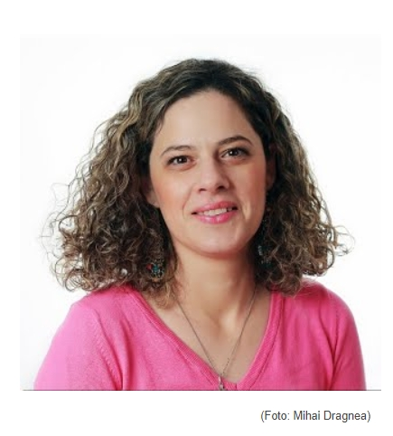
About the author
Antonia Matei is a lecturer at the Faculty of Journalism and Communication Sciences (University of Bucharest). She is an experienced journalist and has spent more than 10 years as a reporter and editor at the Romanian Broadcasting Corporation. She was also an anchor and a presenter of the radioshow “Our Objective: Romania and Our World” and of the talk-show “Europe Is Closer”. She has a PhD in Communication Sciences and is an editor at EJO Romania.

Slide 5
What we are going to discuss
What Is News?
What Is Fake News?
Information Disorder
Key Concepts – Misinformation, Disinformation, Malinformation
Classifying Fake News

Slide 6
What Is News?

Slide 7
What is news?
News represents information about recent events, especially about events that influence people’s lives. Something interesting, intriguing or unique, something that holds a grain of conflict or controversy, something that is happening near a certain audience, something that raises the human interest all these qualify as news.
Dozens of events take place every day in a specific place and hundreds of events take place globally. But not all of these become news. Journalists are the ones who decide which of the information and events that flood the world every day are actually presented to the public. In order to choose what becomes news they have certain tools at hand. Thus, for an event or an information to become news it has to meet at least one of more criteria: impact, significance, prominence, proximity, timeliness, conflict, unusual/human interest, currency, necessity.
Photo source: Articulate
News

Slide 8
What is news?
In a globalized world, news helps people stay informed and find out things that will mark their lives. News is not a literary genre, but a factual one. Its main goal is to inform the audience. That means that news is precise and unbiased, it should present true facts about events, situations or people. All news has a headline, a lead and the text itself (the news body).
The main features of the news are: accuracy and objectivity. Also, news should be balanced (it has to present all the points of view involved in a situation/event), concise (the news should be short because, when reading it, people want to find out as much information as possible in the shortest possible time) and current (the news must present the latest information, not old ones that people have no interest in anymore). It is also important for the news to be clear and rather simple (all people should understand it no matter their degree of education), easy to read, and attractive to everyone.
News

Slide 9
What is news?
News reports usually appear in newspapers, on television, radio or on the internet. Due to the rapid evolution of technology, social media has become an important tool for presenting and sharing news.
One of the main classifications refers to hard news and soft news.
”Hard news is typically used to refer to topics that are usually timely, important and consequential, such as politics, international affairs and business news”. (https://www.digitalnewsreport.org/survey/2016/hard-soft-news-2016/)
Soft news is also called market-centered journalism and refers to topics which can be found between actual information and more entertainment. ”Although the term soft news was originally synonymous with feature stories placed in newspapers or television newscasts for human interest, the concept expanded to include a wide range of media outlets that present more personality-centered stories.” (https://www.britannica.com/topic/soft-news )
News

Slide 10
What Is Fake News?

Slide 11
Fake News & Information Disorder
The term ‘‘fake news” is too vague for the diversity of false content that has flooded the communication space.
By using "fake news" can be difficult to distinguish between the previous and the new forms. Under this general label one can find many different shades and types of misleading content. But, “perhaps most problematic is that the term fake news has been weaponized, mostly by politicians and their supporters to attack the professional news media around the world.” (The Age of Information Disorder | DataJournalism.com)
”Fake news is news that does mischief with the truth in that it exhibits both (a) a lack of truth and (b) a lack of truthfulness. It exhibits a lack of truth in the sense that it is either false or misleading. It exhibits a lack of truthfulness in the sense that it is propagated with the intention to deceive or in the manner of bullshit”. (Jaster, R.; Lanius, D., 2018, 6)
Fake News

Slide 12
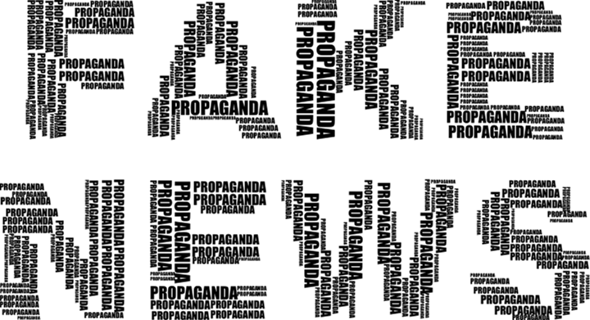
Fake news & Information Disorder
Information disorder is an issue that affects everyone and it is used to describe the new chaos in the information eco-system caused by the massive spread of false content, such as:
Imposter websites
Ambiguous partisan content
Conspiracy theories
Rumors
Deceitful memes
Manipulated videos and photos
Old photos and videos presented as new
Photo source: Articulate
Information Disorder

Slide 13
CONTROLLING QUESTIONS
1. News is a literary genre, not a factual one. Its main goal is to entertain the audience. That means that news is biased, it should present any kind facts about events, situations or people.
True
False
2. Information disorder is an issue that affects everyone and it is used to describe the new chaos in the information eco-system caused by the massive spread of false content.
True
False
What is news?/ Information disorder

Slide 14
KEY CONCEPTS Classifying Fake News

Slide 15
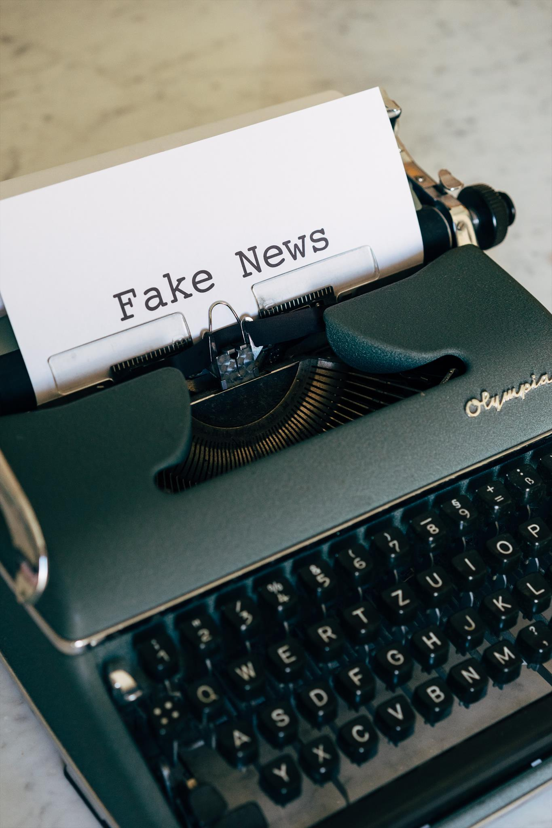
Classifying Fake News
In order to better discern into the present information environment there are three main factors used to classify them. In order to spot the false information a user should pay attention to:
The different sorts of content which are created and then shared
The motivations of the person who created the piece of news
How that content is distributed
Using these elements one can distinguish between three main types of false information: disinformation, misinformation and malinformation.
Misinformation – refers to misleading information created and shared without harmful intent
Disinformation – refers to false information shared with a manipulative intent
Malinformation – refers to accurate information shared intentionally to provoke harm
Photo source: Articulate
Types of Fake News

Slide 16
Disinformation
All types of false misinformation a threat for the society, ”but disinformation is particularly dangerous because it is frequently organised, well resourced, and reinforced by automated technology.” (Cherilyn Ireton and Julie Posetti, 2018, Journalism, Fake News and Disinformation. Handbook for Journalism Education and Training)
It refers to deliberate and sometimes organized attempts to confuse or mislead people by delivering dishonest information to them. This can be associated with other types of actions and schemes like hacking or compromising a public figure.
The Code of Practice on Disinformation launched by the European Commission defines disinformation as "verifiably false or misleading information which, cumulatively, is created, presented and disseminated for economic gain or to intentionally deceive the public" and also ”may cause public harm intended as threats to democratic political and policymaking processes as well as public goods such as the protection of EU citizens' health, the environment or security".
Information Disorder

Slide 17
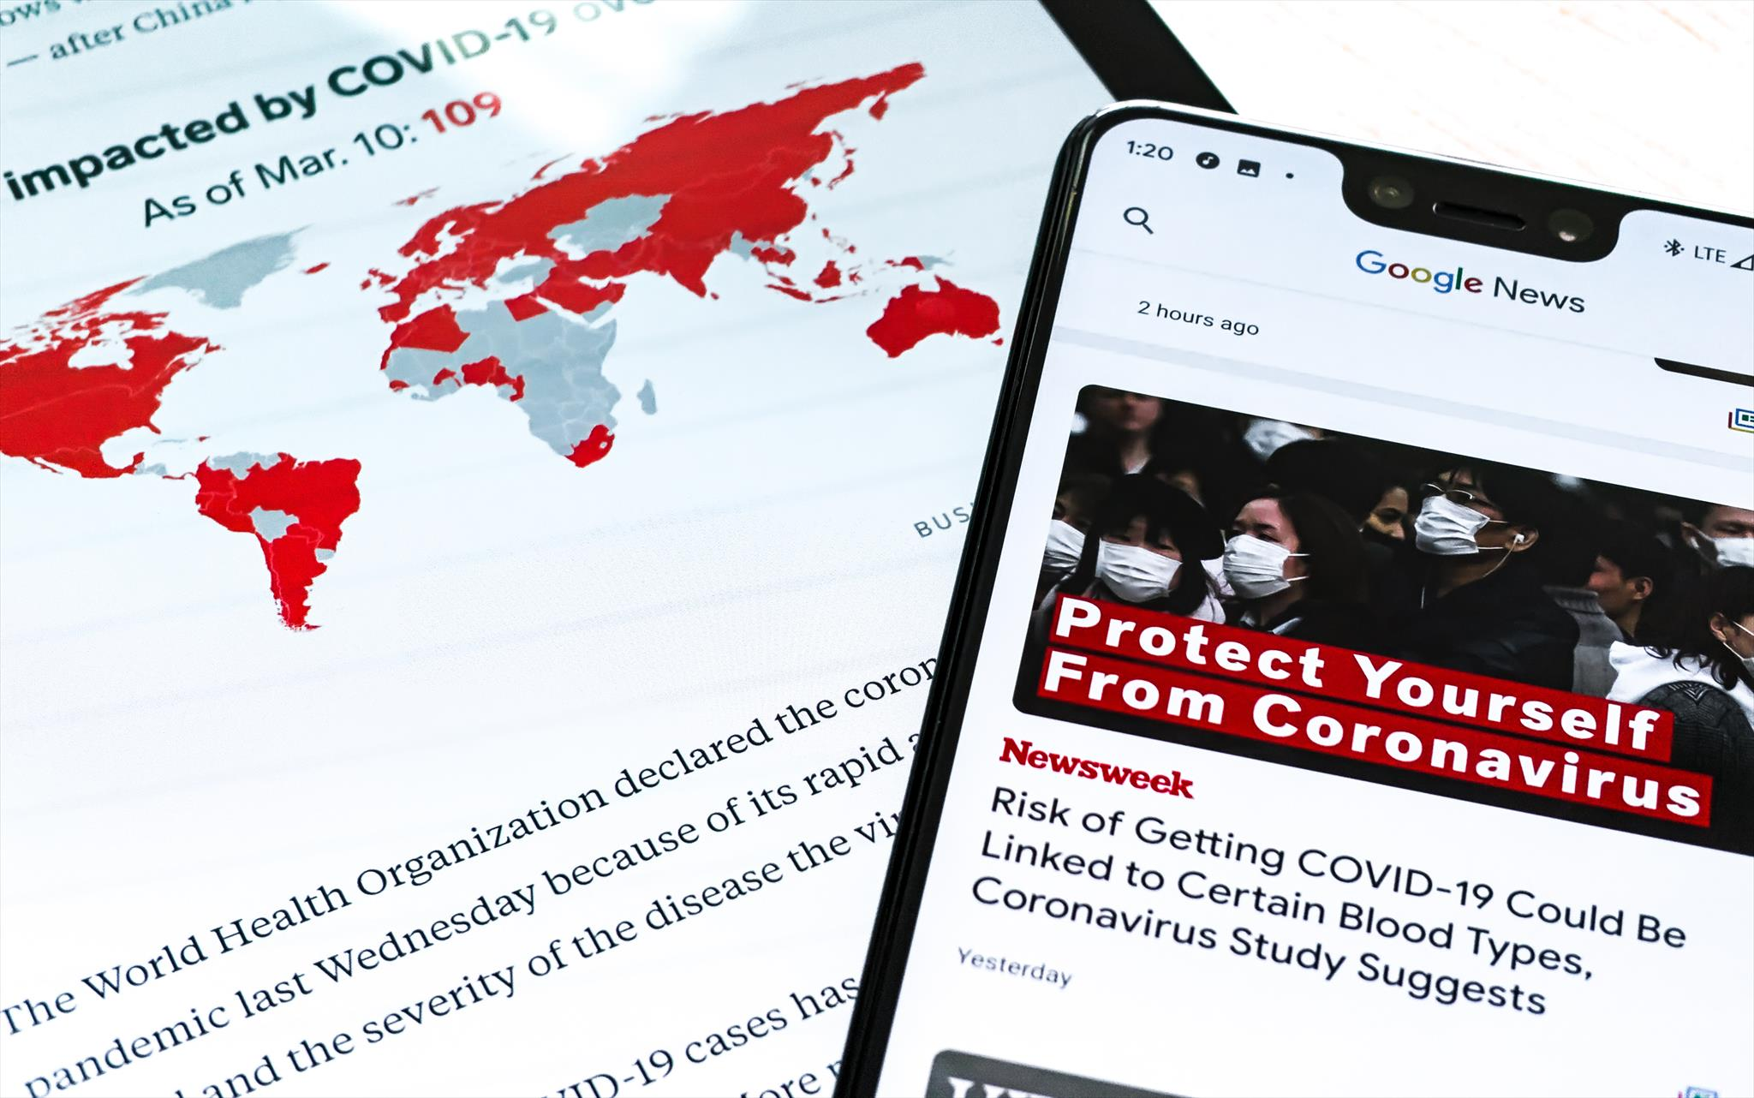
Misinformation
Some people share false information without knowing that the content they are forwarding is only partly accurate or even entirely fake.
Misinformation refers to ”information that is misleading, erroneous or false. Misinformation is generally shared — and sometimes created — by people who are unaware that it’s inaccurate. This is the best term to use when the intent of the creator or sharer is unknown.”
Misinformation can be found especially on social media platforms where users can share whatever content they want, whether true or false. Still, there are situations when people spread false information without actually wanting to harm someone, but with good intentions in mind. They want to express their opinions or alert others about some risky situation.
Photo source: Articulate
Information Disorder

Slide 18
Malinformation
This type of fake news refers to information that is actually true or it is based on a real fact, but it is use with the specific intent of hurting someone (a person, a group of people, a company and even a nation). It is usually disseminated in order to create confusion.
In many cases, malinformation refers to situations in which the private sphere is violated and the intention it that of harming someone`s reputation.
Examples of malinformation consist of:
Private details that are made public without a proper justification (details about the sexual orientations, about religious beliefs a.s.o.)
Cyberbullying, online teasing
Public shaming
Publishing private emails
Information Disorder

Slide 19
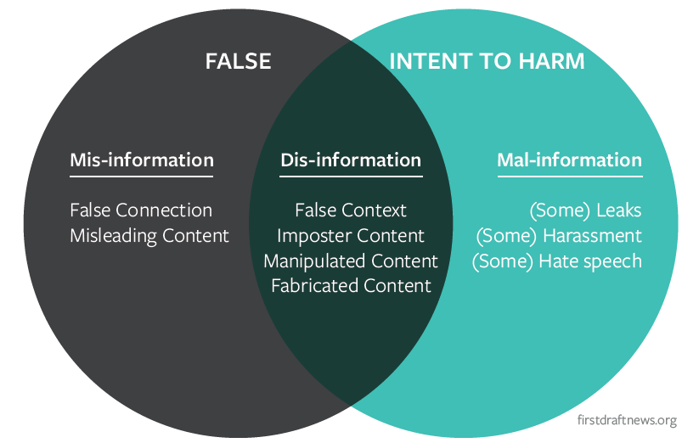
About Information Disorder
The three stages of information
disorder:
1. Creation
2.Production
3. Distribution
The elements of information disorder.
Source: Ireton & Posetti, 2018, p. 46
Information Disorder

Slide 20
CONTROLLING QUESTIONS
Which of the following sentences are NOT correct?
Malinformation is generally shared — and sometimes created — by people who are unaware that it’s inaccurate.
Disinformation refers to deliberate and sometimes organized attempts to confuse or mislead people by delivering dishonest information to them.
Misinformation – refers to misleading information created and shared without harmful intent
In many cases, disinformation refers to situations in which the private sphere is violated and the intention it that of harming someone`s reputation.

Slide 21
MORE TYPES OF FAKE NEWS

Slide 22
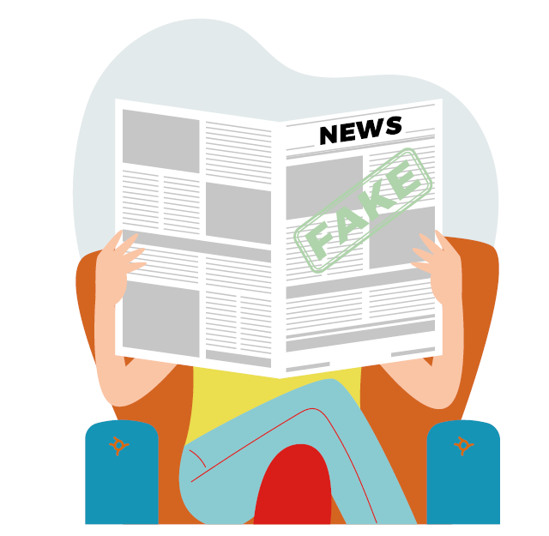
Types of fake news
Satire or Parody
False Connection
Misleading Content
False Context
Imposter Content
Manipulated Content
Fabricated Content
https://firstdraftnews.org/long-form-article/too-much-information/
Types of Fake News

Slide 23
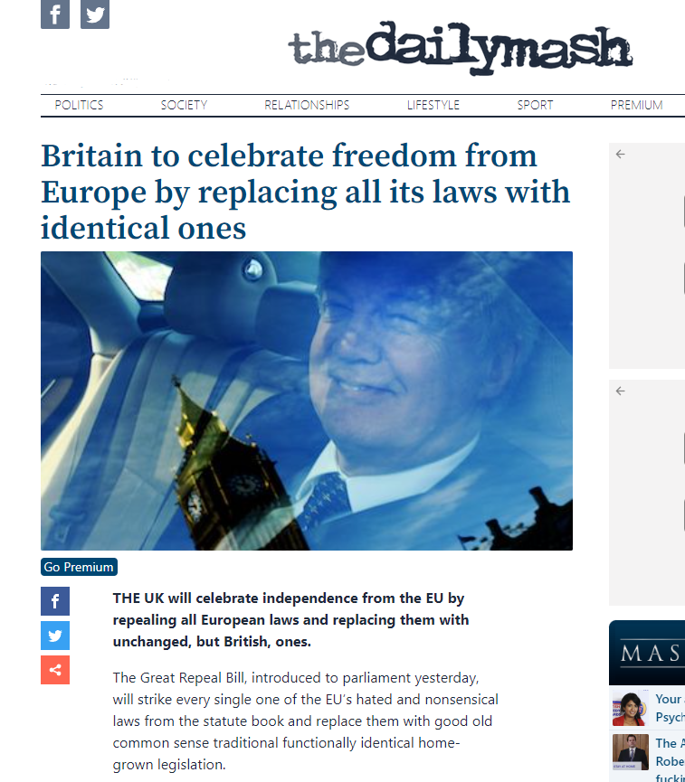
1. Satire or Parody
Satire is ”a way of criticizing people or ideas in a humorous way, especially in order to make a political point, or a piece of writing that uses this style”.
Parody is also defined by Cambridge Dictionary as ”writing, music, art, speech, etc. that intentionally copies the style of someone famous or copies a particular situation, making the features or qualities of the original more noticeable in a way that is humorous”.
https://www.thedailymash.co.uk/politics/politics-headlines/britain-to-celebrate-freedom-from-europe-by-replacing-all-its-laws-with-identical-ones-20170331125198
Types of Fake News

Slide 24
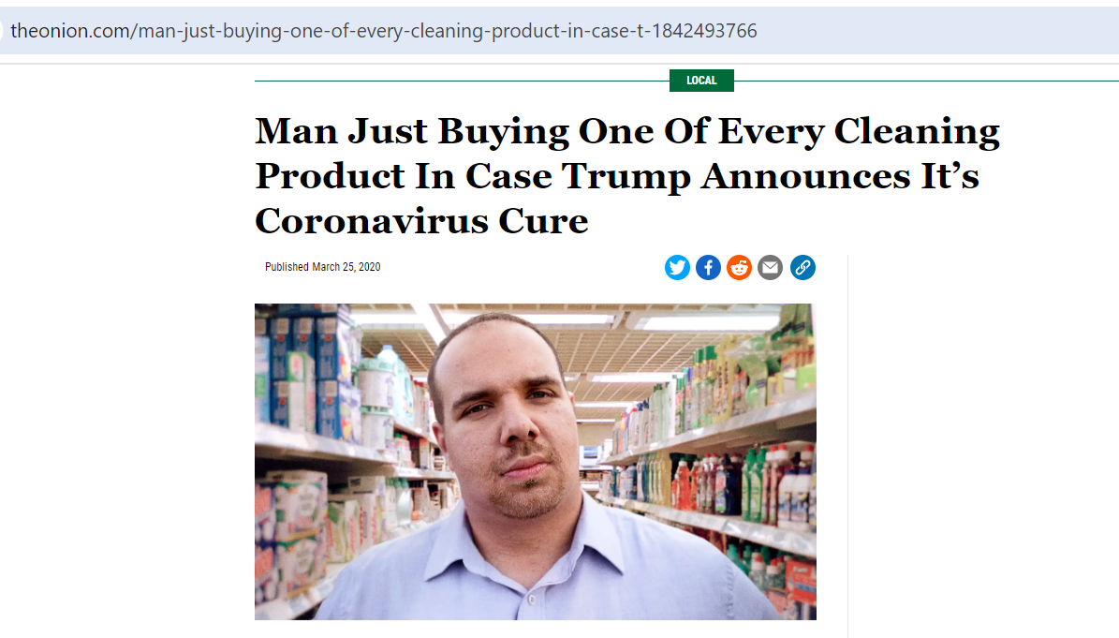
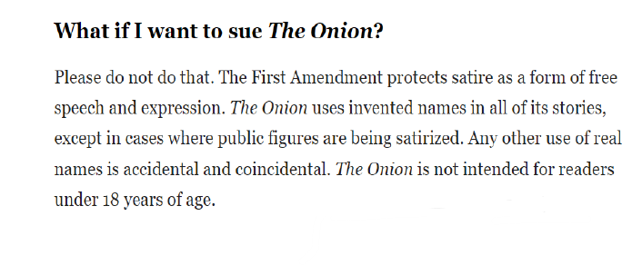
Satire or Parody
The intention of satires and parodies is not to disinform or misinform, but when these types of articles are shared outside of its original context they can be misunderstood and misinterpreted. Those how use satires and parodies in order to spread false information usually cut something from the original article or take just a part of it, thus making it hard to see the humorous intention of the author.
In order not to be mistaken for real reporting, satire and parody should not be taken out of context and should be correctly, clearly and repeatedly labeled as such.
https://www.theonion.com/man-just-buying-one-of-every-cleaning-product-in-case-t-1842493766
Types of Fake News

Slide 25
2. False Connection
It refers to the situations when the headlines, pictures, or captions of an article are not consistent with what is written in the text.
In media, the most used false connection is clickbait. Clickbait refers to something (such as a headline) designed to make readers want to click on a hyperlink especially when the link leads to content of dubious value or interest.
In this competitive media market, newsrooms are fighting for the audience. In this fight, journalists use all kinds of tricks to attract the public's attention. The problem is that not all of these tricks respect the ethical norms of journalism because they promise something to the public and in fact, they deceive it.
Types of Fake News

Slide 26
False Connection
This may also occur also when pictures or captions are utilized, especially on social media platforms, to convey a message that will not actually be found in the article.
”Clickbait websites and content can be generated very cheaply and automatically on a massive scale and the economic incentive makes it lucrative for the producers of such content. The adverse effect of such content, especially when it is generated on a massive scale, is that it competes with, and can potentially drown out, the significance of journalism characterized by verified facts (even when different media outlets exhibit different angles and emphases according to their varied narrative stances).” (McGonagle, T., Bednarski, M., Francese Coutinho, M., Zimin, A., 2019, 19)
Types of Fake News

Slide 27
3. Misleading Content
Misleading content is not something new in journalism, on the contrary, it is a phenomenon that has been studied for decades. In communication sciences, this is called The Framing Theory and basically, it represents the perspective the journalists choose to present a certain information, framing it in a certain way. ”One influential way that the media may shape public opinion is by framing events and issues in particular ways. Framing involves a communication source presenting and defining an issue.” (de Vreese, 2005, 51)
This sort of content refers to using information in a false manner, such as presenting a comment, a remark or a statement as being a fact. More examples consist of cropped images, selecting a certain part of some data or of a quote instead other parts that would be more relevant to the public.
Types of Fake News

Slide 28
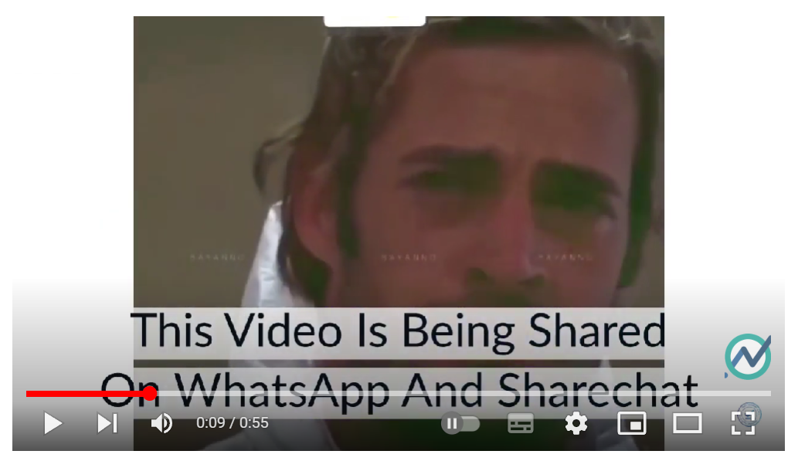
4. False Context
It refers to content that is actually authentic, true, but which is distributed with fake contextual data.
During the Covid pandemic there were many old videos and photos shared as new ones and placed in a different context.
For example, when the pandemic broke out, a video of two so called Italian doctors was shared around the world. The video stated that the doctors treated 75 coronavirus patients and now they were both infected. The video was true, it was from a Mexican TV series called Triunfo del Amor, broadcast in 2010. The context was false since it had nothing to do with Covid.
https://www.youtube.com/watch?v=2ypOi3LHz0g
Types of Fake News

Slide 29
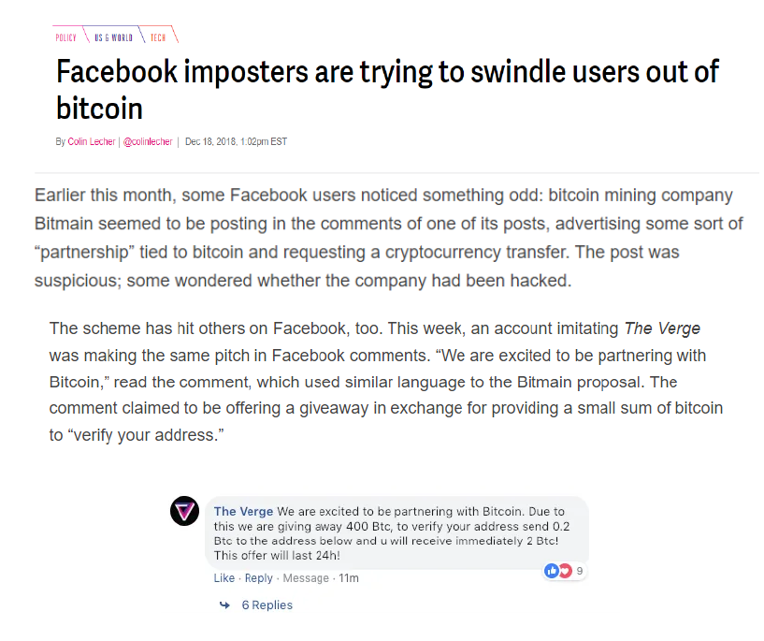
5. Imposter Content
This type of disinformation refers to false information that is spread as being content from a well-known and trusted newsrooms, journalists, companies or other public figures in order to deceive the audience.
Imposter content can come in the form of video, text, pictures, but also audio.
Types of Fake News
https://www.theverge.com/2018/12/18/18146406/facebook-pages-imposters-bitcoin-cryptocurrency

Slide 30
6. Manipulated Content
Each day, people all around the world share millions of pictures and videos on social media platforms. But not all of these are true, many are actually changed and manipulated.
Also media outlets have used different kind of programs in order to present a certain angle and to give a different meaning to what has happened by erasing/adding something (or someone) from a picture, by cropping it in a certain way, by using a special filter or even by staging a photo.
The objective of this type of manipulated content is to mislead the public.
Types of Fake News

Slide 31
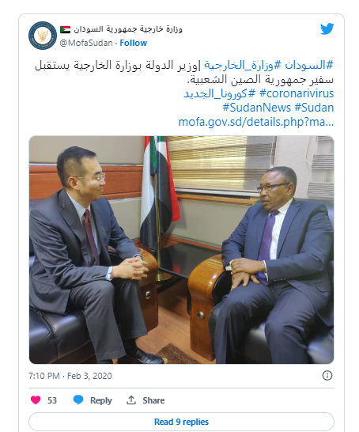
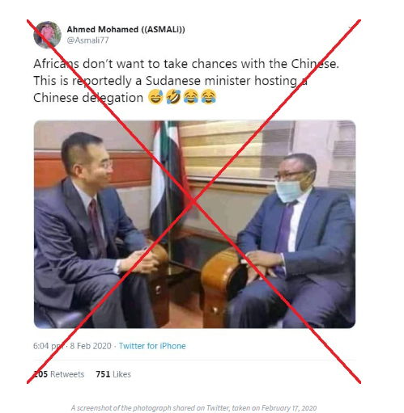
6. Manipulated Content
During the Covid pandemic, the AFP fact-checkers have discovered a picture that showed a Sudanese minister meeting with a Chinese diplomat and wearing a surgical mask to protect himself.
Actually, the photo had been Photoshopped and shared many times on social media.
The manipulated picture The real picture
https://factcheck.afp.com/sudanese-minister-did-not-wear-mask-meet-chinese-diplomat
Types of Fake News

Slide 32
7. Fabricated Content
Finally, fabricated content refers to something which is invented and completely false. It can be:
Staged videos
Made-up websites
Fabricated documents, statements, social media posts
The producers of fabricated content have many reasons and mainly these are political and economic.
Many elections from the past 5 - 10 years were flooded with different types of fabricated content
Types of Fake News

Slide 33
Other types of fake news – to be discussed during the next course
Deep fakes which ”is an AI-based technology used to produce or alter video content by editing faces (face-swapping or creating new face expressions).” (Chryssanthopoulou, K. et al., 2018 ,6)
Pseudoscience which ”consists of statements, beliefs, or practices that are claimed to be both scientific and factual but are incompatible with the scientific method”. ((Chryssanthopoulou, K. et al., 2018 , 8)
Propaganda which ”is the more or less systematic effort to manipulate other people’s beliefs, attitudes, or actions by means of symbols (words, gestures, banners, monuments, music, clothing, insignia, hairstyles, designs on coins and postage stamps, and so forth)”. (https://www.britannica.com/topic/propaganda)
Types of Fake News

Slide 34
CONTROLLING QUESTIONS
1. Clickbait refers to something (such as a headline) designed to make readers want to click on a hyperlink especially when the link leads to content of dubious value or interest.
True
False
2. Fabricated content refers to using information in a false manner, such as presenting a comment, a remark or a statement as being a fact. More examples consist of cropped images, selecting a certain part of some data or of a quote instead other parts that would be more relevant to the public.
True
False
Types of Fake News

Slide 35
CONTROLLING QUESTIONS
3. This type of disinformation refers to false information that is spread as being content from a well-known and trusted newsrooms, journalists, companies or other public figures in order to deceive the audience.
A. Propaganda
B. Imposter content
C. Misleading content
4. It refers to content that is actually authentic, true, but which is distributed with fake contextual data.
A. False context
B. Satire
C. Fabricated content
Types of Fake News

Slide 36
Bibliography, referred works
Jaster, R.; Lanius, D. What is Fake News? 2018. Versus, 2, 207–227. https://philpapers.org/archive/JASWIF.pdf
McGonagle, T., Bednarski, M., Francese Coutinho, M., Zimin, A. (2019). Elections and media in digital times. UNESCO. Paris. https://unesdoc.unesco.org/ark:/48223/pf0000371486
Merriam Webster, https://www.merriam-webster.com/
Reuters Institute for the Study of Journalism, 2016, Digital News Report, Distinctions between Hard and Soft News, https://www.digitalnewsreport.org/survey/2016/hard-soft-news-2016/
The News Literacy Project, https://newslit.org/misinformation-disinformation
The News Manual, What is news? Famous quotes on journalism, https://thenewsmanual.net/Resources/what_is_news_00.htm
UNESCO, MIL for Teachers What Makes News – Exploring the Criteria. http://unesco.mil-for-teachers.unaoc.org/modules/module-2/unit-3/
Wardle, C., The Age of Information Disorder, https://datajournalism.com/read/handbook/verification-3/investigating-disinformation-and-media-manipulation/the-age-of-information-disorder

Slide 37
Bibliography, referred works
Britannica, https://www.britannica.com/
Cambridge Dictionary - https://dictionary.cambridge.org/
Chryssanthopoulou, K., Gotsi, I., López, B., Neuvonen, M., Ražinskaitė, R., Salo, M., Varanauskas, A., Zinkevičiūtė, G. (2018). 10 Disinformation Types Used in Social Media. http://www.checkorcheat.eu/wp-content/uploads/10_DISINFORMATION_TYPES_Check_or_Cheat.pdf
Council of Europe, Dealing with propaganda, misinformation and fake news, https://www.coe.int/en/web/campaign-free-to-speak-safe-to-learn/dealing-with-propaganda-misinformation-and-fake-news
De Vreese, C. H. (2005). News framing: Theory and typology. Information Design Journal + Document Design, John Benjamins Publishing Company, 13(1), 51–62 51
European Commission, The 2022 Code of Practice on Disinformation, https://digital-strategy.ec.europa.eu/en/policies/code-practice-disinformation
First Draft, Too much information: a public guide to navigating the infodemic, https://firstdraftnews.org/long-form-article/too-much-information/
Ireton, C. & Posetti, J. (2018). Journalism, Fake News and Disinformation. Handbook for Journalism Education and Training. UNESCO. https://en.unesco.org/sites/default/files/journalism_fake_news_disinformation_print_friendly_0.pdf

Slide 38
Sources of Photos
Illustration pictures:
Articulate Content Library 360
Unsplash:
All photos published on Unsplash can be used for free. You can use them for commercian and non-commercial purposes.
https://unsplash.com/license
Pixabay:
CCO 1.0 Universal (CC0 1.0) Public Domain Dedication
http://www.pixabay.com
Notes:
See other sources in the notes

Slide 39
Sources of Photos
Freepik: https://www.freepik.com/
Pexels: All photos on Pexels can be used for free. https://www.pexels.com
Microsoft Powerpoint Stock Photos

Slide 40
Other Sources of Photos/Printscreens
Ireton, C. & Posetti, J. (2018). Journalism, Fake News and Disinformation. Handbook for Journalism Education and Training. UNESCO. p. 46
https://en.unesco.org/sites/default/files/journalism_fake_news_disinformation_print_friendly_0.pdf
Sources of printscreens:
https://www.thedailymash.co.uk/politics/politics-headlines/britain-to-celebrate-freedom-from-europe-by-replacing-all-its-laws-with-identical-ones-20170331125198
https://www.theonion.com/man-just-buying-one-of-every-cleaning-product-in-case-t-1842493766
https://www.youtube.com/watch?v=2ypOi3LHz0g
https://www.theverge.com/2018/12/18/18146406/facebook-pages-imposters-bitcoin-cryptocurrency
https://factcheck.afp.com/sudanese-minister-did-not-wear-mask-meet-chinese-diplomat

Slide 41
Other Sources of Photos/Printscreens
rome.us
www.quotemaster.org
https://www.buzzfeednews.com/article/craigsilverman/viral-fake-election-news-outperformed-real-news-on-facebook
https://foreignpolicy.com/2015/10/12/game-over-man-how-an-egyptian-tv-host-got-pwned-by-a-5-year-old-video-game-clip/
http://www.museumofhoaxes.com/images/moonprint2.jpg

Slide 42
Where you can find us
newsreel.pte.hu
newsreel@pte.hu
thenewsreelproject
@thenewsreelproject @newsreelproject
The project was funded by the European Commission. The views expressed in this publication do not necessarily reflect those of the European Commission.

