Slide 1
GRAPHIC JOURNALISM
Funded by the Erasmus+ Programme of the European Union
New Teaching Fields for the Next Generation of Journalists 2020-1-HU01-KA203-078824

Slide 2
Lesson2 - Comics as Media Culture

Slide 3
The Course
Introduction to Comics Studies
Comics as Media Culture
Tools for Analysing Graphic Narratives
Media Genres of Comics Journalism

Slide 4
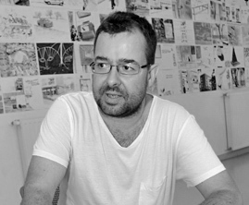
About the author
Gyula Maksa, PhD, dr. habil. is an associate professor at the University of Pécs (Hungary), Department of Communication and Media Studies, where he directs the Comics Studies Research Center (Képregénytudományi Kutatóközpont). He has organized several conferences, exhibitions and published two books in Hungarian on comics as a medium: Változatok képregényre (Variation for Comics, Budapest-Pécs, Hungary, 2010), Képregények kultúraközi áramlatokban (Comics in Transcultural Flows, Cluj, Romania, 2017). His main research areas are the geopolitics of comics, transcultural situations and communicative uses of comics.

Slide 5
What we are going to discuss
Media in this case refers to the institutions, technologies and social practices that organise the production, creation and use of media texts (products).
This conception of media also marks out the broader areas of research that a comics studies with a media studies background can pursue: the industry, comics as media texts and the study of their audiences.
However, it is also important to consider that comics are a media with historical and cultural variations. There are also many links between these variants, and often the dynamic identities of the cultural variants of comics are not separate.
In what follows, we highlight some approaches and analytical perspectives on comics media in variation from the perspective of media studies. These are partly related to the triad already mentioned above, and
the issue of the comics industry, creation and distribution,
they contribute to the study of the themes and creation of comics as media texts,
contribute to research on the audiences and uses of comics.
Some broader approaches are also discussed which can see the triple relationship between industry-texts-audiences. These include the genre approach discussed in the analysis of media texts, and media culture studies and media geopolitics/popular geopolitics.

Slide 6
1. Production, Texts and Audiences

Slide 7
1.1.Production
The functionalist economics of comics explores how producers seek to meet the needs of their audiences through the optimal use of resources. The media industry, including the comics industry, is usually studied in a variety of ways. For example, the importance of archival research, participant observation and interviewing can be highlighted. In addition to analysing documents, it is therefore also interesting to hear the views of the people who shape and run the industry. Critical economics combined with cultural studies of the media puts the industry's workings into a broader media studies framework.
Comic book making is a collective labour of the media industry. It is the collective work of the editor-in-chief, editor, writer, illustrator, inker, letterer, colourist, proofreader, and in some cases others.
1.Production, Texts and Audiences

Slide 8
1.2.Texts
There are many ways of looking at the products created by the media industry as media texts. Some of the methods and aspects of media text study are taken from other disciplines. From content analysis in the social sciences, to analysis methods familiar from literary studies, to aspects familiar from film studies. Narratological analyses, genre analyses, semiotic, semio-pragmatic, rhetorical approaches can only be truly effective if the analysis can take into account the specificities of the comics.
Comics as iconotexts or cultural and media texts never exist in themselves, but in universes of texts organised in networks. These networks are formed not only through genre, paratexts, author, verbal and visual intertexts, allusions, but also through their manifestations in various institutional and mediatic contexts.
1.Production, Texts and Audiences

Slide 9
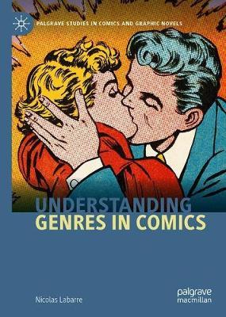
1.2.Texts
Genre analysis can apply to all three major aspects of the media (production/dissemination, texts/products, reception/use). In the case of media texts, genre is the interpretative framework for both producers, creators, and publics, audiences, users. The media industry seeks to shape the expectations of audiences through genres. It generates and modifies audience expectations through references to genre(s). There are relatively well-defined genres that have been developed by the media industry.
One of these is the comic strip, which, although related to the newspaper cartoon, is a comic genre consisting of three or four panels, with the last panel focused on the punchline. In the European francophone tradition, this is similar to the one-page gag, which in turn is typically part of a hardcover, full-colour gag collection published in a 48 or, less frequently, 64-page album. From a marketing point of view, the most sophisticated genre offering is that of the Japanese manga industry.
The genre diversity of manga is well defined and tailored to specific target audiences, e.g. by age, gender and even occupation. Examples include the thematic sub-genres of the larger genres for adolescent girls (shojso), adolescent boys (shonen), young adult men (seinen), adult women (jossei or ladies comics), and the salaryman manga genre, which is aimed at those interested in the world of workplace organisations. This genre diversity is also accompanied by a thematic and narrative diversity that is less restricted by (self-)censorship than popular Western comic narratives, making manga more suitable than its Western counterparts for expressing a kind of 'post-industrial youth aesthetic'. In this context, there is also a specific, complex lifestyle proposition associated with manga, which is much less characteristic of Western comics.
1. Production, Texts and Audiences

Slide 10
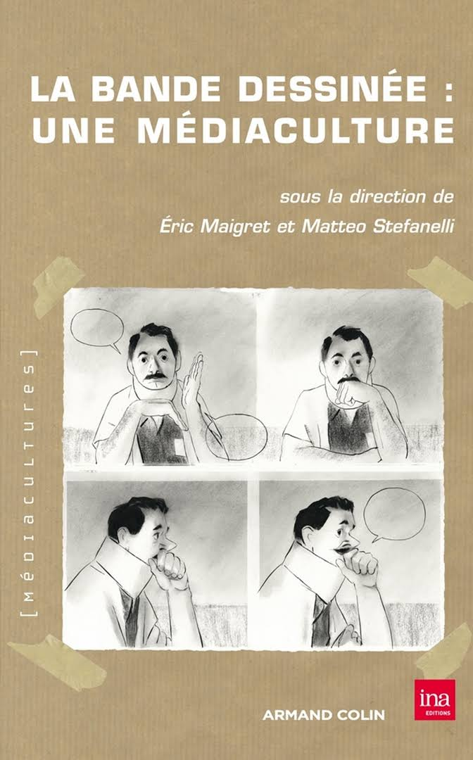
1.3. Audiences
In line with the tradition of audience research in media studies, research on comics media audiences mainly uses social science methods: questionnaire survey, interviews, focus group research, oral history methods based on interviews for audience history studies, but also participant observation in the case of (post)comics subcultures.
1. Production, Texts and Audiences

Slide 11
1.3.Audiences
The study of the social communication uses of comic media is a vast field of research. The starting question in this investigation can usually be which comic works are situated in which communicative dynamics and which ones they can be placed in. Here are some examples:
civic education
advertising
political communication
organisational communication
cultural diplomacy
various other pedagogical uses
community identity formation
The communicative use of comic works is often not a stand-alone issue, but should be considered in its communicative context.
1. Production, Texts and Audiences

Slide 12
Controlling questions
Are the following statements true or false?
The functionalist economics of comics explores how producers seek to meet the needs of their audiences through the optimal use of resources. (true)
Oral history methods are based on archive research for audience history studies. (false)
In the Japanese tradition, the one-page gag is a typically genre. (false)
The hardcover, full-colour gag collection published in a 48 or, less frequently, 64-page album. (true)
Genre analysis can apply to all three major aspects of the media (production/dissemination, texts/products, reception/use). (true)

Slide 13
2. Transcultural Flows and Geopolitics of Comics

Slide 14
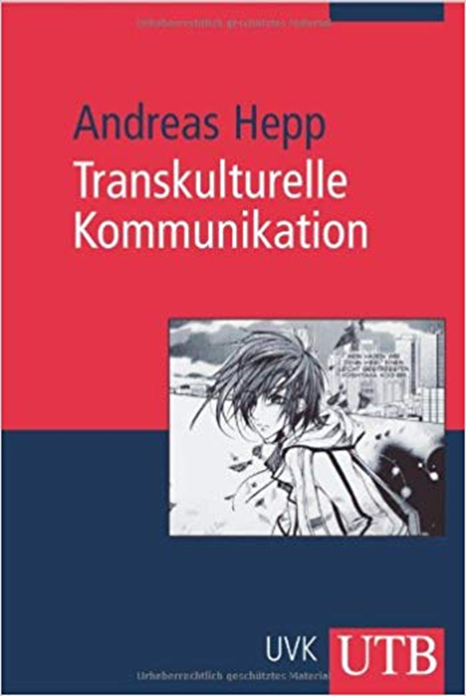
2.1. Transcultural Flows
Comics is a media that exists in historical and cultural variations. Since its birth in the 19th century, it has been in a state of dynamic identity, not remaining the same, but not becoming completely different. It has evolved in different media cultures and in different media environment (e.g. print, cinema, poster, television, etc.). There are many variants, in addition to the industry-leading Japanese manga (Korean manhwa), the European Francophone bande dessinée and North American comics, and these are not uniform in themselves. There are also many links between these variants, and often the dynamic identities of the cultural variants of comics are not separate. From a global perspective, research into transcultural currents and a media geopolitical perspective on comics media may therefore be justified.
2. Transcultural Flows and Geopolitics of Comics

Slide 15
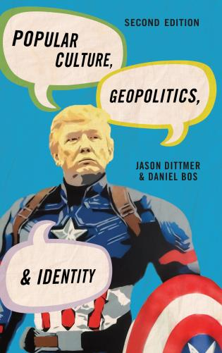
2.2. Geopolitics of Comics
Popular geopolitics produced with the help of narratives within popular media, that is, a geopolitical knowledge shaped by the everyday practices of media audiences and users. In recent years, scholarly journals and other works examined various geopolitical aspects of comics, from the aesthetics of war comics, Joe Sacco’s comics reportages (developed from the tradition of graphic novels), through the relationship between geography and the representation of cities in comics, to the European Tintin.
2. Transcultural Flows and Geopolitics of Comics

Slide 16
2.2. Geopolitics of Comics
All three centres of the world’s comics production, and thus all three major cultural variants of the comics media – North American comics, French-Belgian bande dessinée and Japanese manga – produced certain works which were placed into the dynamics of political communication, making them able to shape certain countries’ “soft power”. (In their writings, Joseph Nye, an expert on North American foreign policy, and his followers make a distinction between the “hard power” based on economic and military power and “soft power”, which arouses attraction from a cultural and ideological source.)
After realising the soft power potential of Japanese popular media culture, in the second half of the 2000s, Japan’s Foreign Ministry cooperated with the private sector and tried to promote the image of the cultural superpower as “Cool Japan”, either with the help of the offices of the Japan Foundation aimed at the international distribution of culture, or by appointing “anime ambassadors”. In some cases, Japanese authorities – admittedly on behalf of public diplomacy – provide organisational framework for the “participatory transmission of culture”: since 2007 the Japanese Ministry of Foreign Affairs has organised an annual international manga drawing contest, and the president of the organising committee is the Foreign Minister. In 2013, entries were submitted from fifty-three different countries.
However, “Cool Japan” is not only shaped by such planned initiatives of public diplomacy. It seems that manga and anime, Japanese comics and cartoon emerge as part of a lifestyle choice that influences eating and dressing habits, the material world, pastime activities etc.
2. Transcultural Flows and Geopolitics of Comics

Slide 17
Controlling questions
Are the following statements true or false?
The “hard power” arouses attraction from a cultural and ideological source and is not based on military or economic force. (false)
Comics is a medium with a dynamic identity. (true)
Popular geopolitics produced with the help of narratives within popular media, that is, a geopolitical knowledge shaped by the everyday practices of media audiences and users. (true)
Joseph Nye is an expert on Japanese manga. (false)
From a global perspective, research into transcultural currents and a media geopolitical perspective on comics media may therefore be justified. (true)

Slide 18
3. Publication Formats, Media Layouts

Slide 19
3.1. Hybridisations and Traditions
Different formats and mediums may be characteristic of different cultural versions of comic media. Indeed, the choice of publication format and medium is also a choice of comic tradition, not culturally neutral. The three-panel comic strip and the comic book, typical of superhero comics, indicate a link with North American comics, while the 48 or 64-page colour hardcover album indicates a link with the Franco-Belgian bande dessinée.
In addition to the various formats of printed publications, daily and weekly newspapers, magazines, albums, books, such as the traditional paperback graphic novel, it is increasingly worthwhile to look at the formats of webcomics or digital comics. This is not just about digitalisation, but also about the new possibilities offered by different media formats and platforms, such as Webtoon, which originated in South Korea, or even Instagram.
Some of the webcomics, webtoon or bande dessinée numérique can be seen as a mediatic hybridisation. It is precisely certain characteristics of the Internet that are combined with the comic styling familiar from printed works. But it is not only on the Internet that comics are hybridised, but also in the cinema, in the theatre and on the street. Comics posters, sculptures, murals abound, especially in cities that can be considered as institutional centres of dominant geo-cultural varieties (although each variety is also multi-centric). Advertising communication all over the world uses comics posters. Comics exhibitions in galleries and other exhibition spaces also present comics in a specific media layout, different from print or electronic publications.
3. Publication Formats, Media Layouts

Slide 20
3.2.Periodicity
Different formats, platforms and dispositives can be different not only in terms of spatial relations, but also in terms of temporal relations. Daily strips, weekly comic strips or feuilleton, annual published albums, more frequent series in comic books and manga books.
Because comics have traditionally, especially since the turn of the last century, when they met the mass-circulation printed press, been mostly media texts defined by the two major types of serialism, as have other products of the media industry:
- Continuous SERIALs (with cliffhangers) and episodic SERIES based on repetition, or combinations of both, are further rolled out with open questions.
3. Publication Formats, Media Layouts

Slide 21
Controlling questions
Are the following statements true or false?
Different formats may be associated with different periodicity of publication. (true)
Webtoon is from South Korea. (true)
Series are continuous and serials are episodic. (false)
The 48 or 64-page colour hardcover album indicates a link with the North American comics. (false)
Advertising communication uses comics posters. (true)

Slide 22
Bibliography, referred works
Dittmer, J. (2010): Popular Culture, Geopolitics, and Identity, Lanham: Rowman & Littlefield Publishers, Lanham.
Maigret, É. – Stefanelli, M. (2012): La bande dessinée: une médiaculture, Paris: Armand Colin – INA., Paris.
Maksa, Gy. (2017): Képregények kultúraközi áramlatokban, Kolozsvár: Erdélyi Múzeum-Egyesület.

Slide 23
Sources of Photos
Illustration pictures:
Articulate Content Library 360
Unsplash:
All photos published on Unsplash can be used for free. You can use them for commercian and non-commercial purposes.
https://unsplash.com/license
Pixabay:
CCO 1.0 Universal (CC0 1.0) Public Domain Dedication
http://www.pixabay.com
Notes:
See other sources in the notes

Slide 24
Sources of Photos
Freepik: https://www.freepik.com/
Pexels: All photos on Pexels can be used for free. https://www.pexels.com
Microsoft Powerpoint Stock Photos

Slide 25
Other Sources of Photos
https://link.springer.com/book/10.1007/978-3-030-43554-7
https://www.fnac.com/a3241842/Eric-Maigret-La-bande-dessinee-une-mediaculture
https://www.zvab.com/buch-suchen/titel/transkulturelle-kommunikation/
https://rowman.com/ISBN/9781538116715/Popular-Culture-Geopolitics-and-Identity-Second-Edition

Slide 26
Where you can find us
newsreel.pte.hu
newsreel@pte.hu
thenewsreelproject
@thenewsreelproject @newsreelproject
The project was funded by the European Commission. The views expressed in this publication do not necessarily reflect those of the European Commission.

