Slide 1
VERIFYING AND ANALYZING „FAKE NEWS”
Funded by the Erasmus+ Programme of the European Union
New Teaching Fields for the Next Generation of Journalists 2020-1-HU01-KA203-078824

Slide 2
Lesson 3 - Fake news and social media

Slide 3
The Course
Lesson 1 - Introduction of the course. History of Fake News
Lesson 2 - What is the news? Fake news typology
Lesson 3 - Fake news and social media
Lesson 4 - Fact-checking

Slide 4
About the author
Marian Popovici is a PhD student in Communication Studies and teaching assistant at the Faculty of Journalism and the Communications Sciences within the University of Bucharest.
He is also a sport journalist.
He is a graduate of both the Faculty of Journalism and Communications Sciences (University of Bucharest) and the Faculty of Finance, Banks and Accounting (Dimitrie Cantemir University).
He also has two MA degrees: Thematic Journalism and Financial Banking Management.
Photo source: personal archive of the author

Slide 5
What are we going to discuss?
In this course we will find out why social media is such a fertile ground for fake news and how to detect fake news on social media
Journalism is very present on social media and we will discuss about how important is the promotion of the news in social media for outlets
Social media platforms started a few years ago to take actions in order to stop the spread of fake news

Slide 6
Why is social media a fertile ground for fake news?

Slide 7
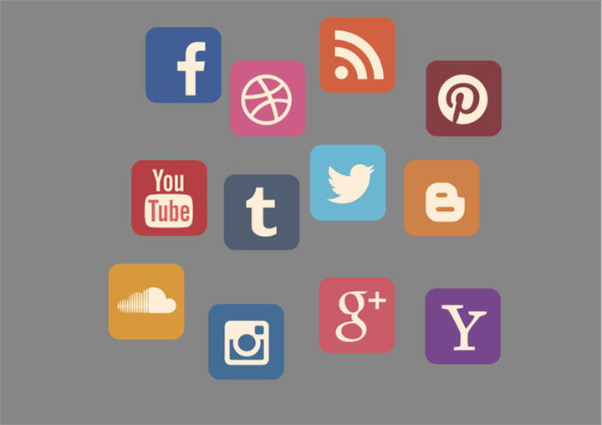
Social media and the spread of fake news
According to statistics, 4,7 billion people around the world are using social media, which is a popular way to news consumption
According to K. Shu et all, social media is also a fertile ground for disinformation and fake news:
“Because it has low barriers to provide and disseminate news online faster and easier through social media, large amounts of disinformation such as fake news, those news articles with intentionally false information, are produced online for a variety of purposes, ranging from financial to political gains” (2020, p. 2)
Photo source: Articulate
Social media - fertile ground for fake news

Slide 8
News on websites vs. news on social media
Edson Tandoc believes that the increasing number of people who get their news from social media instead of news websites leads to various consequences:
“Individuals judge a news story’s credibility not only on who shared it on social media, but also on the number of likes, comments and shares. Fake news producers therefore often produce clickbait content to get more people to like, share, or comment on their fake stories, often playing into readers’ biases or interests'' (Jayakumar et. al., 2021, pp. 10-11)
Social media - fertile ground for fake news

Slide 9
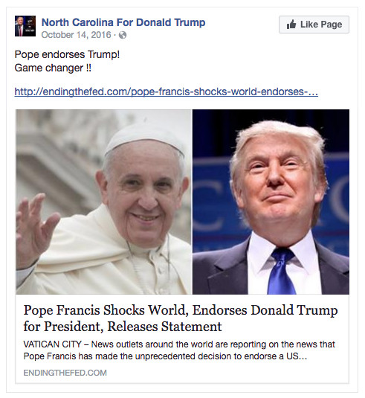
Example
During the American elections in the USA in 2016, the fake news article named “Pope Francis Shocks World, Endorses Donald Trump for President, Releases Statement” had the biggest Facebook engagement.
It surpassed every real news article about elections at this aspect, with over 960.000 reactions (likes, comments, shares), according to Buzzfeed
https://www.linkedin.com/pulse/how-detect-fake-news-real-time-krishna-bharat?utm_source=share&utm_medium=member_android&utm_campaign=share_via
Social media - fertile ground for fake news

Slide 10
The spread of fake news on social media
It has a dynamic nature, can take various forms and disinformation can become misinformation, as K. Shu et al. explain (2020, p.3):
“For example, a disinformation creator can intentionally distribute the false information on social media platforms. People who see the information may be unaware that it is false and share it in their communities, using their own framing.
On the other hand, misinformation can also be transformed into disinformation. For example, a piece of satire news may be intentionally distributed out of the context to mislead consumers”.
Social media - fertile ground for fake news

Slide 11
Disinformation trend, growing in the digital age
There are several reasons why disinformation is growing in the digital age (Greifeneder et. al.2021, p. 29)
Barriers to entry in news media have dropped significantly as websites can be easily set up and monetized via advertising
The fixed costs associated with getting on social media are very small for fake news creators
Photo source: Articulate
Social media - fertile ground for fake news

Slide 12
Disinformation trend, growing in the digital age
Social media are well suited to dissemination of fake news; the information tends to be distributed in short snippets of text
There has been a continued decline in public trust and confidence in mainstream media
In many western countries there has been a rise in political polarization and this can increase the likelihood of fake news being believed
Social media - fertile ground for fake news

Slide 13
Controlling questions
What is the number of social media users globally in 2023?
1.5 billion people
4.7 billion people
7 billion people
2. Many individuals believe that the number of likes, comments and shares give more credibility to the news.
True
False
3. Which of the following is a reason for the growth of disinformation in social media?
The majority of the real news outlets are on social media
The users like to be entertained on social media
Barriers to entry in news media have dropped significantly

Slide 14
Journalism on social media and the promotion of news

Slide 15
Social media and news consumption
Vasterman (2018, p.313) exemplified how social media has changed news consumption:
“Imagine that there are two shops next to each other on a street and they sell the same product. In the first store, the patron sits inside and waits for customers to come and visit or buy something.
The other patron is on the boulevard where everyone meets and sells some products there, talking to people and inviting them to come into the shop as well. We don't even have to think much about which of the two patrons are more successful in this case.
Now, if the store represents the newspaper, the articles are the products and the boulevard is social media, it's no surprise that social networks are a very important part of this business".
Journalism on social media

Slide 16
The fine line between news, fabricated content and fiction
Ireton and Possetti (2018) believe that the line between news, entertainment, advertising, fabricated content and fiction is very blurred on social networks
When disinformation is published, it is impossible to retract due to the massive distribution system, even if journalists or verification factors detect false information: “The digital age has brought continuous, unprecedented challenges and industry changes to the news industry. Journalism is under pressure in the face of a virtual storm of pressures that feed informational dysfunction”.
Journalism on social media

Slide 17
Promoting the news in social media
Social media became in the last years an important instrument to spread the news. The media outlets created specialized departments in order to maximize the potential of social media
In this matter, there are some strategies that are used by media in order to attract more people from social media to news articles:
Enhance the visual
Create better and catchy titles
Share the content in the right timeline
Journalism on social media

Slide 18
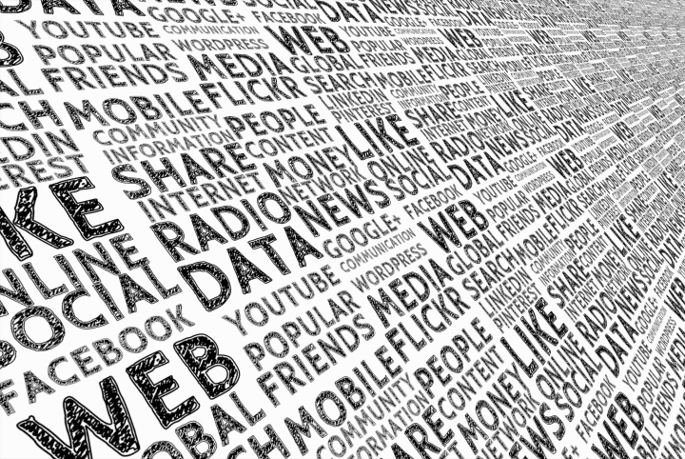
Promoting the news in social media
Share the content at the right platform for the targeted audience
Post a strong information multiple times
Pay for promotion
Concentrate on mobile devices
Photo source: Articulate
Journalism on social media

Slide 19
Finding the truth on internet
What can we do in order to find out if an article we read on the internet is true:
Look at the source: it’s a well known media outlet? It has a strange name? It is from a website with a stated political aim? Check it on the list of questionable or unreliable sources and websites
Google it: an important news will be reported by several websites. If you find it on credible sources, there is a higher chance to be true
Look after the evidence in the article: a well written news article will have strong evidence: documents, statements from well known sources
Photo source: Articulate
Journalism on social media

Slide 20
Controlling questions
1. On social media there is a fine line between news, fabricated content and fiction.
True
False
2. Which of the following is a strategy to promote news on social media?
Post the information just once, for maximum impact
Share the content at the right platform for the targeted audience
Concentrate on desktop devices
3. A well written article doesn’t need evidence in order to maximize the credibility.
True
False

Slide 21
Actions taken by social media platforms to stop fake news

Slide 22
How Facebook tackle fake news
According to Statista, Facebook is the most popular social media network, with nearly 3 billion users in 2023, with a billion more than in 2016
In the last years, Facebook promised to tackle “fake news” in order to make the network a safer place and fight the spreading of false information
The measures taken by Facebook to stop this scourge are: disrupting economic incentives, building new products to curb the spread of false news and helping people make more informed decisions.
Social media platforms fighting fake news

Slide 23
Disrupting economic incentives
Regarding disrupting economic incentives, Facebook has taken some steps into stopping the spammers to make money:
better identifying false news through the community and third-party fact-checking organizations
making it as difficult as possible for people posting false news to buy ads
applying machine learning to assist the response teams in detecting fraud and updating detection of fake news accounts on Facebook, which makes spamming at scale much harder.
Social media platforms fighting fake news

Slide 24
New products to limit the spread of fake news
Facebook claims that they also build new products to limit the spread of fake news:
Ranking improvements which includes feedback from the community
Easier reporting and working with independent third-party fact-checking organizations
Also, Facebook has two programs to help people make more informed decisions:
Facebook Journalism Project
News Integrity Initiative
Social media platforms fighting fake news

Slide 25
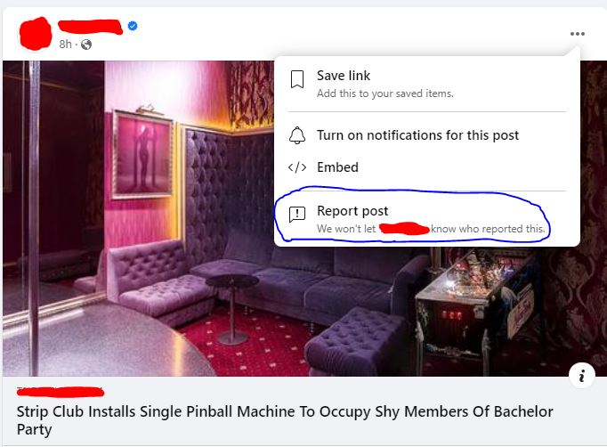
Example
On Facebook, the users can report by clicking on the three dots in the right of the post. There are several options for the report:
Spam
Nudity
Unauthorized sales
Violence
Harassment
Terrorism
Hate speech
False information
Suicide or self-injury
Social media platforms fighting fake news

Slide 26
Controlling questions
Facebook is the most popular social media network.
True
False
2. Identify one of the measures taken by Facebook to stop the spreading of fake news?
Building new products to stop the spreading
Limit the access for unverified accounts
Making it easy for people posting false news to buy ads
3. Facebook has five programs to help people make more informed decisions.
True
False

Slide 27
Highlights
Highlights
Social media is a fertile ground for disinformation and fake news because it has low barriers to provide and disseminate news online faster and easier through social media
The spread of fake news on social media can take various forms and disinformation can become misinformation
The line between news, entertainment, advertising, fabricated content and fiction is very blurred on social networks
Social media became in the last years an important instrument to spread the news. The media outlets created specialized departments in order to maximize the potential of social media
The measures taken by Facebook to stop spreading of fake news are: disrupting economic incentives, building new products to curb the spread of false news and helping people make more informed decisions.

Slide 28
Bibliography, referred works
Bharat, Krishna. (2017). How to Detect Fake News in Real-Time. https://www.linkedin.com/pulse/how-detect-fake-news-real-time-krishna-bharat?utm_source=share&utm_medium=member_android&utm_campaign=share_via
Barclay, Donald A. (2018): Fake News, Propaganda, and Plain Old Lies, The Rowman & Littlefield Publishing Group, London
Data Reportal, 2022, Digital 2022: Global Overview Report. https://datareportal.com/reports/digital-2022-global-overview-report
Greifeneder R., Jaffé, M.E., Newman, E.J. , Schwarz N. (2021). The Psychology of fake news, Routledge
Ireton C., Posetti J. (2018). Journalism,‘Fake News’ & Disinformation, UNESCO Series on Journalism Education, Paris
Jayakumar S., Ang B., Anwar N. 2021. Disinformation and Fake News, Palgrave Macmillan, Singapore
Meta for Media, Meta Journalism Project, https://www.facebook.com/formedia/mjp

Slide 29
Bibliography, referred works
Meta for Media, Introducing the News Integrity Initiative, https://www.facebook.com/formedia/blog/introducing-the-news-integrity-initiative
Meta for Media, Working to Stop Misinformation and False News. https://www.facebook.com/formedia/blog/working-to-stop-misinformation-and-false-news
Shu, K. et al. (eds.) (2021). Disinformation, Misinformation, and Fake News in Social Media, Springer
Silverman, C. (2016). This Analysis Shows How Viral Fake Election News Stories Outperformed Real News On Facebook, https://www.buzzfeednews.com/article/craigsilverman/viral-fake-election-news-outperformed-real-news-on-facebook#.lkOvJO6p0
Vasterman, P. (coord.) (2018). From Media Hype to Twitter Storm. News Explosions and Their Impact on Issues, Crises, and Public Opinion. Amsterdam University Press

Slide 30
Sources of Photos
Illustration pictures:
Articulate Content Library 360
Unsplash:
All photos published on Unsplash can be used for free. You can use them for commercian and non-commercial purposes.
https://unsplash.com/license
Pixabay:
CCO 1.0 Universal (CC0 1.0) Public Domain Dedication
http://www.pixabay.com
Notes:
See other sources in the notes

Slide 31
Sources of Photos
Freepik: https://www.freepik.com/
Pexels: All photos on Pexels can be used for free. https://www.pexels.com
Microsoft Powerpoint Stock Photos

Slide 32
Sources of Printscreens
Bharat, Krishna. (2017). How to Detect Fake News in Real-Time. https://www.linkedin.com/pulse/how-detect-fake-news-real-time-krishna-bharat?utm_source=share&utm_medium=member_android&utm_campaign=share_via

Slide 33
Where you can find us
newsreel.pte.hu
newsreel@pte.hu
thenewsreelproject
@thenewsreelproject @newsreelproject
The project was funded by the European Commission. The views expressed in this publication do not necessarily reflect those of the European Commission.

