Slide 1
GRAPHIC JOURNALISM
Funded by the Erasmus+ Programme of the European Union
New Teaching Fields for the Next Generation of Journalists 2020-1-HU01-KA203-078824

Slide 2
Lesson3 – Tools for Analysing Graphic Narratives

Slide 3
The Course
Introduction to Comics Studies
Comics as Media Culture
Tools for Analysing Graphic Narratives
Media Genres of Comics Journalism

Slide 4
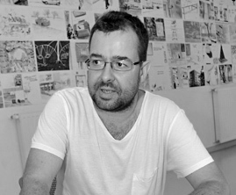
About the author
Gyula Maksa, PhD, dr. habil. is an associate professor at the University of Pécs (Hungary), Department of Communication and Media Studies, where he directs the Comics Studies Research Center (Képregénytudományi Kutatóközpont). He has organized several conferences, exhibitions and published two books in Hungarian on comics as a medium: Változatok képregényre (Variation for Comics, Budapest-Pécs, Hungary, 2010), Képregények kultúraközi áramlatokban (Comics in Transcultural Flows, Cluj, Romania, 2017). His main research areas are the geopolitics of comics, transcultural situations and communicative uses of comics.

Slide 5
What we are going to discuss
In the course of our media text study, it is worthwhile to learn about the industry, creative and institutional context of each work, as well as the reception, the geographical-cultural variety and the historical context offered by the genre. Our background information thus provides us with a preliminary, comprehensive picture that we can shape, modify, partially reject or confirm in our more media-textual analysis. And what should we look out for in such a more mediatext-centric analysis? Here are some possible analysis aspects.

Slide 6
1. Panel, Sequence, Page

Slide 7
1.1.Panel
Comic books are made up of different shapes and sizes of frames, or panels, which are arranged in sequences of images and pages, or double-pages.
As in the case of cinematic narrative, we can talk about the use of panels as part of the framing. However, the framing is more variable in the case of comic narrative than in film, and the form of the frames is less fixed.
1. Panel, Sequence, Page

Slide 8
1.2. Sequence
The panels are arranged in a sequence. Will Eisner, a comics creator who also reflects on the tools and expressions of comics storytelling, says that comics is a sequential art. From this point of view, therefore, the sequences of images, arranged in a single section, in a sequence, are the essence of comic media. This proved to be a powerful idea, while the boundaries between comic strip and cartoon are not sharp.
1. Panel, Sequence, Page

Slide 9
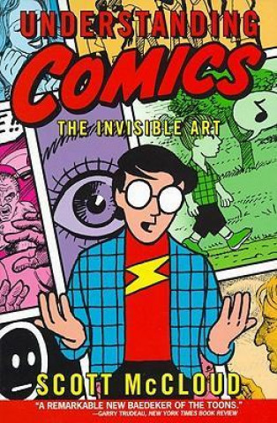
1.2. Sequence
In terms of sequencing, Scott McCloud identifies six types of transitions and connections between panels. These are:
transition from moment to moment;
transition from action to action, showing a single sujet;
transition from subject to subject within the framework of a scene or an idea;
transition from scene to scene, often with a large jump in space and time;
transition from aspect to aspect, change of point of view for a scene, mood or idea;
non-sequitur, no logical relationship between panels.
Scott McCloud's own research shows that in popular Western, i.e. American and European, comic book series, the most commonly used transition type is action-to-action, but there is also a strong presence of subject-to-subject and scene-to-scene transitions. Mangas show a greater variety in their use of transition types, and more frequent shifts in point of view. He draws this conclusion from the work of Tezuka Osamu, considered the father of modern manga, but also from artworks by other Japanese artists.
1. Panel, Sequence, Page

Slide 10
1.3.Page
The panels are arranged in sequences, elliptical rows of images, allowing a linear, straight-line reading of the succession of frames. At the same time, they are also a space of one page and a double page that can be captured by the gaze. The page space, the page layout, also implies another reading mode, called „tabular”. Then the unit of the comic narrative is not the panel or the sequence, but the page. The framing of the comics is not only variable in terms of the size and shape of the frames, but also plural. Because of the space between panels, every frame, every sequence, every page and every double page has a frame, so that every panel exists in a multiple frame in the graphic narrative.
1. Panel, Sequence, Page

Slide 11
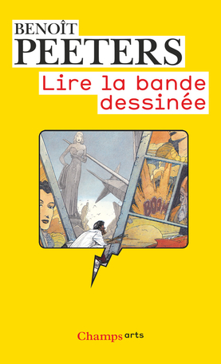
1.3.Page
Benoit Peeters has grouped the page layouts. He did this on the basis of whether the narrative, or more precisely the linearity of the storytelling, or the composition is the dominant feature of the page concept, and how autonomous or independent the two are from each other. From this perspective, we can distinguish four cases:
- linearity of storytelling dominant, narrative and composition are independent - conventional layout
- dominated by the composition, narrative and composition are independent - decorative layout
- linearity of storytelling dominant, narrative and composition are interdependent - rhetorical layout
the composition dominates, narrative and composition are interdependent - productive layout
We can therefore talk about 1. conventional layout, where there are bars of the same height on the page, with frames of the same size (e.g. Garfield, Peanuts). 2. decorative layout is usually very spectacular, with special panel construction techniques emphasised, but not subordinated to the narrative or overly shaping the narrative (e.g. Tarzan). 3. rhetorical page layout, on the other hand, also adapts the paneling and page layout to the storytelling (e.g. Tinin, Asterix). 4. The paneling becomes a creative force, it plays a decisive role in shaping the narrative, and the tabularity of the visual, the composition is not subordinated to the story-telling, but can even sometimes make the linear image/text reading impossible through its productivity (e.g. Little Nemo in Slumberland, Simbabbad de Batbad).
1. Panel, Sequence, Page

Slide 12
Controlling questions
Are the following statements true or false?
In popular American comic book series, the most commonly used transition type is aspect-to-aspect, but there is also a strong presence of subject-to-subject and scene-to-scene transitions. (false)
Mangas show a greater variety in their use of transition types, and more frequent shifts in point of view. (true)
The conventional page layout favours a lineal reading order. (true)
The composition of the rhetorical page layout is not adapted to the storytelling. (false)
Will Eisner called comics sequential art. (true)

Slide 13
2. Genre, Graphic Style

Slide 14
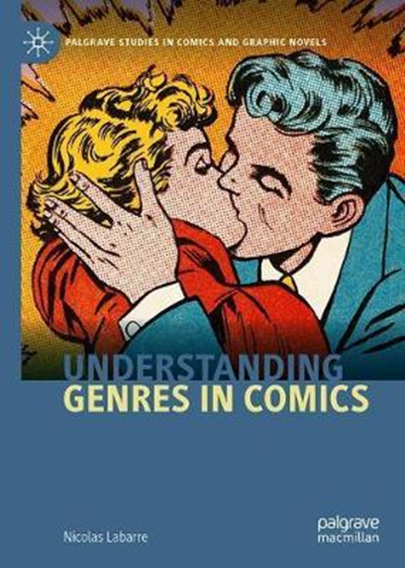
2.1.Genre
Typically, genre analysis asks how a media text, in this case a work of comics, benefits from different genre traditions. Which ones does it draw from, which ones is it associated with, what does it do with these traditions, how does it relate to them, how does it shape them? There are relatively well-defined genres that have been developed by the media industry. One of these is the comic strip, which, although related to the newspaper cartoon, is a comics genre consisting of three or four panels, with the last panel focused on the punchline. In the European francophone tradition, this is similar to the one-page gag, which in turn is typically part of a hardcover, full-colour gag collection published in a 48 or, less frequently, 64-page album. From a marketing point of view, the most sophisticated genre offering is that of the Japanese manga industry.
2. Genre, Graphic Style

Slide 15
2.2. Graphic Style
The graphic style indicates a link to the comics tradition. Line drawing, use of colour, movement, onomatopoeia (sound painting) and ideograms are all part of the style. The homogeneity or heterogeneity of graphic styles, i.e. the "polygraphy" of a work, can be examined.
2. Genre, Graphic Style

Slide 16
2.2. Graphic style
Scott McCloud distinguished between more realistic and more minimalist/iconic/abstract comic styles. We can also observe combinations of styles in one work. One example is the ligne claire graphic style that characterises Hergé's Tintin. In the Tintin series, the characters, especially the title character, are more minimalist, while the environment is more elaborate and realistic, this technique of making it easier to identify with the protagonist of the adventure series. The ligne claire allows for strong lines, a clear visual world and narrative.
2. Genre, Graphic Style

Slide 17
Controlling questions
Are the following statements true or false?
In the Tintin series, the characters, especially the title character, are more realistic, while the environment is more minimalist. (false)
Will Eisner created the Tintin series. (false)
From a marketing point of view, the most sophisticated genre offering is that of the Japanese manga industry. (true)
Polygraphy refers to a homogeneous graphic style. (false)
The 48-page hardcover album is typical of North American comics tradition. (false)

Slide 18
3. Verbal Texts

Slide 19
3.1. The Role of Verbal Texts in Comic Iconotext
The role of verbal texts in comic iconotext, types of image/text combinations according to Scott McCloud:
word specific combination, images illustrate the text as a whole
picture specific combinations, where the words act as a soundtrack to a storyline narrated in pictures
duo-specific combination, where picture and word convey essentially the same message
additive combination, where the word reinforces or expands the pictorial representation, or vice versa
parallel combination, where image and text are independent of each other but in the same panel space
montage combinations, where the words are part of the picture
- interdependent, the most common and characteristic feature of comic books, where the image and the words together create and convey a message that they would not be able to do separately
3. Verbal Texts

Slide 20
3.2.Dialoge Bubbles, Onomatopoeia
It should be noted that there are pantomime comics without verbal texts. It is a characteristic of comic creation that the integration of verbal representation into the graphic style may also require interpretation. The placement of text or words in bubbles, the shape, size and characterisation of the bubbles, the onomatopoeia , the typography, the size, shape and drawing of the letters, the caption of the frame, etc. The representation of the texts of those not present in the picture and those depicted, also require attention. Through onomatopoeic sound effects, they can express not only the character, strength, colour, slope of the sound, but also the spatial movement of the body shape emitting the sound.
3. Verbal Texts

Slide 21
Controlling questions
Are the following statements true or false?
In the case of the word specific image/text combination, images illustrate the text as a whole. (true)
In the case of the duo-specific combination, the image and the word do not essentially convey the same message. (false)
In an additive combination, the word enhances or expands the pictorial representation, or vice versa. (true)
For montage combinations, the words are part of the picture. (true)
The most common feature of comic books is that the image and the words together create a message that they would not be able to do separately. (true)

Slide 22
Bibliography, referred works
Rey Cabero, E. (2019): ‘Beyond Linearity: Holistic, Multidirectional, Multilinear and Translinear Reading in Comics’, The Comics Grid: Journal of Comics Scholarship Vol. 9, No. 1. doi: https://doi.org/10.16995/cg.137
McCloud, S. (1994): Understanding comics, New York: HarperPerennial.
Smolderen, T. (2012): ‘Histoire de la bande dessinée’ in Maigret, Stefanelli (eds.): La bande dessinée: une médiaculture, Paris: Armand Colin – INA, 71–90.
Peeters, B. (1998): Lire la bande dessinée, Paris: Flammarion.
Peeters, B. (2007): ‘Four Conceptions of the Page’, transl. by Jesse Cohn, ImageTexT, Vol. 3, No. 3, 41-60. https://imagetextjournal.com/four-conceptions-of-the-page/

Slide 23
Sources of Photos
Illustration pictures:
Articulate Content Library 360
Unsplash:
All photos published on Unsplash can be used for free. You can use them for commercian and non-commercial purposes.
https://unsplash.com/license
Pixabay:
CCO 1.0 Universal (CC0 1.0) Public Domain Dedication
http://www.pixabay.com
Notes:
See other sources in the notes

Slide 24
Sources of Photos
Freepik: https://www.freepik.com/
Pexels: All photos on Pexels can be used for free. https://www.pexels.com
Microsoft Powerpoint Stock Photos

Slide 25
Other Sources of Photos
https://openlibrary.org/books/OL7286003M/Understanding_Comics
https://editions.flammarion.com/lire-la-bande-dessinee/9782081244856
https://link.springer.com/book/10.1007/978-3-030-43554-7

Slide 26
Where you can find us
newsreel.pte.hu
newsreel@pte.hu
thenewsreelproject
@thenewsreelproject @newsreelproject
The project was funded by the European Commission. The views expressed in this publication do not necessarily reflect those of the European Commission.

