Slide 1
JOURNALISM FOR VOICE-ACTIVATED ASSISTANTS AND DEVICES
Funded by the Erasmus+ Programme of the European Union
New Teaching Fields for the Next Generation of Journalists 2020-1-HU01-KA203-078824

Slide 2
Lesson3 - Languages and limitations to produce and search content for voice-activated devices and assistants

Slide 3
The Course
Journalism for voice-activated assistants and devices
Lesson 1 - Brief history of voice-activated devices and assistants
Lesson 2 - Voice-activated devices and assistants and their use in media and journalism
Lesson 3 - Languages and limitations to produce and search contents for voice-activated devices and assistants
Lesson 4 - State of the art of voice-activate devices and assistants

Slide 4
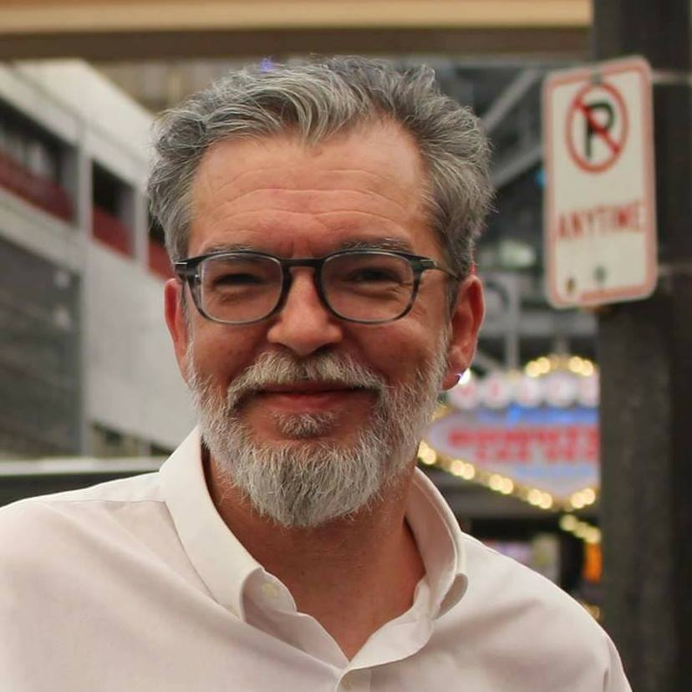
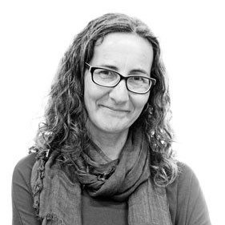
About the authors
Miguel Crespo is a journalist, editorial consultant, and researcher at MediaLab_ISCTE -University Institute of Lisbon, and OberCom – Portuguese Media Observatory. Lecturer at ISCTE and European University Lisbon, and trainer at ETIC Creative School and Cenjor – Portuguese Journalists Training Center. PhD student in Communication Sciences and Master’s in Communication, Culture, and Information Technologies.
Ana Pinto-Martinho is a journalist and researcher at MediaLab_ISCTE -University Institute of Lisbon of ISCTE-IUL and Obercom – Portuguese Media Observatory. Lecturer at ISCTE-IUL, where she is the executive coordinator of the post-graduation programme in Journalism. She is currently working on her PhD, has a Master’s degree in Communication, Culture and Information Technologies and a Bachelor's Degree in Communication Sciences.
Wanessa Andrade is a journalist for 14 years, 10 of them for the largest communication company in Latin America, TV Globo, where she was a reporter, anchor and editor. Nominated for the News and Documentary Emmy Awards. Trainer in communication, storytelling strategies for social media and video recording and editing techniques. Master's in Internet Studies (ISCTE-IUL).

Slide 5
What we are going to discuss
Languages and limitations to produce and search contents for voice-activated devices and assistants
Discussion focused on present and future uses:
Being able to discuss appropriately the benefits and limitations of the journalistic content production for voice-activated devices and assistants.

Slide 6
Languages and limitations to produce and search content

Slide 7
Just to remember
Natural Language Processing (NLP) is the key!
It needs training and lots of online information to increase accuracy.
The major problem:
English is the "official language" of the Internet.
Of the total number of articles published in scientific journals in 2020, 95% were written in English. (Source: OEI)

Slide 8
Is the device able to understand exactly what the user was looking for?
Language is the first challenge when not working with English
Just to give you an example, for Portuguese (Brasil)
the system confuses UOL with "wall“
The problem is UOL is one of the major online news provider in Brazil… and they have a brand which is not recognizable by the voice-activated devices!

Slide 9
How can content producers stand out and be accessed by the users?
Different business models made it necessary to develop different types of algorithms, according to the platforms’ strategy. We know that:
Amazon prioritises commercial relationships
Google prioritises the customer journey
Apple prioritises… what?
So, content producers need to understand and develop their products/services according to the priorities of each platform

Slide 10
How does the device decide what content
to show?
This is one of the best kept secrets, since none of the providers explain how they designed their algorithms to work.
Depending on what they prioritise (Amazon prioritise commercial relationships and Google the customer journey), the algorithm shows different results, from different providers, to the same request
So, users which want a specific content from a specific news producer, should ask for it, like “I want to know how the electricity prices in Europe are evolving from The Financial Times”

Slide 11
How users use smart-speakers to access news?
Some initial thoughts:
Most accessed news content (Andrade, 2021):
Short news bulletins (up to 5 minutes in length)
Peak consumption at 8 am
81,2%
% of users which use internet-connected platforms to inform themselves
Notes:
Credits: Andrade, 2021

Slide 12
How users use smart-speakers to access news?
Daily
Frequency of use of the device to listen to news or information podcasts
Most people do it daily
Up to 3 times a week
Up to 5 times a week
Only at weekends
Every 15 days
Less than once a month
Notes:
Credits: Andrade, 2021

Slide 13
How users use smart: speakers to access news?
"News of the day"
Request news with the name of the media outlet
Most common texts for requesting news
Most requests are for the “news of the day”
"Latest news", "news of the moment" and "top news"
"Show news", "play news" and "listen to news"
Directing a subject as "Covid news"
Automation with "good morning".
0
5
10
15
20
25
Notes:
Credits: Andrade, 2021

Slide 14
How users use smart-speakers to access news?
Only 45% search for news using the name of a media outlet
For the 55% that don’t search for a specific media, it’s the platform who decides where the information came from
And all media producers wants to get those users!
Yes 45%
No 55%
Notes:
Credits: Andrade, 2021

Slide 15
How users use smart-speakers to access news?
No 69%
But the device has some difficulty in understanding the language (Portuguese) for more than 2/3 of the users
Similar results can be found for most of the languages (except English)
Yes 31 %
Notes:
Credits: Andrade, 2021

Slide 16
How users use smart-speakers to access news?
Look at some examples of misunderstood words in Portuguese. In other languages there are similar common errors (with other words)
Just for reference, these words are:
Alarm Clock
Restart
Player
Stop
Turn off
Fan
Notes:
Credits: Andrade, 2021

Slide 17
How users use smart-speakers to access news?
Some first conclusions… and subjects for discussion
The sample indicates that there is a great potential of use of this platform to access news in Portuguese (and, of course, in other languages).
Users are mainly looking for news summaries of the facts of the day
Big challenges for media brands
Difficulty also for small media to pierce the bubbles of Google, Amazon and Apple
Notes:
Credits: Andrade, 2021

Slide 18
Controlling questions

Slide 19
Controlling questions
In general, the most accessed news content is: (select the correct answer):
Radio news bulletins (up to 5 minutes in length)
Short news bulletins (up to 5 minutes in length)
Long news bulletins (more than 25 minutes in length)
Written news bulletins (more than 25 minutes in length)
(correct answer in RED)

Slide 20
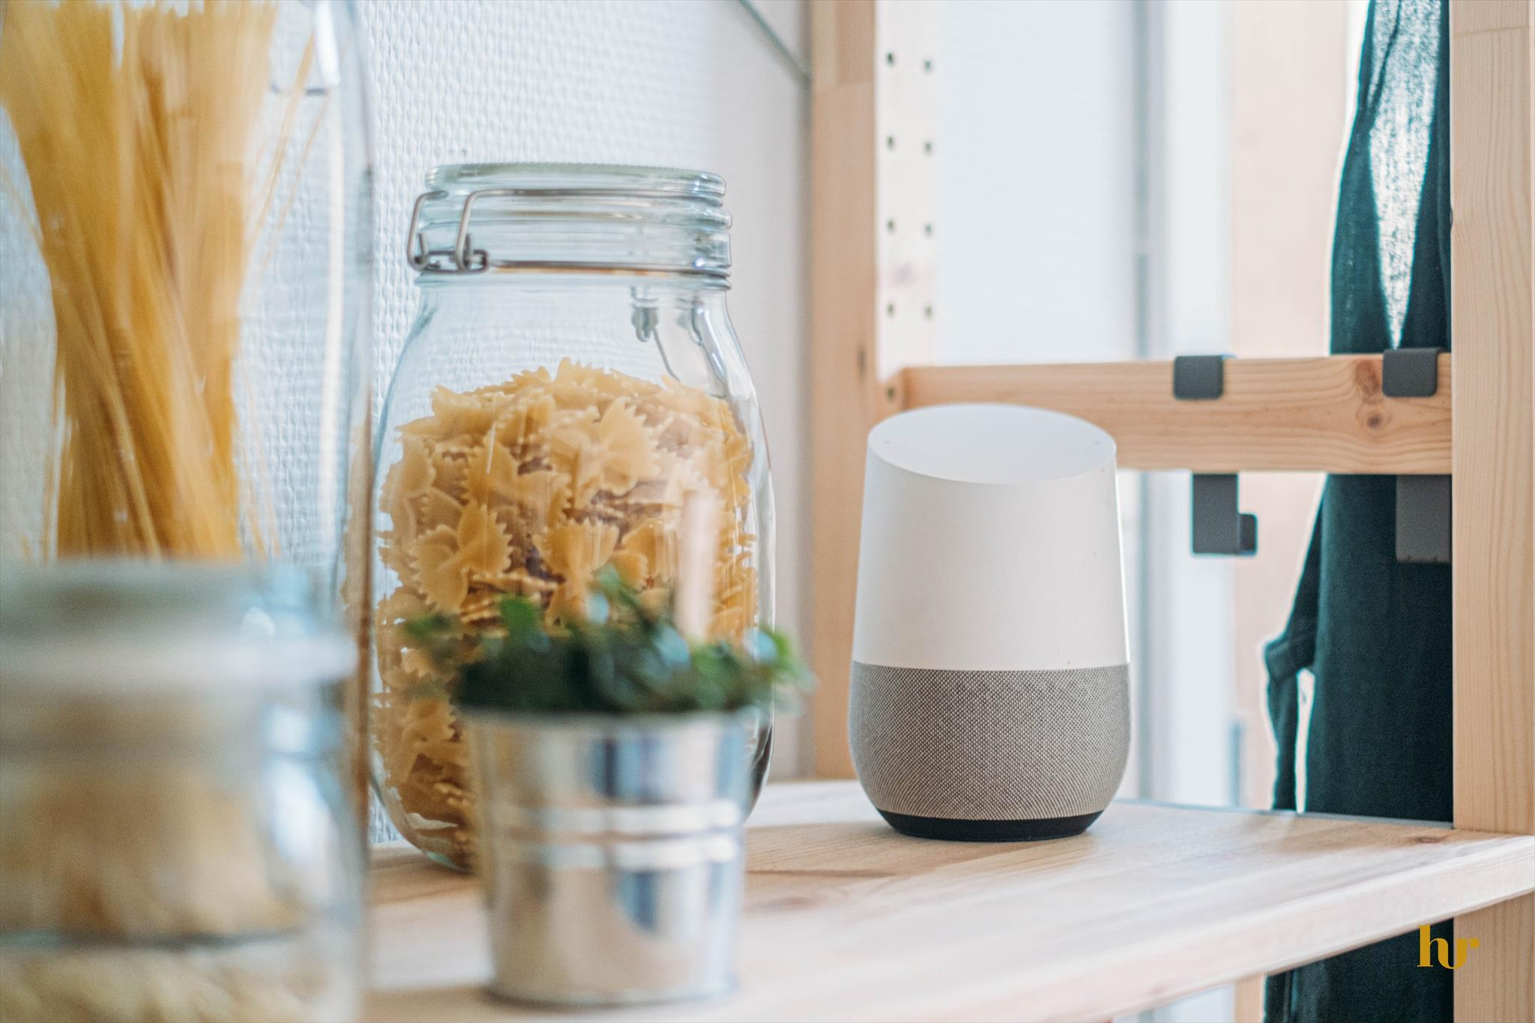
Controlling questions
In general, peak consumption of news though these devices is: (select the correct answer):
at 8 am
at 18h
at 8 pm
At 16h
(correct answer in RED)

Slide 21
How producers approach the use smart-speakers to access news?

Slide 22
How producers approach the use smart-speakers to access news?
Content curation has different approaches in newsrooms:
In some cases, there is an editor: a person who stays in the newsroom and then each editorial office - with the support of developers -, develops the content.
In other cases, there is a dedicated team, usually with experience in audio production, to think about product development.
Notes:
Credits:

Slide 23
Languages and limitations to produce and search content
In all cases, companies agree to say that a product to be activated by a smart-speaker cannot be thought of in the same way as content that will be accessed by another platform, because of the uniqueness of the devices.
Generally, people who use voice interactions are more active than spectators and will not always have the support of a visual resource on a screen.
Notes:
Credits:

Slide 24
How producers approach the use smart-speakers to access news?
On the contrary, the main resource is precisely the voice.
Notes:
Credits:

Slide 25
How producers approach the use smart-speakers to access news?
Thus, the "spoken" text needs to be understandable enough for people to be able to use it without resorting to other channels.
That's why it's important to think of several ways out of the box to circumvent users' multiple intentions.
That’s why the companies (media and/or tech) don't talk about amounts invested, but they all stress the importance of having dedicated product development teams for smart speakers.
Notes:
Credits:

Slide 26
How producers approach the use smart-speakers to access news?
Some media companies decided to start restructuring, to become “media tech” companies.
These companies assume this investment is necessary, as voice interactions via smart-speakers and smart-screens, connected cars and other devices that carry this technology, such as smartphones, headsets and smart-watches, are increasingly gaining market share.
For them, it is a new communication channel that will allow to expand the points of contact with its consumers' journey.
Notes:
Credits:

Slide 27
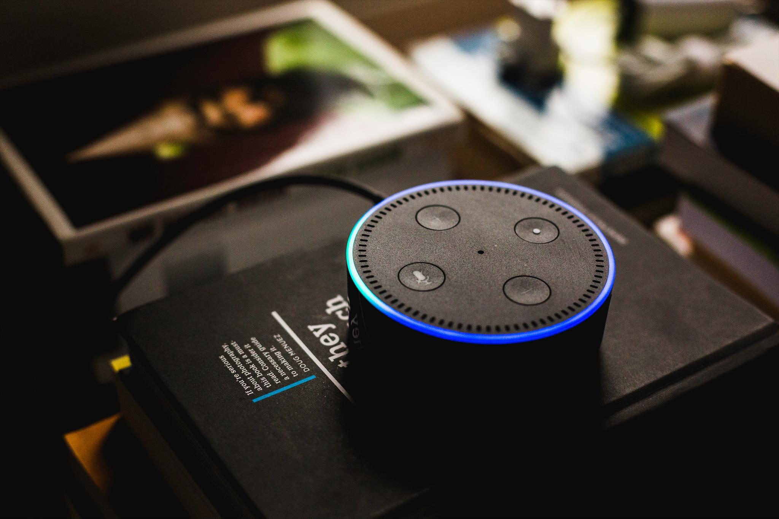
How producers approach the use smart-speakers to access news?
To meet the users needs:
communications companies need to train the professionals already in the market
universities need to prepare students to produce content to be activated by voice assistants

Slide 28
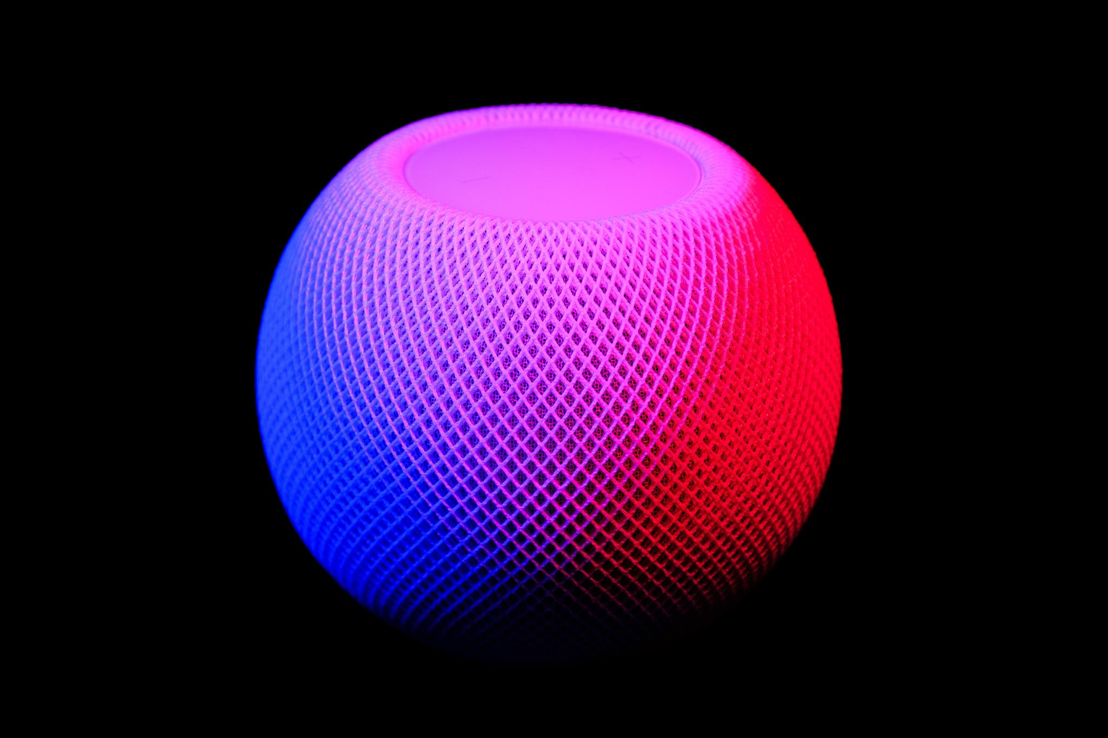
How producers approach the use smart-speakers to access news?
Not only for the medium language, which is different from TV, print, radio or internet websites:
the content must be text to be heard, and in an objective way!

Slide 29
How producers approach the use smart-speakers to access news?
To meet the users needs:
Google and Amazon should train the NLP systems more, including prosody and vocabulary from different regions, even in the same language
We need to understand the impact of the platforms decision to show news based on commercial partnerships
We need to know what will news consumption on this platform look like after the pandemic
Be aware of the importance of search in what regards contents for voice-activated assistants and devices and the role of algorithms in the field
Notes:
Credits:

Slide 30
Controlling questions

Slide 31
Controlling questions
Content curation has different approaches in newsrooms: (select the correct answer):
In any cases, there is a dedicated team to develop the content
In all cases, there is an editor to develop the content
In all cases, there is a dedicated team to develop the content
In some cases, there is an editor to develop the content
(correct answer in RED)

Slide 32
Controlling questions
To meet the users needs: (select the correct answer):
communications companies don’t need to do anything
communications companies just need to hire the professionals already in the market
communications companies need to train the professionals already in the market
communications companies can not do anything
(correct answer in RED)

Slide 33
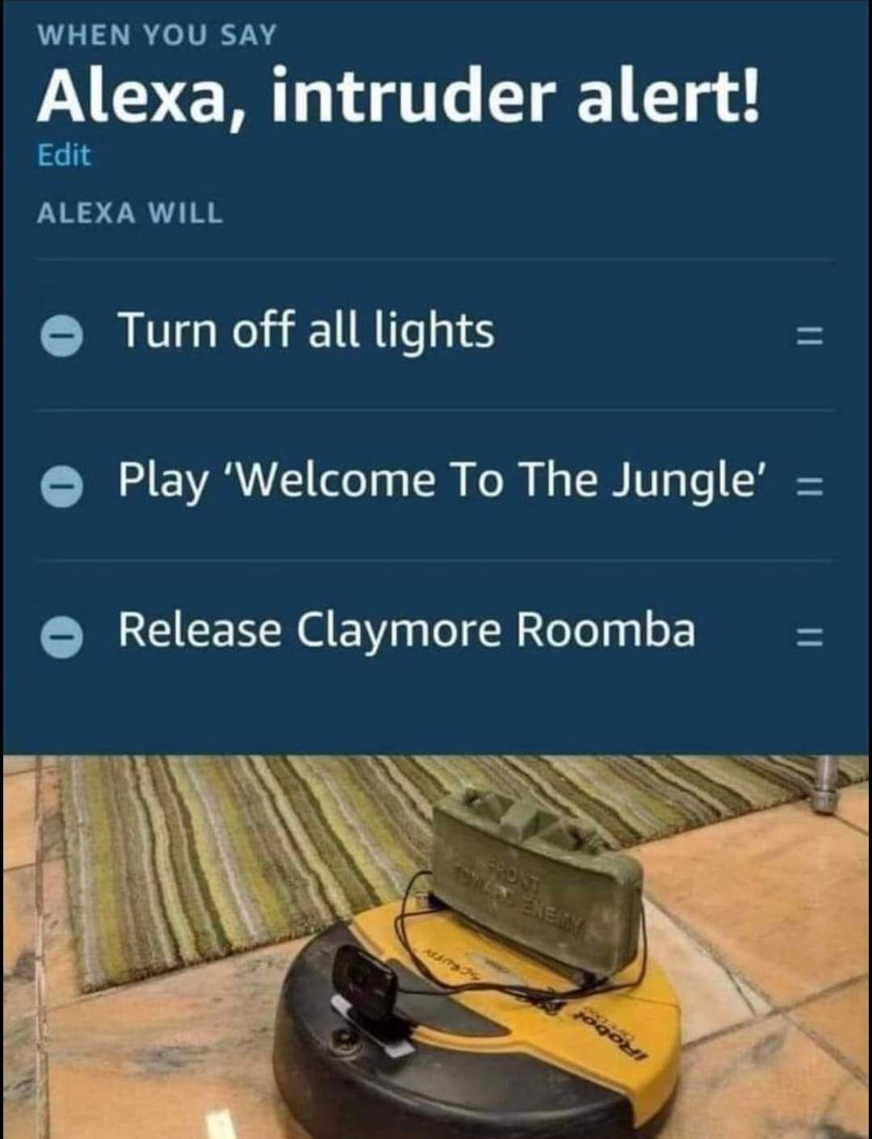
Voice-activated devices and assistants and their use in media and journalism Journalism for voice-activated assistants and devices
Be aware
Notes:
Source: Woodys360 (https://memescraps.com/2020/02/02/claymore-roomba/)

Slide 34
Bibliography, referred works
Andrade, W. (2021) Smart speakers and the news in Portuguese: consumption pattern and challenges for content producers. Available at http://hdl.handle.net/10071/23092
Beckett, C. (2019), New powers, new responsibilities: a global survey of journalism and artificial intelligence (Polis/LSE), available at https://blogs.lse.ac.uk/polis/2019/11/18/new-powers-new-responsibilities/
CDEI (2019), Smart Speakers and Voice Assistants, Available at https://assets.publishing.service.gov.uk/government/uploads/system/uploads/attachment_data/file/831180/Snapshot_Paper_-_Smart_Speakers_and_Voice_Assistants.pdf
Humphry, J., & Chesher, C. (2020). Preparing for smart voice assistants: Cultural histories and media innovations. New Media & Society, 23(7), 1971–1988. doi:10.1177/1461444820923679
Matthew B. Hoy (2018) Alexa, Siri, Cortana, and More: An Introduction to Voice Assistants, Medical Reference Services Quarterly, 37:1, 81-88, DOI: 10.1080/02763869.2018.1404391
Pieraccini, R. (2012) The Voice in the Machine: Building Computers That Understand Speech, MIT Press

Slide 35
Sources of Photos
Illustration pictures:
Articulate Content Library 360
Unsplash:
All photos published on Unsplash can be used for free. You can use them for commercian and non-commercial purposes.
https://unsplash.com/license
Pixabay:
CCO 1.0 Universal (CC0 1.0) Public Domain Dedication
http://www.pixabay.com
Notes:
See other sources in the notes

Slide 36
Sources of Photos
Freepik: https://www.freepik.com/
Pexels: All photos on Pexels can be used for free. https://www.pexels.com
Microsoft Powerpoint Stock Photos

Slide 37
Where you can find us
newsreel.pte.hu
newsreel@pte.hu
thenewsreelproject
@thenewsreelproject @newsreelproject
The project was funded by the European Commission. The views expressed in this publication do not necessarily reflect those of the European Commission.

