Slide 1
VERIFYING AND ANALYZING „FAKE NEWS”
Funded by the Erasmus+ Programme of the European Union
New Teaching Fields for the Next Generation of Journalists 2020-1-HU01-KA203-078824

Slide 2
Lesson 4 - Fact-checking

Slide 3
The Course
Lesson 1 - Introduction of the course. History of Fake News
Lesson 2 - What is the news? Fake news typology
Lesson 3 - Fake news and social media
Lesson 4 - Fact-checking

Slide 4
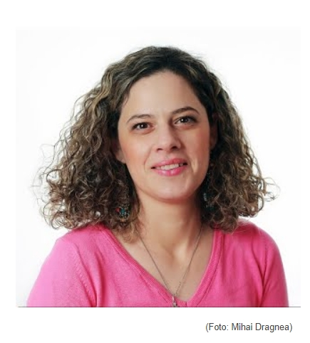
About the author
Antonia Matei is a lecturer at the Faculty of Journalism and Communication Sciences (University of Bucharest). She is an experienced journalist and has spent more than 10 years as a reporter and editor at the Romanian Broadcasting Corporation. She was also an anchor and a presenter of the radioshow “Our Objective: Romania and Our World” and of the talk-show “Europe Is Closer”. She has a PhD in Communication Sciences and is an editor at EJO Romania.

Slide 5
What we are going to discuss
What is fact-checking?
Fact-checking initiatives
Types of fact-checking
How it works? Tools for fact-checking
Self-checking the facts
Challenges

Slide 6
What Is Fact-Checking?

Slide 7
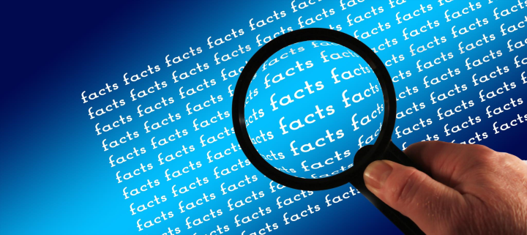
What is fact-checking?
The Cambridge Dictionary gives a very basic definition of factchecking, stating that this is ”the process of checking that all the facts in a piece of writing, a news article, a speech, etc. are correct”.
“It is important to move beyond recent narratives of “facts” and “fake news” and immediate political and social moments, to emphasize fact checking position in a wider consideration of human nature, interaction, and our inter-relatedness. Simply put, fact-checking is a form of critical, investigative inquiry.” (Leonard, A.; Meban A.; Young O., https://factcheckni.org/articles/explainers/what-is-fact-checking-and-why-is-it-important/)
Photo source: Articulate
Fact-checking

Slide 8
What is fact-checking?
From these definitions, we can see that the term “fact-checking” can now have two different meanings in journalism.
Traditionally, fact-checkers were those who would verify facts, figures and any other details before an article was published.
Nowadays, we come across a different type of fact-checkers. An independent organization verifies statements made by politicians, public figures or other representatives of companies/organization in order to check if they told the truth or lied and not to mislead and misinform the public.
Photo source: Articulate
Fact-checking

Slide 9
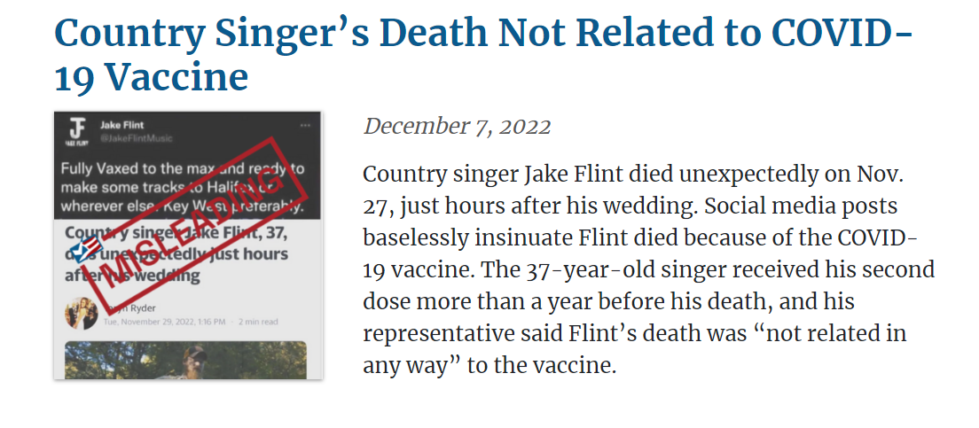
Why do we need fact-checking?
Fact-checking has become more and more important in journalism practice in the last years because disinformation and misinformation have also dangerously grown in recent years.
Ordinary people, bots, but also politicians or public institutions representatives are spreading so many fake news, false claims, rumors, conspiracy theories and ”alternative facts” that, in order for journalists to do their job correctly and to present the public quality reports and true information, it is necessary not only to verify, but also to fake-check.
Source: https://www.factcheck.org/page/18/
Fact-checking

Slide 10
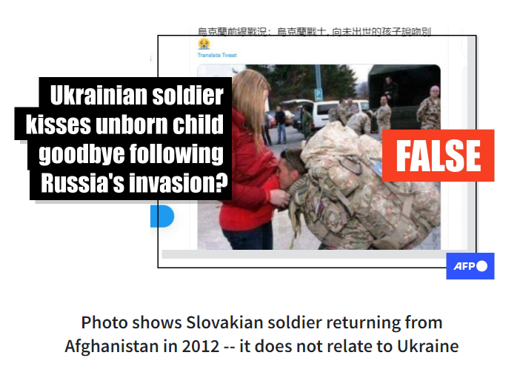
Why do we need fact-checking?
”The emergence of digital media and specifically social media meant that public figures now had direct channels to a broader part of the population without gatekeepers. This inspired the birth of online organizations performing and publishing fact-checks (post hoc)”. (Lindén, C.-G.; Nguyen, D.T.D.; Salas-Gulliksen, C.; Khan, S. A.; Amelie, M.; Dierickx, L. 2022, p. 7)
Thus, we need fact-checking in order to respect journalistic standards and freedom of media and to have democratic societies.
https://factcheck.afp.com/doc.afp.com.324M6XN
Fact-checking

Slide 11
Fact-checking initiatives
https://correctiv.org/
https://www.factual.ro/
disinfo.eu
https://www.afp.com/en
https://demagog.org.pl/
https://pagellapolitica.it/
Initiatives

Slide 12
Types of fact-checking

Slide 13
Types of fact-checking
As we’ve mentioned from the definition section, there are two types of fact-checking:
Editorial fact- checking – in which media outlets verify the information before publishing it. These fact-checkers are especially hired for this job. Taking into account the financial problems that newsrooms have had recently, there are many who have given up this type of service considering that the journalist must verify the information they publish.
”It is the editorial fact- checker’s job to unbraid the pieces of the story and examine each strand, testing its strength and probing for weak points; in the process, fact- checking also attempts to uncover whether any vital pieces of the story are missing. The fact- checker takes a hard look at the writer’s sources to assess if they are trustworthy; decides whether the writer used the facts fairly and accurately to build the story; and pushes back against the writer and editor— who are now invested in the story and its structure— if the evidence doesn’t support the way the story is written.” (Borel, 2023, p.5)
Editorial fact- checking

Slide 14
Types of fact-checking
Editorial fact-checking follows one of these models:
The magazine model – where someone (not the journalist that wrote the article, nor the editor) is checking again all the facts including specific details and more comprehensive arguments or storylines. The fact-checker may use the journalist's sources, but they can also add other news sources.
The newspaper model – in this type of model the journalist is the one checking all the details from the article/report. An editor can also make an exact check of a certain detail
The hybrid model – which is „a verification system in which a single newsroom deploys both the magazine model and newspaper model, depending on the type of story. Longer, complex pieces typically get the magazine model; shorter, newsier pieces get the newspaper model”. (Broke Borel)
Editorial fact- checking

Slide 15
Types of fact-checking
Political fact- checkers – this is a second type of fact-checking and consists of verifying different statements of politicians and/or other persons.
This is also called ”ex post” fact-checking and ”it seeks to make politicians and other public figures accountable for the truthfulness of their statements. Fact-checkers in this line of work seek primary and reputable sources that can confirm or negate claims made to the public”. (Mantzarlis, 2018, p. 81)
This is the type of fact checking is the one that we will focus more in this course. The first type of verification is also very important, but this is not necessarily something new. It rather represents one of the basic rules of journalism, so we will not insist upon it.
Political fact- checking

Slide 16
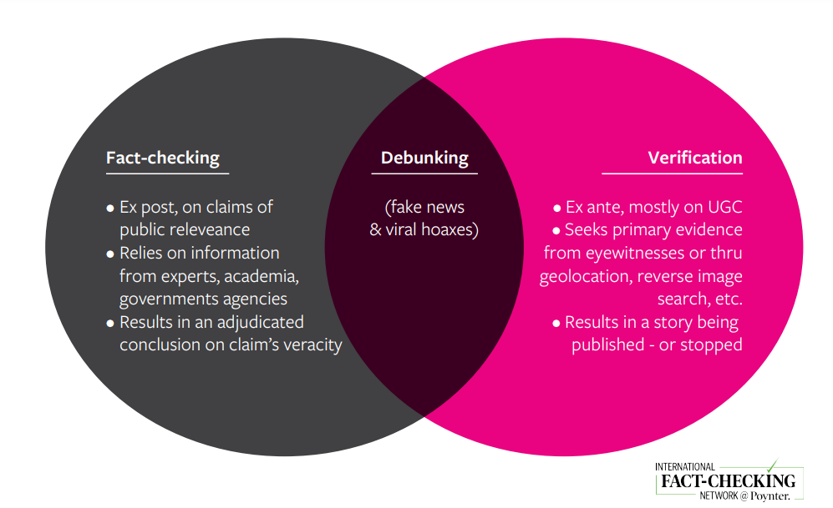
Types of fact-checking
Mantzarlis, A., 2018, p. 86 in Ireton, C. & Posetti, J. Journalism, 2018, Fake News and Disinformation. Handbook for Journalism Education and Training. UNESCO. https://en.unesco.org/sites/default/files/journalism_fake_news_disinformation_print_friendly_0.pdf
Fact- checking vs Verification

Slide 17
CONTROLLING QUESTIONS
1. Fact-checkers are those who verify facts, figures and any other details before an article was published. Fact-checkers are also those who verify statements made by politicians, public figures or other representatives of companies/organization in order to check if they told the truth or lied.
True
False
2. The newspaper model – in this type of fact-checking model the editor is the one checking all the details from the article/report. A journalist can also make an exact check of a certain detail.
True
False
What is news?/ Information disorder

Slide 18
How it works? Stages

Slide 19
Stages
Fact-checking processes have several phases:
The first one is actually finding the statements to be verified. The early steps consist of selecting the important comments or claims that can and should be fact-checked.
In order to find the statements that need to be verified, the fact-checkers have to monitor:
social media,
TV stations,
political debates,
different news outlets.
Fact-checking

Slide 20
Stages
The second step is to analyze the statement and the evidence that can be found on the topic.
The third step is to find evidences that confirms or not the facts from the statement. Alexios Mantzarlis (2018, p. 91) proposes a short checking guide in order to search the evidence that backs up or disproves the findings. Sources can be evaluated according to the following parameters.
 | Poor | Medium | Strong
Proximity
Expertise
Rigour
Transparency
Reliability
Conflict of Interest
Fact-checking

Slide 21
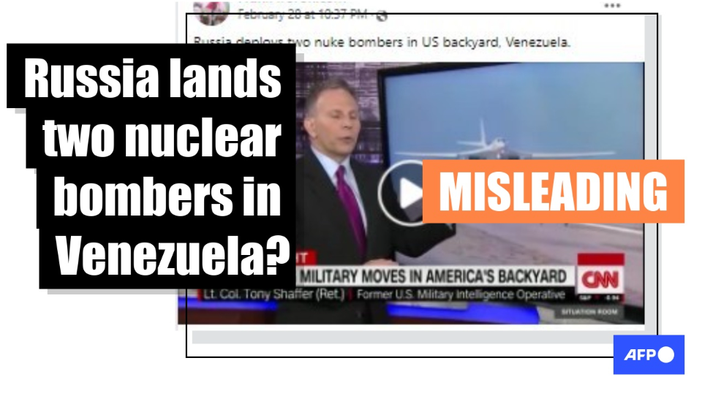
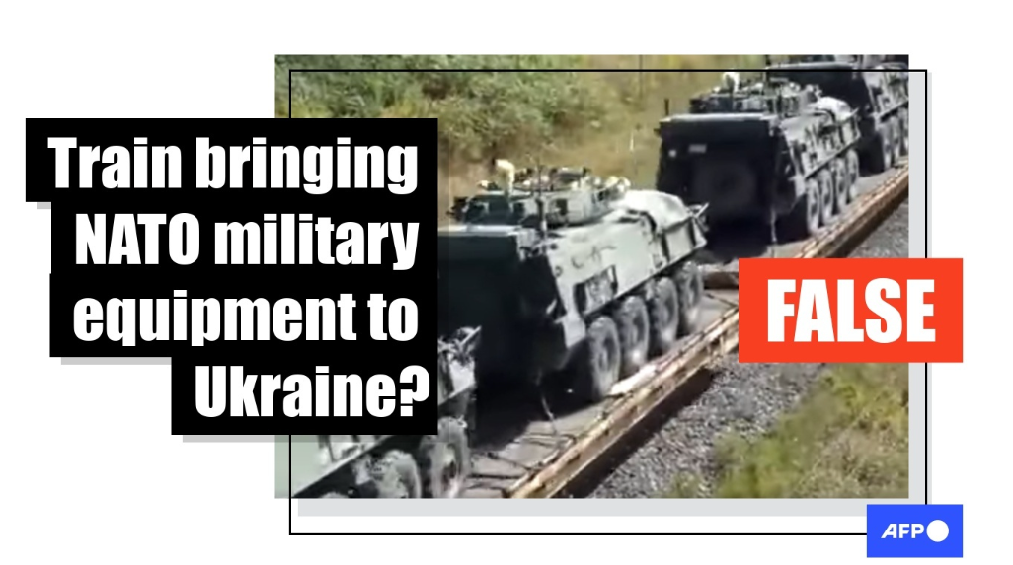
Stages
The next step is to present the facts that are not correct and to correct them.
The finale stage is to present the scale of truthfulness, as clear as possible in order for the public to understand what are the actual facts. The claims can be true, misleading or false.
https://factcheck.afp.com/doc.afp.com.324P7U2
https://factcheck.afp.com/doc.afp.com.324M4WH
Fact-checking

Slide 22
CONTROLLING QUESTIONS
Fact-checking processes have several phases. These are:
The first stage is finding the statements to be verified. The second step is to analyze the statement and the evidence that can be found on the topic. The third step and the final step is to find evidences that confirms or not the facts from the statement.
True
False
What is news?/ Information disorder

Slide 23
How it works? Tools for fact-checking

Slide 24
Reverse image search
There are many online tools that can be used in order to verify content, photos or/and video.
Reverse image search is a technique through which you can check if a picture has been posted before.
It is very helpful because, often, fake news spreads through older pictures redistributed and presented in a different context.
Some of the website where you can do this are: Google Images, TinEye or Dupli Checker.
Tools

Slide 25
Geolocation
Geolocation is another useful tool in fighting false information. It refers to finding evidence in video or pictures to discover where they were taken.
In the context where so many things are happening all over the world, the newsrooms cannot send so many correspondents to report from all these events, geolocation is an effective tool to discover if those pictures or videos were taken exactly in that area or somewhere else.
Geolocation ”refers to the identification of the geographic location of a user or computing device via a variety of data collection mechanisms.”
The most used platforms for geolocation are: Google Maps, Bing Maps, Mapillary, Yandex, Open street map
Tools

Slide 26
Geolocation
Full Fact, a non-profit company, has researched a video posted on Facebook that claimed to present a fire in Ukraine started by a Russian airstrike. The fact-checkers discovered that the video was not from Ukraine, but was actually taken in 2015 in a Chinese city, called Tianjin and it presented an explosion at a warehouse.
https://fullfact.org/online/china-explosion-video-ukraine/
Tools

Slide 27
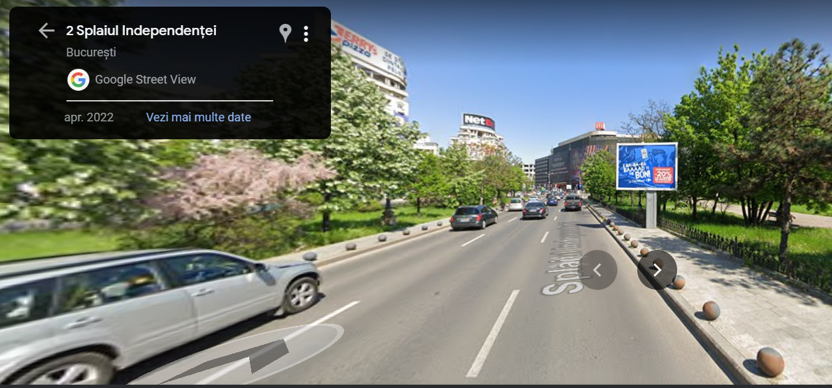
Geolocation
”Some of the clues fact-checkers look out for are shop signs, landmarks, the style of buildings, logos, and street signs. Other elements in the video that also help in geolocating a video are the language used in the video, vehicle registration numbers, and even flags.” (Saran,M.,2022, https://www.thequint.com/news/webqoof/using-geolocation-for-fact-checking-verify-kiya-kya-google-maps#read-more)
https://www.google.ro/maps/
Tools

Slide 28
Other tools
CrowdTangle is another tool which fact-checkers can use to identify posts that contain misinformation. This is a public insights tool that helps users to follow, investigate, and study on what’s going on with public content on social media.
WayBackMachine helps fact-checkers to find past versions of the websites that don’t exist anymore
https://www.crowdtangle.com/
https://archive.org/web/
Tools

Slide 29
Self-checking the facts
The author - check who the author of the article/information is. Is it a journalists? Is it an expert? Does this author have other articles on the same topic?
“About Us” section - all quality publications have ”about us” and ”contact us” sections. If there is no information about the publication, something is not right.
Balance – is the article equitable or does it tend to support a certain viewpoint? One-sided articles are not presenting the entire story.
Verify the dates - one type of fake news comes in the form of reusing old information and placing it in another context in order to mislead the public. So make sure you pay attention to the date when the article was published.
Tools

Slide 30
Self-checking the facts
Analyze the sources - An informative article that presents facts (and not someone's opinion) must contain sources and must be based on sources. This way, the journalist proves the public his/her article is based on facts. The lack of sources in an article must raise a question mark.
Consider the urls - One other way of tricking people is to copy a well-known website and to change some small detail at the name.
Suspect the sensational - When you see something posted that looks sensational, it is even more important to be skeptical. Exaggerated and provocative headlines with excessive use of capital letters or emotional language are serious red flags.
Be a doubting Thomas – Don`t believe right away anything that you read. Try to use your own filters and critical thinking. https://researchguides.ben.edu/c.php?g=608230&p=4219925
Tools

Slide 31
Challenges & limitations

Slide 32
Challenges for fact-checking
There are many problems and challenges that fact-checkers come across from more large categories: monitoring, researching and publication and distribution.
Monitoring the statements and claims. Some of the problems are:
There is a huge number of declarations that should be monitored and there aren’t enough fact-checkers to do this. Not all of these should be verified because not all of them are relevant. This is another challenge, to establish if the respective statement is relevant enough to be analyzed.
Too many requests from the audience. Help from the public can be good because people can draw attention to certain statements, but these are not always relevant.
No monitoring tool for YouTube
Challenges

Slide 33
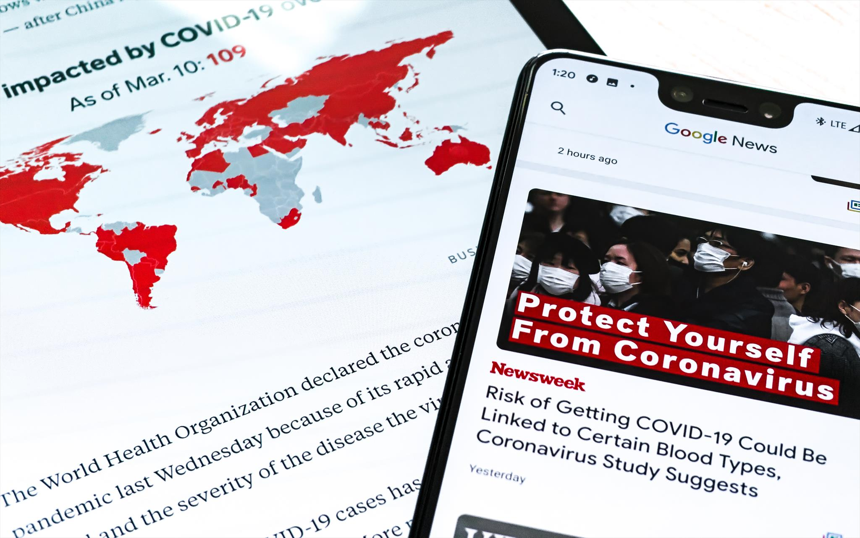
Challenges for fact-checking
2. Researching. The challenges include:
Problems in getting the information
Lack of transparency from the authorities
Training editorial staff
Problems in finding the right source
3. Publication and distribution. Some of the problems consist of:
Keeping media partnerships
Doing fact-checking with not enough resources of space and design
Internet shutdowns
Online harassment
Photo source: Articulate
Challenges

Slide 34
FACT-CHECKING: CONTROLLING QUESTIONS
Which of the following sentences are NOT correct?
The hybrid model is a verification system in which a newsroom deploys the magazine model.
Self-checking the facts consists, among others, in analyzing the author, interviewing other sources, reading the “about us” section, verifying the date and the urls.
In order to search the evidence that backs up or disproves the facts, sources can be evaluated according to the following parameters: proximity, expertise, rigour, transparency, reliability, conflict of interest.

Slide 35
Bibliography, referred works
Cambridge Dictionary - https://dictionary.cambridge.org/
Broke, Borel, 2023, The Chicago Guide to Fact- Checking, The University of Chicago Press, Chicago
Broke, Borel, The Three Models of Fact-Checking. https://ksjhandbook.org/fact-checking-science-journalism-how-to-make-sure-your-stories-are-true/the-three-models-of-fact-checking/
Dierickx, L.; Sheikhi, G.; 2022. NORDIS Report on the user needs of fact-checkers, https://edmo.eu/wp-content/uploads/2022/10/Report-task-4.2-Fact-checkers-user-needs.pdf
Full Fact, 2020, The challenges of online fact checking, https://fullfact.org/media/uploads/coof-2020.pdf
Lindén,C.-G.; Nguyen, D.T.D.; Salas-Gulliksen, C.; Khan, S. A.; Amelie, M.; Dierickx, L.; 2022. State of the art in
fact-checking technology. https://edmo.eu/wp-content/uploads/2022/10/Report-task-4.1-The-State-of-Art-of-Fact-Checking-Tools.pdf
Mantzarlis, A. 2018. Fact-checking 101 in Ireton, C. & Posetti, J. Journalism, Fake News and Disinformation. Handbook for Journalism Education and Training. UNESCO. https://en.unesco.org/sites/default/files/journalism_fake_news_disinformation_print_friendly_0.pdf
Leonard, A.; Meban A.; Young O., What is fact-checking and why is it important? https://factcheckni.org/articles/explainers/what-is-fact-checking-and-why-is-it-important/

Slide 36
Bibliography, referred works
Saran, M.,2022, Geolocation: Using Google Maps To Fact-Check Location in Videos and Photos, The Quint, https://www.thequint.com/news/webqoof/using-geolocation-for-fact-checking-verify-kiya-kya-google-maps#read-more
Wardle, C., The Age of Information Disorder, https://datajournalism.com/read/handbook/verification-3/investigating-disinformation-and-media-manipulation/the-age-of-information-disorder
https://www.mapillary.com/
https://yandex.com/
https://www.bing.com/maps
https://www.google.com/maps
https://factcheck.afp.com/doc.afp.com.324M4WH
https://factcheck.afp.com/doc.afp.com.324P7U2

Slide 37
Sources of Photos
Illustration pictures:
Articulate Content Library 360
Unsplash:
All photos published on Unsplash can be used for free. You can use them for commercian and non-commercial purposes.
https://unsplash.com/license
Pixabay:
CCO 1.0 Universal (CC0 1.0) Public Domain Dedication
http://www.pixabay.com
Notes:
See other sources in the notes

Slide 38
Sources of Photos
Freepik: https://www.freepik.com/
Pexels: All photos on Pexels can be used for free. https://www.pexels.com
Microsoft Powerpoint Stock Photos

Slide 39
Other Sources of Photos/Printscreens
Sources of printscreen:
https://www.factcheck.org/page/18/
https://factcheck.afp.com/doc.afp.com.324M6XN /
https://correctiv.org/
disinfo.eu
https://www.factual.ro/
https://demagog.org.pl/
https://www.afp.com/en
https://pagellapolitica.it/
https://archive.org/web/
https://www.crowdtangle.com/

Slide 40
Other Sources of Photos/Printscreens
Mantzarlis, A., 2018, p. 86 in Ireton, C. & Posetti, J. Journalism, 2018, Fake News and Disinformation. Handbook for Journalism Education and Training. UNESCO. https://en.unesco.org/sites/default/files/journalism_fake_news_disinformation_print_friendly_0.pdf
https://factcheck.afp.com/doc.afp.com.324P7U2
https://factcheck.afp.com/doc.afp.com.324M4WH
https://fullfact.org/online/china-explosion-video-ukraine/

Slide 41
Where you can find us
newsreel.pte.hu
newsreel@pte.hu
thenewsreelproject
@thenewsreelproject @newsreelproject
The project was funded by the European Commission. The views expressed in this publication do not necessarily reflect those of the European Commission.

