Slide 1
GRAPHIC JOURNALISM
Funded by the Erasmus+ Programme of the European Union
New Teaching Fields for the Next Generation of Journalists 2020-1-HU01-KA203-078824

Slide 2
Lesson4 - Media Genres of Comics Journalism

Slide 3
The Course
Introduction to Comics Studies
Comics as Media Culture
Tools for Analysing Graphic Narratives
Media Genres of Comics Journalism

Slide 4
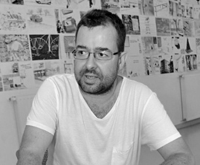
About the author
Gyula Maksa, PhD, dr. habil. is an associate professor at the University of Pécs (Hungary), Department of Communication and Media Studies, where he directs the Comics Studies Research Center (Képregénytudományi Kutatóközpont). He has organized several conferences, exhibitions and published two books in Hungarian on comics as a medium: Változatok képregényre (Variation for Comics, Budapest-Pécs, Hungary, 2010), Képregények kultúraközi áramlatokban (Comics in Transcultural Flows, Cluj, Romania, 2017). His main research areas are the geopolitics of comics, transcultural situations and communicative uses of comics.

Slide 5
What we are going to discuss
In the case of media texts, genre is the interpretative framework for producers, creators, those responsible for media texts, as well as for recipients, audiences and users.
Media genres are also commonly seen by researchers as a 'contract' between the creator and the recipient of media texts, or at least as a promise made by the creator to the recipient. The media industry seeks to shape the expectations of audiences through genres. It generates, modifies or even undermines audience expectations through references to genre(s), through procedures aimed at creating the promise of genre.
The following are examples of two genres of graphic journalism and one borderline genre.

Slide 6
1.Comics Reportages

Slide 7
1.1.Origin
Also informed by the centuries-old tradition of newspaper illustrations, but mainly reflecting the generic characteristics of the autobiographical graphic novel (and certainly inspired by its success), comics reportage developed at the intersection of journalistic practice and comics drawing. The genre became popular in both the North American Comics and the French-Belgian(-Swiss) bande dessinée tradition after the turn of the millennium (Bourdieu, 2012). Joe Sacco’s influential war report Palestine (1993) played a crucial role in the recognition and institutionalization of the genre.
1.Comics Reportages

Slide 8
1.2.Joe Sacco
Indeed Sacco canonized certain characteristics of the genre through the impact of the Maltese-born
US comics journalist’s reports on the Middle East and the Balkan Wars. Sacco’s works, although
retaining some of the authentication procedures of conventional reporting, including references to
real space and time, make a spectacular break with the requirement of journalistic objectivity. The
author-narrator-protagonist is, therefore, in a sense, an autobiographic reporter who draws himself
into the narrative, and becomes a character and participant in the events. He reflects on the
impressions, experiences, and feelings he encountered during his field work, as well as on his own
cultural background and biographical history. The latter feature also links the comic book report to
autobiographical works. He observes, represents, and sometimes comments on everyday
occurrences, and his conversations with local people are also “put on stage”.
1.Comics Reportages

Slide 9
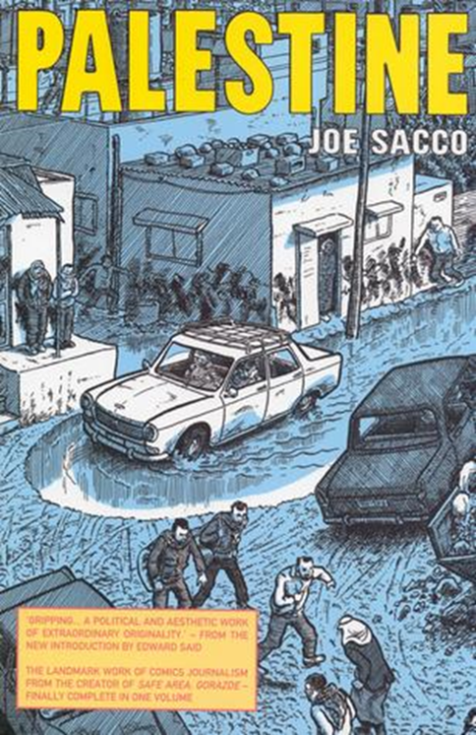
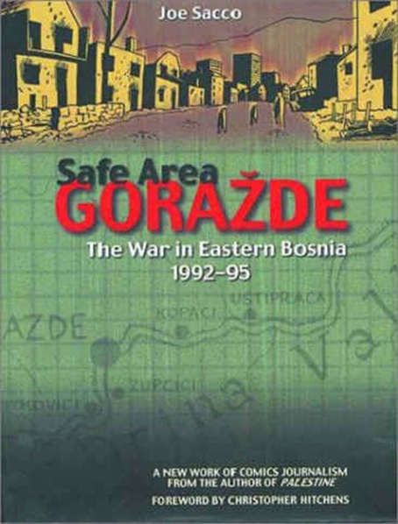
1.2.Joe Sacco
Joe Sacco’s influential works defined the genre, such as Palestine (1993 and 1996, in one volume 2001), Goražde (2000) or The Fixer (2003).
1.Comics Reportages

Slide 10
1.3.Patrick Chappatte
Creating comics reportage presupposes both journalistic and cartoonist work and skills, and in the case of the autobiographical tradition (and the innovations heralded by Sacco) one person should possess all these skills. In a lecture, Swiss Francophone comics journalist Patrick Chappatte explained that his work in the field is similar to that of his traditional reporter role: he takes notes, conducts interviews and takes photographs (Chappatte, 2011b).
1.Comics Reportages

Slide 11
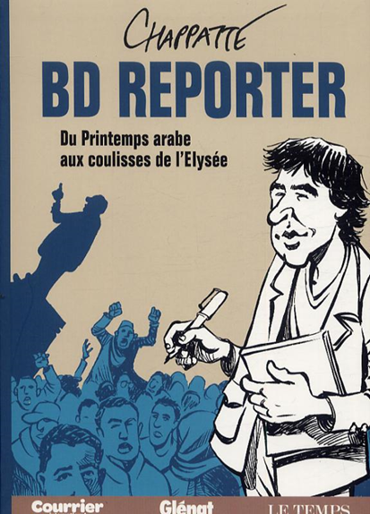
1.3.Patrick Chappatte
Patrick Chappatte has produced over thirty pieces of comics reportage published in his 2011 book BD Reporter. Du “printemps arabe” aux coulisses de l'Élysée (BD Reporter. From the "Arab Spring" to the backstage of the Elysée Palace) and in various Swiss, Italian, French, and US-based magazines, and covered a wide variety of topics and locations (Chappatte, 2011a).
Patrick Chappatte: http://www.graphicjournalism.com/
1.Comics Reportages

Slide 12
Controlling questions
What are the main characteristics of a Sacco comics reportage?
Journalistic objectivity (false)
Autobiographical work (true)
Reflexion on the subjective impressions (true)
Superheros (false)
Reporter draws himself into the narrative (true)

Slide 13
2.Feuilleton: Comics Journalism and Everyday Life

Slide 14
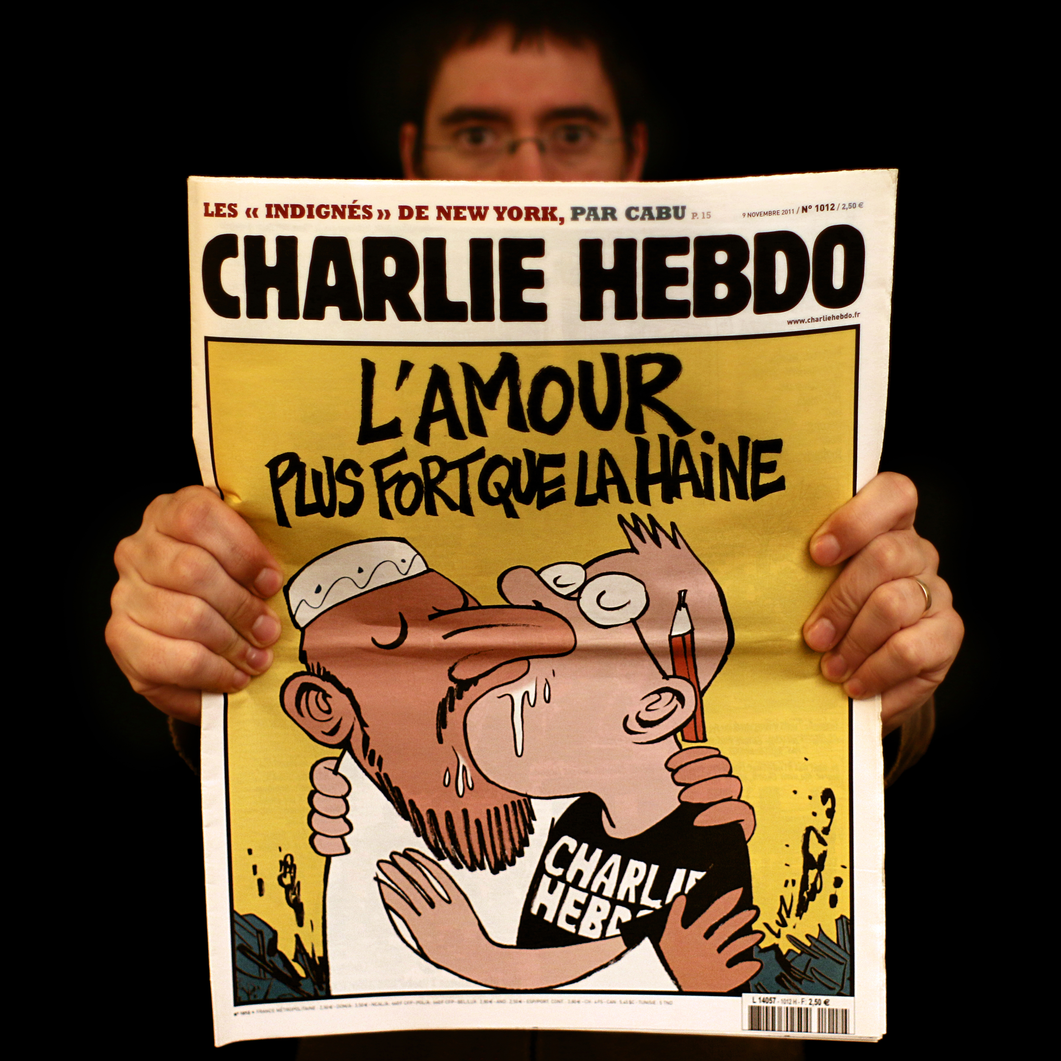
2.1.„The Secret Life of Young People”
Riad Sattouf’s three-volume The Secret Life of Young People (La vie secrète des jeunes, 2007, 2010, 2012) occupies a unique place within the world of comics journalism. One-page micronarratives of the volumes were originally published as “feuilletons” in the satirical journal Charlie Hebdo, famous for its scandals, lawsuits, bans and the January 2015 attack. Charlie Hebdo usually reflects on current political and public events with its cartoons and comics. The book medium, the paper quality and the covers together trigger the expectations of the roman graphique in the reader, while the abundance as well as the fragmentary nature of micronarratives undermine the image of novel-like comics reportage.
https://www.taurillon.org/charlie-hebdo-et-demain?lang=fr
2. Feuilleton: Comics Journalism and Everyday Life

Slide 15
2.2.Satiric tableaux
Using everyday examples “seen and heard” on the streets, The secret life of young people puts the violation of certain rules and habits of behaviour, social coexistence, and culture into spotlight, sometimes also revealing the hypocritical attempts to conceal such violations. Despite the fragmentary nature, it delivers a weird, upsetting, yet ridiculous image of the metropolitan society in France, a kind of satiric tableaux where traces of overemphasized, repressed, monetized, etc. sexuality can appear in various places, situations and through characters ranging from prostituted middle-class girls and precocious sex-hungry little boys to headscarfed Muslim women licking ice-cream in an erotic way.
2.Feuilleton: Comics Journalism and Everyday Life

Slide 16
2.2.Satiric Tableaux
Typical locations are the spaces of fast-food chains and public transport, so the inescapable transience of everyday life in the metropolitan city becomes emphatic, yet the comprehensive narrative characteristic of the more traditional report books is not provided, only fragmentary notes with frequent gestures of authentication, which are further reinforced by the preface of the first book promising to expose human habits and behaviour. In The secret life of young people the cartoonist does not appear on the scene as in traditional comics reportages, and the commentary-like voice also plays a reduced role.
2. Feuilleton: Comics Journalism and Everyday Life

Slide 17
Controlling questions
What are the main characteristics of „The Secret Life of Young People” ?
War reportage (false)
Ridiculous image of the metropolitan society (true)
Fragmentary nature (true)
Superheros (false)
Reporter draws himself into the narrative (false)

Slide 18
3.“Expat” Graphic Novels

Slide 19
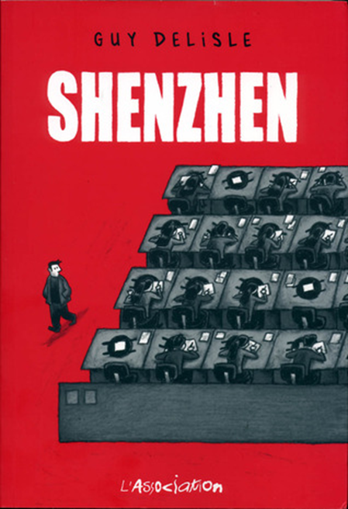
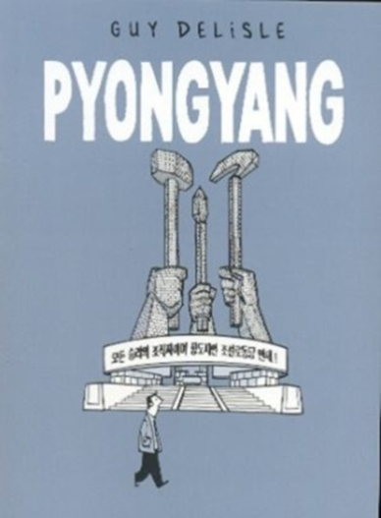
3.1.An Emerging Genre
An emerging genre, similar to the comics reportage depicting the experience of countries, languages and cultures distant from the home of the reporter, could be referred to as the “expat graphic novel”, which largely originates in the work of the Canadian Guy Delisle. The narrator of these graphic novels is transferred from his own country to a foreign linguistic-cultural environment. Such a situation emerges in the Delisle novels published from the beginning of the new millennium either because of the narrator-protagonist’s work as an animated filmmaker, or because of the missions of his spouse, Nadège, who works for the international aid organization Doctors Without Borders. The first group includes novels describing North Korean and Chinese experiences, and the second includes “expat experiences” in Burma and Israel/Palestine, exhibiting the everyday life and the relationships with locals and other expats (Delisle, 2000; 2003; 2007; 2011).
3.“Expat” Graphic Novels

Slide 20
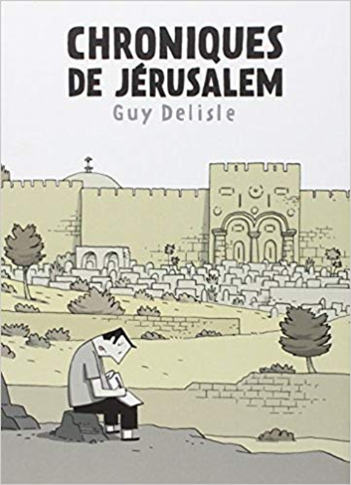
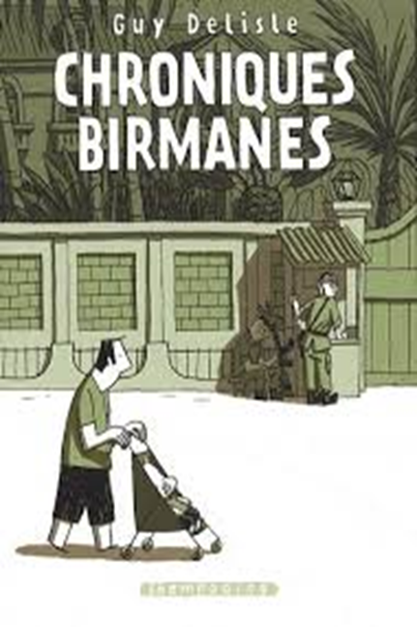
3.2.Delisle’s novels
Delisle’s novels are autobiographies which are not free from geopolitical topics. However, frequent topics of international journalism, such as North Korean propaganda and Israeli West Bank Wall, here appear in the comics narrator’s subjective perspective, usually depicted on the level of the practices of daily life. The novel set in Jerusalem also features a comics reportage part, but its narrative framework suggests deviation from the genre, emphasising even more that outside this experiment we are not reading a comics reportage, and therefore it is not recommended to approach this graphic novel along the expectations of general journalism and comics reportages.
Unlike Joe Sacco, the founding father of comics journalism, Guy Delisle, is not a professional journalist. As travel literature expert Jelena Bulić points out in her thorough analysis of Delisle’s novels, these works are not journalistic reports (“reportages”) in the sense of Joe Sacco. They are rather accounts (“reports”) that bypass the canonical conventions of travel literature and travel related media narratives, and attempt to convey the experience of everyday life. The daily routine is also discussed in detail regarding topics such as work, cooking or childcare — a kind of thematization not unusual in autobiographical comics and autobiographies (Bulić, 2012, 63). The experience of everyday life here is also the experience of violence in Israeli-Palestinian everyday life (Fall, 2014, 100).
3.“Expat” Graphic Novels

Slide 21
Controlling questions
What are the main characteristics of Delisle’s expat novels?
Not journalistic reports (“reportages”) in the sense of Joe Sacco (true)
Expatriate experience (true)
Superheros (false)
Reporter draws himself into the narrative (true)
Book format (true)

Slide 22
Bibliography, referred works
1. Primary sources
Chappatte, P. 2011a. BD Reporter. Du „printemps arabe” aux coulisses de l’Élysée. Nyon: Glénat (Suisse).
Delisle, G. 2000. Shenzhen. Paris: L'Association.
Delisle, G. 2003. Pyongyang. Paris: L'Association.
Delisle, G. 2007. Chroniques birmanes. Paris: Delcourt.
Delisle, G. 2011. Chroniques de Jérusalem. Paris: Delcourt.
Sacco, J. 1993. Palestine: A Nation Occupied. Seattle: Fantagraphics Books.
Sacco, J. 1996. Palestine: In the Gaza Strip. Seattle: Fantagraphics Books.
Sacco, J. 2000. Safe Area Goražde: The War in Eastern Bosnia 1992–1995. Seattle: Fantagraphics Books.
Sacco, J. 2001. Palestine. London: Jonathan Cape.
Sacco, J. 2003. The Fixer: A Story from Sarajevo. Montréal: Drawn and Quarterly Books.
Sattouf, R. 2007. La Vie secrète des jeunes 1. Paris: L'Association.
Sattouf, R. 2010. La Vie secrète des jeunes 2. Paris: L'Association.
Sattouf, R. 2012. La Vie secrète des jeunes 3. Paris: L'Association.
2. Secondary literature
Bourdieu, S. 2012. Le reportage en bande dessinée dans la presse actuelle: un autre regard sur le monde. COnTEXTES 2012/11. Retrieved fromhttp://contextes.revues.org/5362
Bulić, J. 2012. The Travelling Cartoonist. Representing the Self and the World in Guy Delisle’s Graphic Travel Narratives. Narodna umjetnost: hrvatski časopis za etnologiju i folkloristiku 49: 61-80. Retrieved from https://hrcak.srce.hr/84963
Chappatte, P. 2011b. Un nouveau modèle de reportage. TEDxParis, Filmé à l'Espace Pierre Cardin le 15 janvier 2011b. Retrieved from https://www.youtube.com/watch?v=Ti_rWjlN4m4
Fall, J. J. 2014. Put Your Body on the Line: Autobiographical Comics, Empathy and Plurivocality. In Dittmer, J. Comic Book Geographies, 91-108. Stuttgart: Franz Steiner.

Slide 23
Sources of Photos
Illustration pictures:
Articulate Content Library 360
Unsplash:
All photos published on Unsplash can be used for free. You can use them for commercian and non-commercial purposes.
https://unsplash.com/license
Pixabay:
CCO 1.0 Universal (CC0 1.0) Public Domain Dedication
http://www.pixabay.com
Notes:
See other sources in the notes

Slide 24
Sources of Photos
Freepik: https://www.freepik.com/
Pexels: All photos on Pexels can be used for free. https://www.pexels.com
Microsoft Powerpoint Stock Photos

Slide 25
Other Sources of Photos
https://www.taurillon.org/charlie-hebdo-et-demain?lang=fr

Slide 26
Where you can find us
newsreel.pte.hu
newsreel@pte.hu
thenewsreelproject
@thenewsreelproject @newsreelproject
The project was funded by the European Commission. The views expressed in this publication do not necessarily reflect those of the European Commission.

