Slide 1
JOURNALISM FOR VOICE-ACTIVATED ASSISTANTS AND DEVICES
Funded by the Erasmus+ Programme of the European Union
New Teaching Fields for the Next Generation of Journalists 2020-1-HU01-KA203-078824

Slide 2
Lesson4 - State of the art of voice-activate devices and assistants – Guided reflection

Slide 3
The Course
Journalism for voice-activated assistants and devices
Lesson 1 - Brief history of voice-activated devices and assistants
Lesson 2 - Voice-activated devices and assistants and their use in media and journalism
Lesson 3 - Languages and limitations to produce and search contents for voice-activated devices and assistants
Lesson 4 - State of the art of voice-activate devices and assistants – Guided reflection

Slide 4
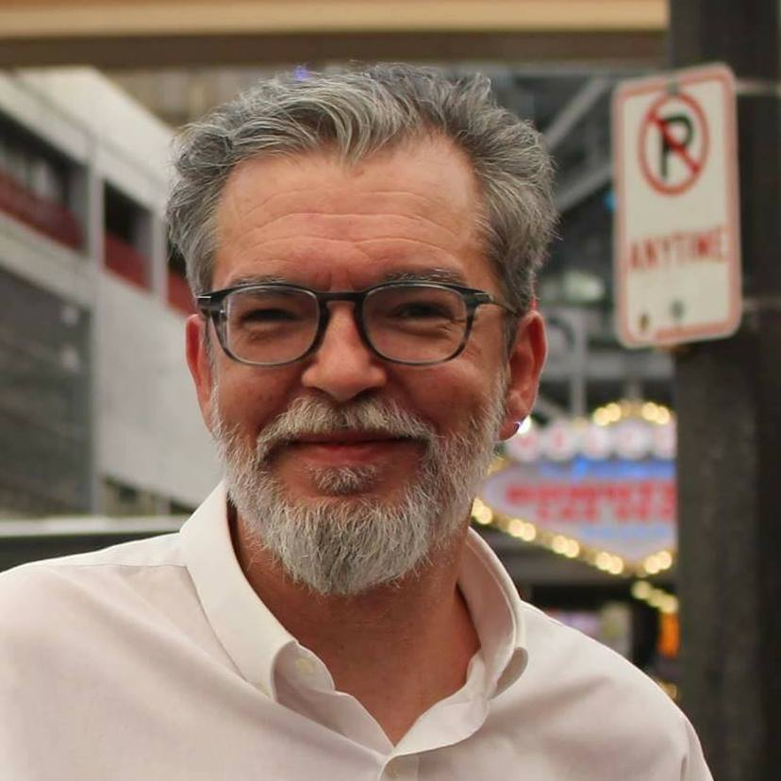
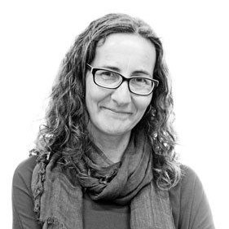
About the authors
Miguel Crespo is a journalist, editorial consultant, and researcher at MediaLab_ISCTE -University Institute of Lisbon, and OberCom – Portuguese Media Observatory. Lecturer at ISCTE and European University Lisbon, and trainer at ETIC Creative School and Cenjor – Portuguese Journalists Training Center. PhD student in Communication Sciences and Master’s in Communication, Culture, and Information Technologies.
Ana Pinto-Martinho is a journalist and researcher at MediaLab_ISCTE -University Institute of Lisbon of ISCTE-IUL and Obercom – Portuguese Media Observatory. Lecturer at ISCTE-IUL, where she is the executive coordinator of the post-graduation programme in Journalism. She is currently working on her PhD, has a Master’s degree in Communication, Culture and Information Technologies and a Bachelor's Degree in Communication Sciences.
Wanessa Andrade is a journalist for 14 years, 10 of them for the largest communication company in Latin America, TV Globo, where she was a reporter, anchor and editor. Nominated for the News and Documentary Emmy Awards. Trainer in communication, storytelling strategies for social media and video recording and editing techniques. Master's in Internet Studies (ISCTE-IUL).

Slide 5
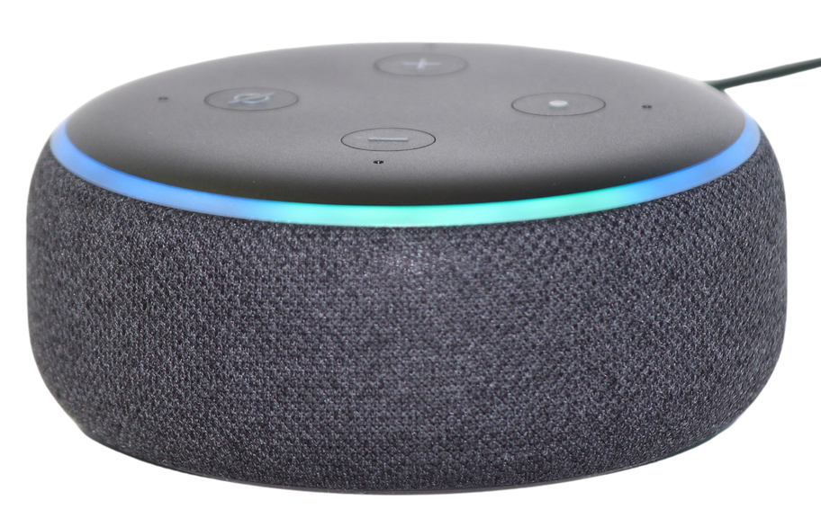
Guided reflection about the state of the art
Voice-activated devices or smart-speakers arrived on the market in 2014, in English.
They are a small speaker with a microphone installed, without a keyboard, to be operated only by the user's voice.
Notes:
Credits: Amazon
Caption: Amazon Alexa/ Echo

Slide 6
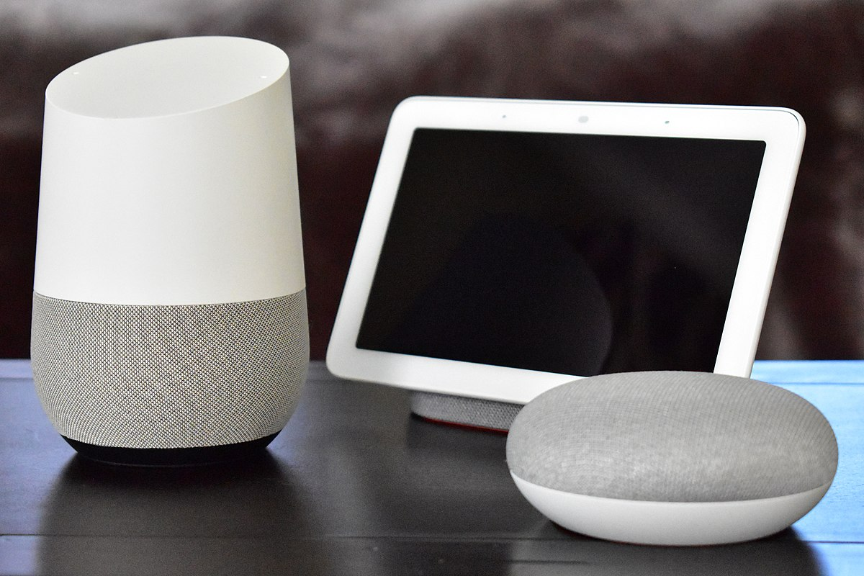
Guided reflection about the state of the art
This is an interface very different from more traditional ones (writing or touching).
The device may or may not have a screen, but smart-speakers without a screen are the most popular.
Notes:
Credits: Google
Caption: Google Home

Slide 7
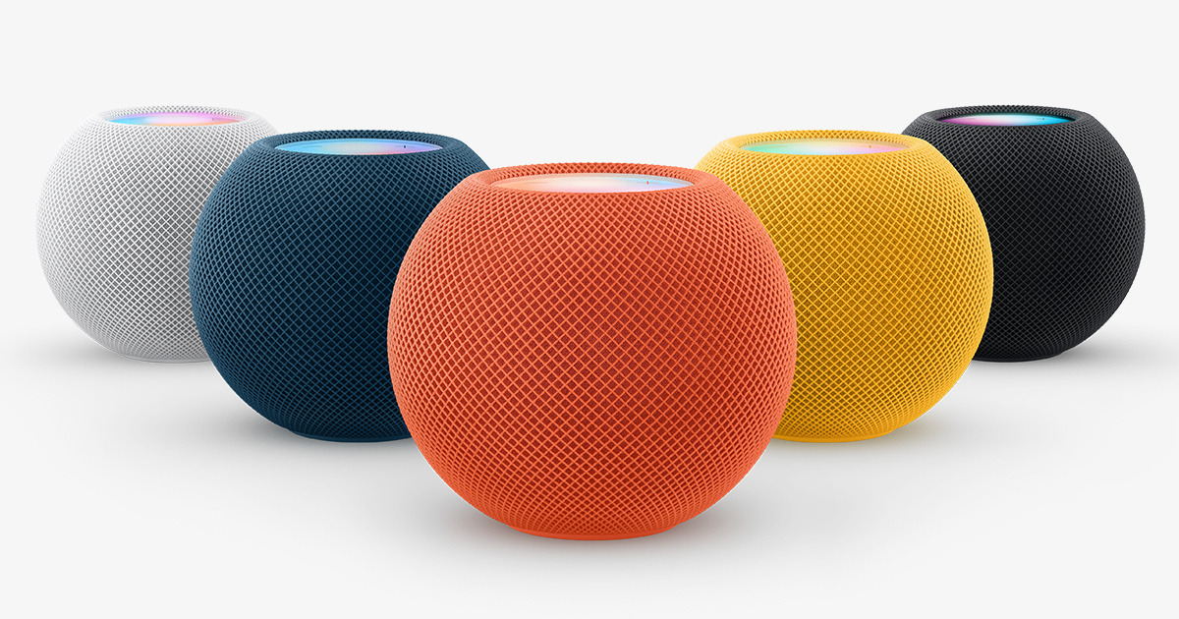
Guided reflection about the state of the art
Voice assistants, also called an intelligent personal assistant or a connected speaker, are new types of products marketed by Apple, Amazon and Google and are based on natural language speech recognition (NLP).
They allow a search to be carried out using a voice command entered by the user, as well as information retrieval by voice synthesis.
Notes:
Credits: Apple
Caption: Apple Homepod

Slide 8
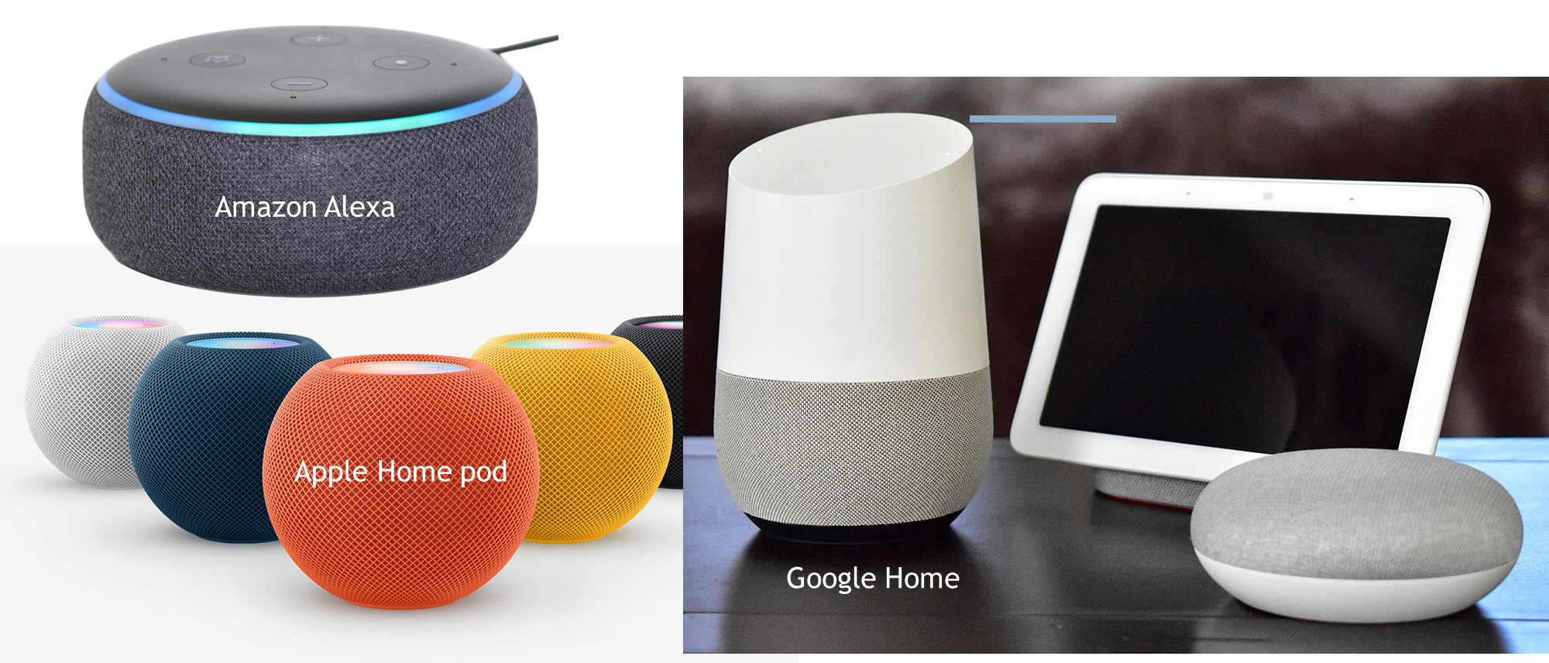
Guided reflection about the state of the art
Guided reflection about the state of the art
Notes:
Credits: image by the authors, with images from Apple, Google, Amazon

Slide 9
Guided reflection about the state of the art

Slide 10
Guided reflection about the state of the art
Natural Language Processing (NLP) is the key! (we will speak more about it in later sessions)
It needs training and lots of online information to increase accuracy.
The major problem:
English is the "official language" of the Internet.
Of the total number of articles published in scientific journals in 2020, 95% were written in English. (Source: OEI)
So, other languages recognition is not that easy (or efficient).
Notes:
Credits: Apple
Caption: Apple Homepod

Slide 11
Food for thought – research activity
What is the situation with your language?
Make a small research with in the main plataforms and see if your language is among the chosen ones to have speach recognition
Reflect on the importance of the result of your search in the potential market for this kind of news contents.

Slide 12
Guided reflection about the state of the art
So, language is the first challenge (even when it is available in your own language)
Other challenge is the business model and how algorithms are designed according to it:
Amazon prioritises commercial relationships
Google prioritises the customer journey
Apple… who knows?
Notes:
Credits: Apple
Caption: Apple Homepod

Slide 13
Guided reflection about the state of the art
In all cases, companies agree to say that a product or content to be activated by a smart-speaker cannot be thought of in the same way as content that will be accessed by another platform, because of the uniqueness of the devices.
Generally, people who use voice interactions are more active than spectators and will not always have the support of a visual resource on a screen.
On the contrary, the main resource is precisely the voice.
Notes:
Credits: Apple
Caption: Apple Homepod

Slide 14
Guided reflection about the state of the art
Thus, the "spoken" text needs to be understandable enough for people to be able to use it without resorting to other channels.
That's why it's important to think of several ways out of the box to circumvent users' multiple intentions.
And that’s why the companies (media and/or tech) don't talk about amounts invested. But they all stress the importance of having dedicated product development teams for smart speakers.
Notes:
Credits: Apple
Caption: Apple Homepod

Slide 15
Guided reflection about the state of the art
To meet the users needs:
producing companies need to train the professionals already in the market
universities need to prepare students to produce content to be activated by voice assistants
Not only for the language, which is different from TV, print, radio or internet websites:
the content must be text to be heard, and in an objective way!
Notes:
Credits: Apple
Caption: Apple Homepod

Slide 16
Controlling questions

Slide 17
Controlling questions
The interface of smart-speakers is: (select the correct answer):
Very similar to any other
very similar to the more traditional ones
very different from more traditional ones
Not very different from any other
(correct answer in RED)

Slide 18
Controlling questions
A product to be activated by a smart-speaker: (select the correct answer):
Can be thought of in the same way as content that will be accessed by another platform
Is just another media product
Cannot be thought any way we want, as in any other another platform
Cannot be thought of in the same way as content that will be accessed by another platform
(correct answer in RED)

Slide 19
Some conclusions to reflect upon

Slide 20
Some conclusions about the state of the art
Google, Apple and Amazon should train the NLP systems more, including prosody and vocabulary from different regions, even in the same language.
It is urgent to discuss ethics for the Internet of Things, international rules to guarantee, among other things, users' privacy.

Slide 21
Some conclusions about the state of the art
There is the need to monitor the concentration of distribution of content by large companies.
It is necessary to understand the impact of the platforms decision to show content based on commercial partnerships.

Slide 22
Some conclusions about the state of the art
To work for voice-activated assistants and devices journalists must:
Be aware of the benefits and limitations of content production for voice-activated assistants
Know the basics on Natural Language Processing (NLP) and its role in the field
Understand the language limitations to produce and search contents for voice-activated devices and assistants
Accept the growing importance of voice content: how to prepare for this challenge

Slide 23
Voice Activated devices uses and challenges to reflect upon

Slide 24
The use of voice activated devices in journalism is still in its early stages, but there is potential for this technology to change the way news are consumed. Voice activated devices offer a number of advantages over other news sources, such as:
Convenience: Voice activated devices allow users to get news updates hands-free, which is especially convenient for people who are busy or on the go.
Personalization: Voice activated devices can be personalized to deliver news that is relevant to the user's interests.
Accessibility: Voice activated devices can be used by people with disabilities who may have difficulty reading or using traditional news sources.

Slide 25
But there are also some challenges that need to be addressed before voice activated devices can become a major source of news for consumers, we’ve tackled some of them, but we can highlight the following:
Quality of the content: Currently, much of the news content available on voice activated devices is re-purposed from other sources, such as radio or print. This can lead to a lack of originality and depth in the news reporting.
User experience: Voice activated devices can be difficult to use for some people, especially those who are not familiar with the technology. This can make it difficult to find the news that you are looking for.
Privacy implications: Voice activated devices collect a lot of data about their users, which raises privacy concerns. This data could be used to track users' habits and interests, which could then be used to target them with advertising.

Slide 26
Beharing the afored mentioned in mind reflect with your class on the following:
What are the benefits of using voice activated devices for news consumption?
What are the challenges of using voice activated devices for news consumption?
How can journalists make their content more accessible to voice activated devices?
What are the privacy implications of using voice activated devices for news consumption

Slide 27
Bibliography, referred works
Averbuch et al., (1987) Experiments with the Tangora 20,000 word speech recognizer, ICASSP '87. IEEE International Conference on Acoustics, Speech, and Signal Processing, 1987, pp. 701-704, doi: 10.1109/ICASSP.1987.1169870
CDEI (2019), Smart Speakers and Voice Assistants, Available at https://assets.publishing.service.gov.uk/government/uploads/system/uploads/attachment_data/file/831180/Snapshot_Paper_-_Smart_Speakers_and_Voice_Assistants.pdf
Chung, H., Iorga, M., Voas, J., & Lee, S. (2017), Alexa, can I trust you?, Computer, 50(9), 100-104
Humphry, J., & Chesher, C. (2020). Preparing for smart voice assistants: Cultural histories and media innovations. New Media & Society, 23(7), 1971–1988. doi:10.1177/1461444820923679
Lowerre, B.T. (1976) The HARPY Speech Recognition System, PhD thesis, Carnegie-Mellon University, Pitsburg, USA. Avaliable (summary) at https://stacks.stanford.edu/file/druid:rq916rn6924/rq916rn6924.pdf
Matthew B. Hoy (2018) Alexa, Siri, Cortana, and More: An Introduction to Voice Assistants, Medical Reference Services Quarterly, 37:1, 81-88, DOI: 10.1080/02763869.2018.1404391
Pieraccini, R. (2012) The Voice in the Machine: Building Computers That Understand Speech, MIT Press
Sergeeva, T. (2019) The gender history of voice assistants and their influence on users. Nauka.me, Issue 2, DOI: 10.18254/S241328880006338-5

Slide 28
Sources of Photos
Illustration pictures:
Articulate Content Library 360
Unsplash:
All photos published on Unsplash can be used for free. You can use them for commercian and non-commercial purposes.
https://unsplash.com/license
Pixabay:
CCO 1.0 Universal (CC0 1.0) Public Domain Dedication
http://www.pixabay.com
Notes:
See other sources in the notes

Slide 29
Sources of Photos
Freepik: https://www.freepik.com/
Pexels: All photos on Pexels can be used for free. https://www.pexels.com
Microsoft Powerpoint Stock Photos

Slide 30
Where you can find us
newsreel.pte.hu
newsreel@pte.hu
thenewsreelproject
@thenewsreelproject @newsreelproject
The project was funded by the European Commission. The views expressed in this publication do not necessarily reflect those of the European Commission.

